Slide 1
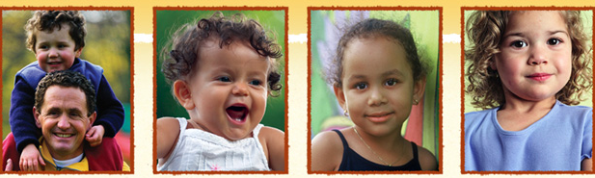
Rock Solid Foundations: Promoting the Social & Emotional Competence of
Young Children
Building Positive Relationships
Notes:
NOTES TO INSTRUCTOR:
Script and instructor notes are included on each slide.
Handouts and videos are labeled with ‘IT’ if from an Infant Toddler module and ‘P’ if from a Preschool module.
3. Although the videos are embedded in this presentation throughout, you must double check them to ensure that they are compatible to your computer. Also a technology consideration is to play within the presentation, the videos must be in the same folder in which the PP is located in order to effectively play. In case you have to reinsert the videos for compatibility purposes, they can be found in the Instructors Resources section under Rock Solid Foundations in both mpg and mp4 formats.
You may choose to insert your name, contact, date, etc. on this slide. Remember to add your own pictures to enhance the points on the slide and engage participants in the topic.
Welcome! I’m so glad that all of you decided to join us today to learn more about Rock Solid Foundations: Promoting the Social and Emotional Competence of Young Children. This training utilizes The Pyramid Model, research based strategies and resources from the Center on the Social and Emotional Foundations of Early Learning (CSEFEL), focusing on the social emotional development and school readiness of young children. I’m sure that everyone here would agree that promoting children’s social and emotional competence and preventing and addressing challenging behaviors is an important topic that touches every early care and education program in every classroom across the country.

Slide 2

Introductions
Your name, program.
What is your role?
What will you do with the information you will learn today?
INSERT PICTURE OF
STATE WHERE DOING
TRAINING
Notes:
First introduce yourself and provide a description of your experiences and the training you received on the CSEFEL modules.
Ask participants to introduce themselves. If you have time, each person can introduce themselves or if time is limited or the group is too large, you can ask them to either introduce themselves to others at their table or get up and find someone they don’t already know and introduce themselves.
(put a ClipArt pic of the state your are working in)

Slide 3

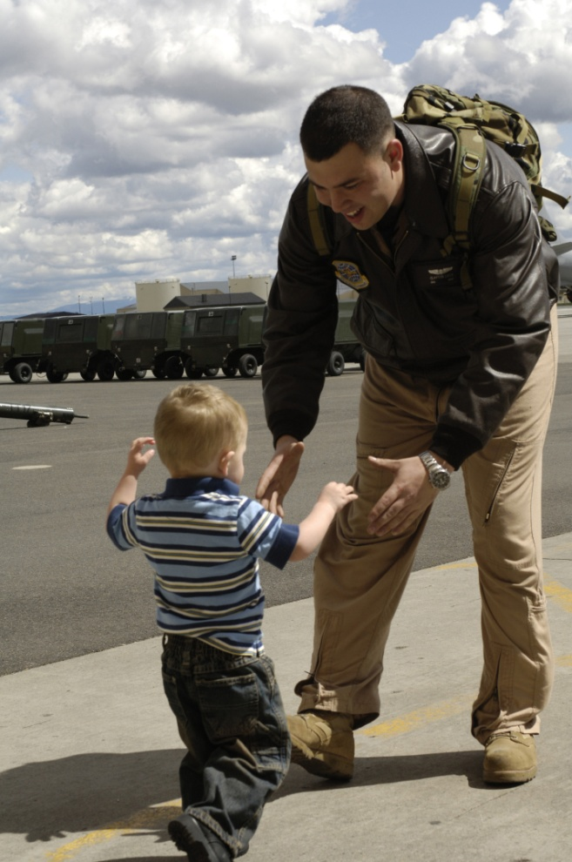
CYTTAP
Allison Silberber, 2007
Notes:
Show 3-minute video which will help illustrate the scope of the Childcare and Youth Training and Technical Assistance project. You will need to download the 3 minute video from the CYTTAP website under the Instructor Resources for Rock Solid Foundations. The video is labeled: Military Extension Partnership Video. Participants may contact Dr. Kathleen Lodl klodl@unl.edu or Dr. Tonia Durden tdurden2@unl.edu for further information or inquiries about the project.

Slide 4
Promote Children’s Success
Create an environment where EVERY child feels good about coming to school
Design an environment that promotes child engagement
Focus on teaching children what To Do!
  Teach expectations and routines
  Teach skills that children can use in place of challenging behaviors
Notes:
We know that supporting children’s social and emotional development is key to school readiness and overall healthy growth and development. Today we are going to introduce several evidence-based practices and resources taken from the Center on the Social and Emotional Foundations of Early Learning (CSEFEL).
Our discussions will include infants, toddlers, and preschool age children. If you currently care for only one of these age groups you will benefit from learning about the entire birth to five developmental spectrum. You will then understand what your children have already achieved and what lies ahead.
Ask participants to name some ways to support children’s social and emotional development then go over the three bullet points.

Slide 5
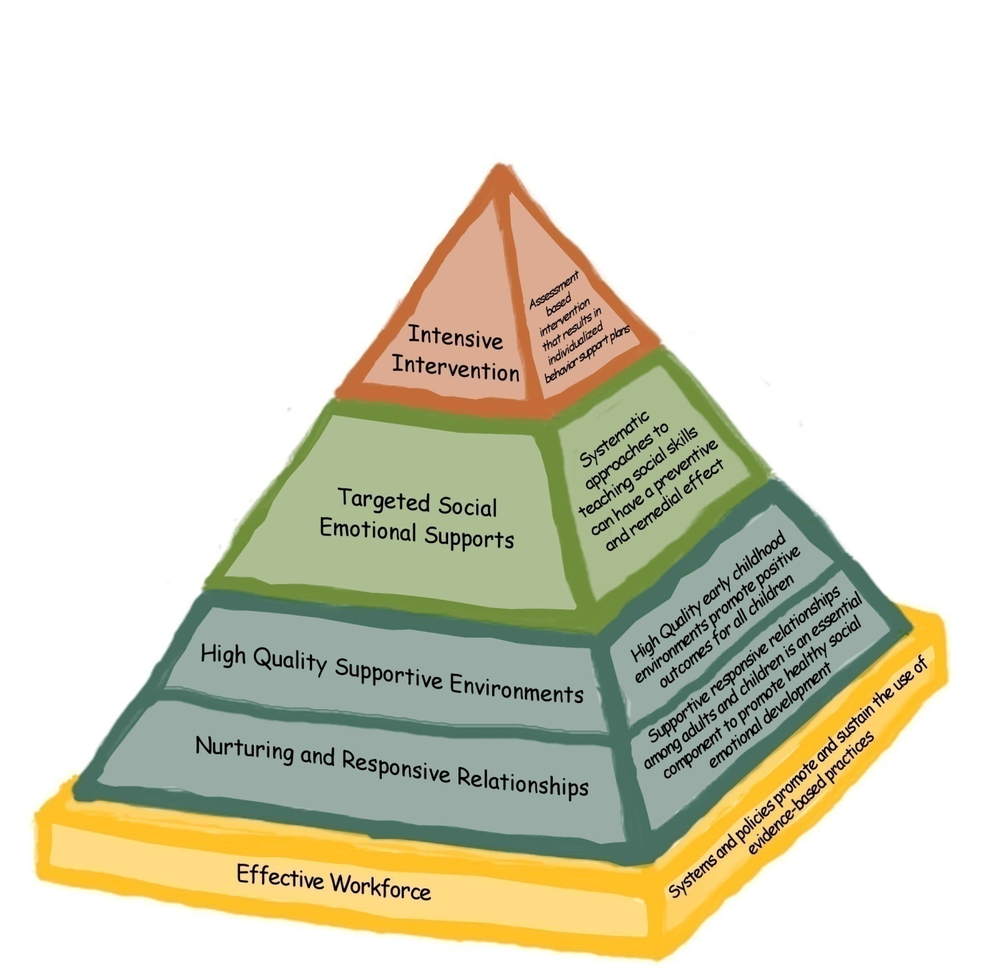
CSEFEL Pyramid Model
Notes:
Introduce the CSEFEL Pyramid.
Along with learning about infant, toddler and preschool development and how to understand individual children, this session will offer strategies for:
creating group care environments and practices that support social emotional well-being of infants, toddlers and preschoolers;
working with families to support the well being of very young children;
problem-solving when behavior is of concern.
In order to understand and respond effectively to behavior that center and family care providers, home visitors, and other professionals and parents experience as challenging, we all need to understand how typical social emotional development unfolds during the first five years.
We also need to spend some time examining our own emotions and responses when children’s behavior is unusual and persists despite our best efforts. The definition of challenging situations or behavior may be different for different caregivers and we will explore that issue.
There are a number of strategies that can be used to support the social emotional development or competence of very young children. The Pyramid is a model that represents components of adult behavior and strategies that parents, caregivers, teachers and other professionals can use to assist children in developing social emotional competence.
The primary focus of the Pyramid is on promotion of social emotional development and prevention of challenging behaviors for all children, moving on to individualized interventions only when the bottom of the Pyramid is in place and children continue to engage in challenging behavior.
Strong relationships form the foundation of the Pyramid and are necessary for everything else we do with young children.
Well designed environments support children’s appropriate behaviors and make it less likely that children will need to engage in challenging behavior. In addition, environments can be designed to help children learn about expectations and promote their engagement and interactions.
The emphasis of this session is on the blue and green levels of the Pyramid.

Slide 6
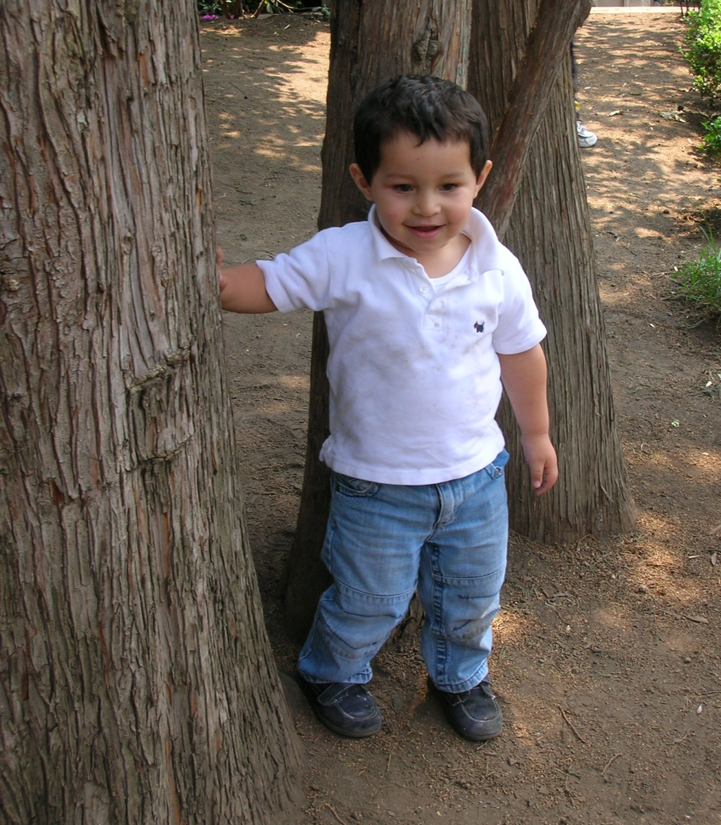
Definitions, Research and Rationale
Notes:
The primary goals of the CSEFEL materials are to promote young children’s social and emotional development and to prevent and address challenging behaviors. Before we get into the materials, it will be helpful to discuss definitions for these terms as well as discuss developmental milestones for young children’s social and emotional development.

Slide 7
CSEFEL Definition of Social Emotional Development
The term social emotional development refers to the developing capacity of the child from birth through five years of age to form close and secure adult and peer relationships; experience, regulate, and express emotions in socially and culturally appropriate ways; and explore the environment and learn - all in the context of family, community, and culture.
Caregivers promote healthy development by working to support social emotional wellness in all young children, and make every effort to prevent the occurrence or escalation of social emotional problems in children at-risk, identifying and working to remediate problems that surface, and, when necessary, referring children and their families to appropriate services.
Adapted from ZERO TO THREE, 2001 HANDOUT: IT 1.2
Notes:
HANDOUT: IT 1.2
For the purposes of this training, we will use the CSEFEL definition of social emotional development for children birth through five years on this slide and your handout.
Ask the participants to read the definition and underline key points as they think about the children in their care.
Lead a discussion by asking participants for their ideas about what each of the phrases means.
You may want to use some of the following ideas:
“Developing capacity” – Children grow and change quickly, gaining more skills in all areas of development: physical, cognitive, and social emotional. Think about the different abilities of a newborn, a 1 year old, 2 year old, 3 year old, 4 year old, and 5 year old.
“Form close and secure adult and peer relationships” – Young children require nurturing relationships with adult caregivers for healthy social emotional development. When adults are loving, responsive and consistent in their care, very young children learn that they are valued and that their world is primarily satisfying and predictable. They learn through these relationships how to interact with their peers. In the first few years they require a lot of support in managing peer relationships.
“Experience, regulate, and express emotions in socially and culturally appropriate ways” – Joy, sadness, and frustration are just some of the emotions that all children experience during their first years. Infants and toddlers watch important adults to figure out how they should feel and act in certain situations. With adult help, they increasingly learn how to control or regulate their emotions so that they don’t get overwhelmed by them. The family’s culture affects the way in which parents interact with their very young children as their values, beliefs, goals, expectations, and resources are expressed in their child-rearing practices.
“All in the context of family, community, and culture” – Young children first learn about relationships and feelings as part of a family. As was just mentioned, culture influences the relationship between children and caregiving adults. Communities, too, play a role in shaping how adults and children interact and how they are supported (or not) through public policies and the availability of resources.
The primary focus will be on developing relationships. One of our most important roles in supporting positive social emotional development with young children is to establish nurturing and trusting relationships. It is through these relationships that infants and toddlers learn about their world and their place in it. They learn that the world is safe and responsive to their needs. They learn to form satisfying relationships with others, to communicate, to face challenges, and to experience and regulate their emotions.
Since relationships are constantly adjusting to changes in development, we need to understand the course of social emotional development. Building positive relationships with both children and parents is essential for a child’s healthy development. Young children observe our relationships and what they observe shapes their expectations for how people treat each other. Relationships are established with each individual child and family and, therefore, look somewhat different with each. Those of us who provide care to young children and their families build our skills in carefully observing the social emotional cues provided to us by the children in order to respond to them with interactions that build responsive, nurturing relationships.

Slide 8
What is Social-Emotional Development?
  The developmentally and culturally appropriate ability to:
Manage Emotions | Relate to Adults
Relate to Peers | Feel Good About Self
Notes:
Source: Jane Knitzer, NCCP
If time permits complete this activity as well.
Share with participants that this definition plays out in many ways. Ask participants to work together to write down things/strategies/activities/ideas that they do to promote children’s social and emotional development in each of the four areas (i.e., manage emotions, relate to adults, relate to peers, and feel good about self.) If needed you can provide an example in each area. This activity gives them a chance to acknowledge the great work they are doing and to hear new ideas from other participants and yourself.
Have them talk in pairs or small groups, jot down their ideas, and then report out. You could have one piece of large chart paper for each area, OR just have each group share 2 of their favorite ideas, etc.
There are many variations of all of the activities. When you are making decisions about how to do an activity take into consideration how much time you have, the understanding level of your participants (you may be aware that your group REALLY needs to spend time on a certain topic), and the engagement of your participants in the topic at hand.
Return to this activity or the wall charts at the end of the day--- do participants have more ideas/strategies to add to the list?

Slide 9
The Developmental Continuum from Birth to 15 months:
Social and Emotional Indicators*
Age Range | Attachment Trust/Security | Self-Awareness/ Identity | Exploration Autonomy/Independence
Infant (Birth to 15 months) | Newborns recognize human language and prefer their own mother's voice Prefer human faces Early social interaction is a smile and mutual gazing Crawls away but checks back visually; calls, and gestures to ensure adult contact Stretches arms to be taken Prefers familiar adults Acts anxious around strangers Uses a blanket or stuffed toy for security and reassurance | Goes from accidentally sucking own hands to carefully watching them Tries to make things happen Hits or kicks things to make a pleasing sight or sound continue Talks to self when alone Prefers to be held by familiar people Imitates adult behaviors Knows own name Understands simple directions | Brings thumb or hand to mouth Tracks mother’s voice Observes own hands Babbles using all types of sounds Uses a few words mixed with babbling to form sentences Tries to keep a knee ride going by bouncing to get the adult started again Shows strong feelings (anger, anxiety, affection)
*This list is a sampling of developmental indicators and is not intended to include all behaviors associated with early development. For infant, there is considerable overlap among areas of growth. The term “mother” is used to represent the primary attachment figure.
HANDOUT I/T1.7
Notes:
Refer participants to Handout IT1.7 where all of the social and emotional milestones for children ages birth to three are listed. Point out a few highlights related to each of the main areas listed. For example, you may want to point out that through our relationships with young children often form attachment and trust (first column). When children have positive attachment relationships, children develop a sense of self-awareness and identity (second column) and are more likely to explore their environment and develop independence (third column). In other words, all of these areas are linked. All of these skills, especially the third column (exploration autonomy/independence) are critical to later success in school and life.
To help participants think about what this actually looks like in their setting, ask them to pair up with another person (preferably someone they don’t know) and talk about what this looks like in “real life.” You may choose to have them pair with a person to talk about a specific age group (i.e., birth to 15 months; 12 months to 2 ½ years, etc) or one of the topics (i.e., attachment; self awareness; exploration).

Slide 10
The Developmental Continuum from 12 months
to 2 ½ years: Social and Emotional Indicators (cont’d)
Age Range | Attachment Trust/Security | Self-Awareness/ Identity | Exploration Autonomy/Independence
Toddler (12 mos. to 2 1/2 years) | Relates to others by exploring things with them Pulls up, stands holding furniture, then walks alone Goes through a phase of clinging to primary caregiver Experiences periods of intense feelings when separating or reuniting with a parent Sees others as a barrier to immediate gratification | Knows can make things happen but is not sure of responsibility for actions Becomes bossy Uses the words me, you, and I Says "No" to adults Explores everything Is sensitive to others' judging behavior | Keeps looking for a toy that is hidden from view Understands many more words than can say Has wide mood swings (for example, from stubborn to cooperative) Wants to do things by self
Adapted with permission from J. Ronald Lally, Abbey Griffin, et al., Caring for Infants and Toddlers in Groups: Developmentally Appropriate Practice (Washington, DC: ZERO TO THREE/The National Center, 1995), pp. 78-79.

Slide 11
The Developmental Continuum from Age 2 ½ - 3 ½ :
Social and Emotional Indicators (cont’d)
Age Range | Attachment Trust/Security | Self-Awareness/ Identity | Exploration Autonomy/Independence
Preschool (2½ to 3½ years) | Is capable of dramatic play Has better control over all aspects of self Needs to practice Needs adult coaching to get along well with others Shows feelings with words and in symbolic play Is more aware that others have feelings Can plan ahead | Is capable of self-evaluation (for example, good, bad, pretty, ugly) Tries to control self (for example, emotions and toileting) Is learning to take turns in conversations Knows a lot about communicating in the style of own culture Can play well with others if the setting is right | Uses names of self and others Can tell others about what happened that day Has much larger vocabulary to express ideas Shows concern for others Classifies, labels, and sorts objects and experiences into groups
Adapted with permission from J. Ronald Lally, Abbey Griffin, et al., Caring for Infants and Toddlers in Groups: Developmentally Appropriate Practice (Washington, DC: ZERO TO THREE/The National Center, 1995), pp. 78-79.

Slide 12
Developmentally Appropriate Behavior for Young Children
Typical Social and Emotional Development
AGE 2.6 | Emotional Understanding: Begins to understand others and their emotions, empathy emerges
 | Social Development: Language development supports more interactions with others, begin to understand the absence of familiar adults
AGE 3 | Emotional Understanding: Understand the cause and effect of their interactions with peers and adults
 | Social Development: Play is more inclusive of peers, dramatic play becomes more sophisticated
Notes:
This slide and the next are expanding the previous information through age 5. Unfortunately we don’t have the same depth of info for this age group that you have on the other slides. However, you can continue the type of discussion where participants come up with examples of what this actually looks like in their home care environment. You could have teams of 2 people choose one age or area to focus on and then have time for sharing/reporting so that everyone can hear the ideas.

Slide 13
Developmentally Appropriate Behavior for Young Children
Typical Social and Emotional Development
AGE 4 | Emotional Understanding: Understand the feelings and desires of others, separate from their own feelings
 | Social Development: Empathy becomes reflexive, children can begin to solve problems independently
AGE5 | Emotional Understanding: Understands how to follow and break rules
 | Social Development: Children can negotiate conflicts, and can respond appropriately to acts of aggression

Slide 14
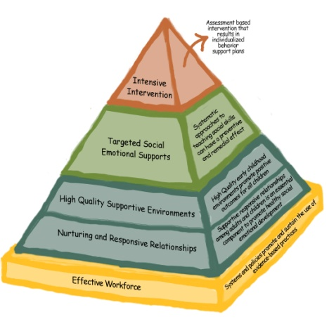
Building on
a Foundation of
Positive Relationships with Children, Families,
and Colleagues
Notes:
As noted in the discussion of the teaching pyramid, relationships form the foundation of the teaching pyramid. If we are not building on a strong foundation, just like a building, our relationships will crumble! Therefore, we have to make an effort to do all that we can to develop positive relationships with children, families, and colleague/coworkers.

Slide 15
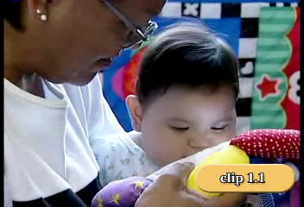
Notes:
1. As an intro to the topic, tell participants that they are going to watch two short video clips (Video IT 1.1) of interactions between very young children and their caregivers. Ask them to observe these interactions and pay particular attention to what the adult does and says.
2. After viewing the videos, ask participants what they noticed about the interactions between these two young children and their adult caregivers. Some possible observations might include: 1st interaction: caregiver holding the child, using warm, comforting voice, following the child’s lead, being responsive, saying the child’s name, supporting learning about eyes, mouth, etc. and 2nd interaction: using an engaging, warm voice, responding to the child’s vocalizations, using good positioning so the child can see the book, etc.

Slide 16
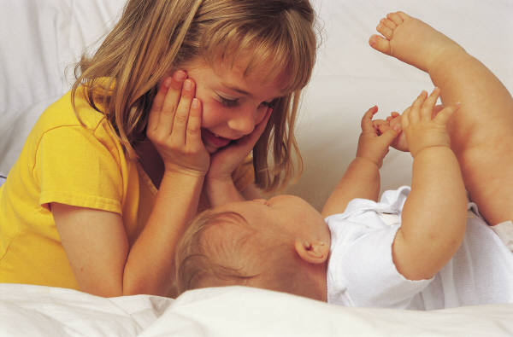
Relationships vs. Interactions
Define interactions
Define relationships
How are they different?
Notes:
Ask participants to talk with those near them and come up with a brief definition for interactions and for relationships. Ask them to consider the differences as they talk. After 3—5 minutes, ask them to share their definitions for interactions and for relationships. You may choose to write these on chart paper.
Typically participants will share something similar to the following for a definition of relationship:
Have emotional connections
• Endure over time
• Have special meaning between the two people
• Create memories and expectations in the minds of the people involved
Make the point that repeated interactions lead to fairly predictable relationships because the infant or young child begins to know how the other person will respond to him or her. This pattern of responses creates the emotional connection that the infant has to the other person. Most adults respond to infants in predictable ways and they, too, form emotional connections when they repeatedly care for an infant.

Slide 17
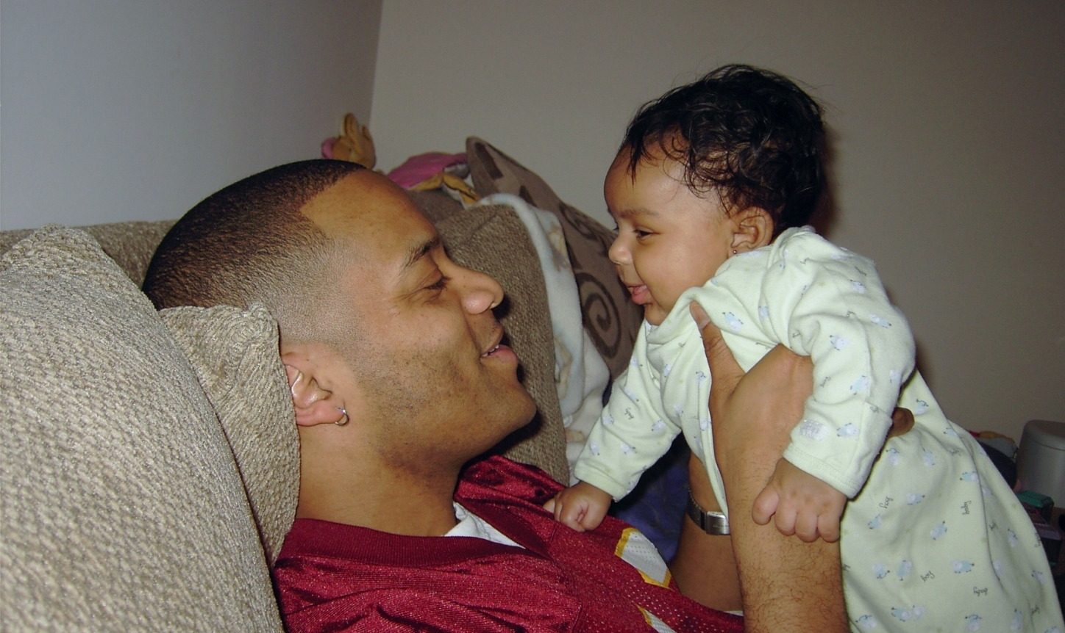
What is the child doing that tells us that s/he is inviting or participating in a relationship?
Notes:
As you show each slide, ask the group to describe what they see the baby or toddler doing that tells us that the child is inviting or participating in a relationship. Ask participants to be as specific as possible about the behavioral cues that the infant or toddler is demonstrating.

Slide 18
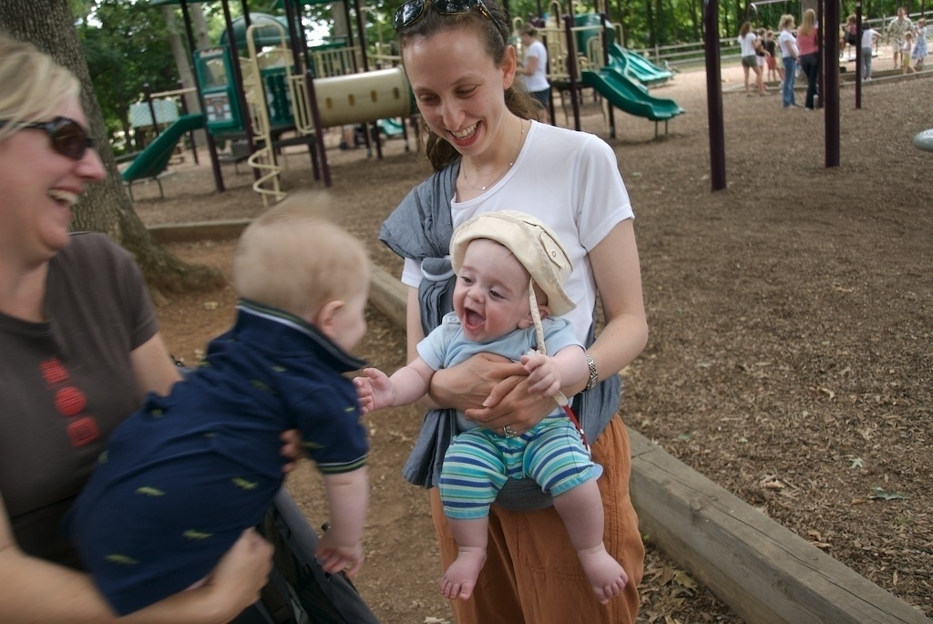

Slide 19
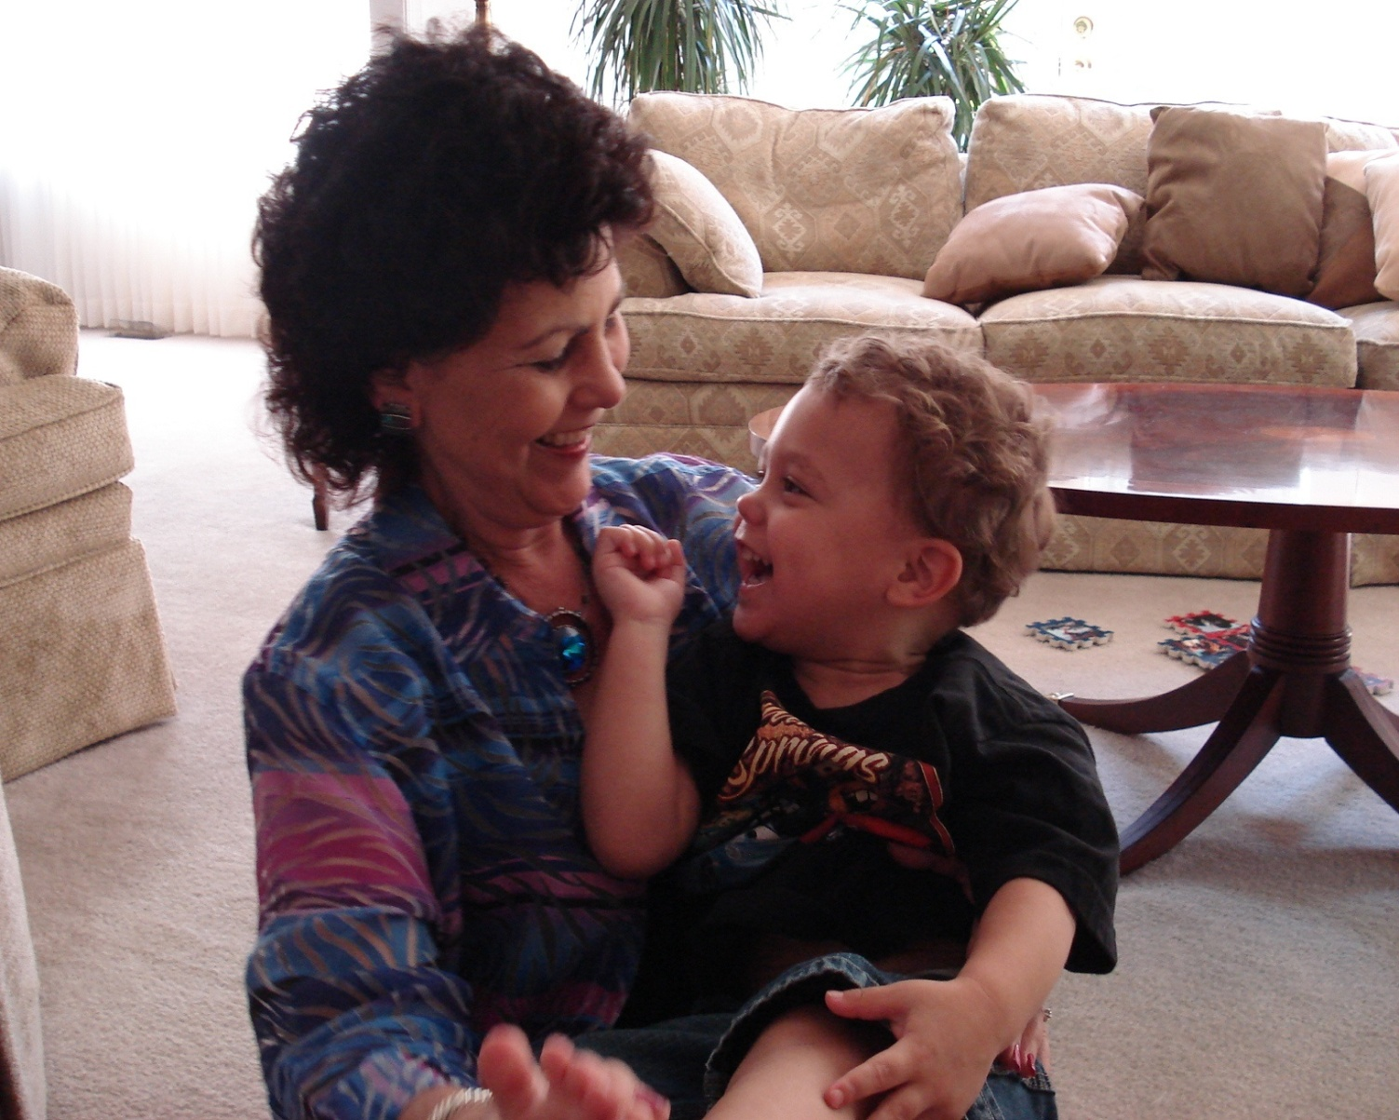

Slide 20
Activity
Complete Reflective Inventory
HANDOUT I/T1.3
Notes:
Suggest to the participants that when we start to talk about children’s relationships, it is helpful to reflect on the role that relationships have played in our own lives.
Use the Reflective Inventory (Handout I/T 1.3) and ask participants to fill it out with a partner at their table.
After participants complete the inventory questions, ask for comments from the group. Use a flip chart to record the feeling words participants offer. Let them know that this activity is included to restate the importance for all caregivers of very young children to develop the capacity to reflect on why they do what they do or why they say what they say to children. Elicit responses that focus on the discovery or awareness of the patterns in their own behavior with children. Point out that our prior relationships create feelings, expectations and behaviors that we bring to each new relationship, including those with babies we care for.
If we have a personal history, going back to our childhood, of basically satisfying and supportive experiences, we are likely to go into new relationships with the expectation that these relationships will also be satisfying and supportive. But, if we have a personal history of emotionally difficult or traumatic experiences, we may find it harder to manage new experiences as adults – particularly stressful ones. Point out that during our childhood, we received all sorts of messages about ourselves. We are likely to send some of those messages on to the children we care for, whether we intend to or not. Sometimes these messages were verbal and sometimes they were non-verbal. If they were received before we could talk and use language, they were pre-verbal experiences.
We are more able to recognize the impact of our personal experiences on the messages we send children in our care if we reflect on how the messages we received in childhood were interpreted by us. As adult caregivers of very young children, it is not easy to be calm and supportive of infants and toddlers when they are behaving in ways that we don’t understand or that are causing problems for them or others – particularly if we have not experienced relationships in our own personal lives that helped us deal with stress. It is important that all of us have the opportunity to think about and discuss the impact of our past experiences on our current behavior and relationships with other adults and children as part of ongoing professional development experiences. Working to become more self aware helps us separate our current feelings and reactions from those generated in past experiences

Slide 21
Three Major Elements of Social Emotional Wellness (Infants/Toddlers)
  Forming close and secure relationships (attachment)
  Experiencing, expressing, and regulating emotions
  Exploring the environment and learning
Notes:
We will now spend time exploring each of these elements and thinking about what this means for us as we work with infants and toddlers.

Slide 22

Forming Close & Secure Relationships: Attachment
Attachment is a pattern of interaction that develops over time as the infant or toddler and caregiver engage
Chart: How do you promote and support secure attachments with children?
Notes:
Point out that when infants feel threatened, they turn to the caregiver for protection and comfort. The caregiver’s consistent, accurate response to the infant’s signal of need, such as crying, helps mold the attachment relationship into a predictable, back and forth pattern of interaction that develops over the first year of life. The infant is, in fact, biologically inclined to use the caregiver as a provider of comfort. We use the term “secure base” to describe the feeling of safety provided to an infant or toddler by a caregiver. For example, you have probably seen a toddler venture off to try something new, but keep looking back to make sure that you (his secure base) are still there and close by if he needs you.
Add that the history created between the infant and the caregiver, as the relationship develops, allows the infant to begin to predict the caregiver’s response to efforts to seek comfort. There are many things we can do in childcare and in supporting families to facilitate the development of strong attachment relationships.
Point out that when we consistently and lovingly meet the needs of infants and toddlers in our care, secure attachments are formed. Children who develop secure attachments to one or more adults are more likely to develop positive social and emotional skills. They know that they can rely on adults to meet their needs, to respond to them, and to comfort them. They feel important and begin to develop a sense of competence and confidence. When we are unpredictable, unresponsive, insensitive, or even threatening, insecure attachments develop. Insecure attachments can make children feel badly about themselves and feel that they aren’t important. They may feel a lack of control over their environment and may struggle to develop positive relationships with others. Secure and insecure attachments are reflective of the quality of the relationships between caregivers and children.
Ask participants: What are some ways you support have the development of secure attachments with children ? List ideas on chart paper.

Slide 23
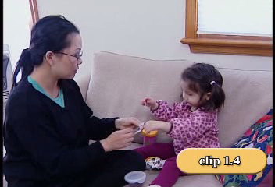
I/T
I/T
Notes:
To demonstrate this topic - - - Ask participants to watch this video clip IT 1.4 and then discuss with those a their table what this mother is doing to support attachment. Possible answers: followed child’s lead, asks child if she needs help, proximity, encourages her, gives the child time.

Slide 24
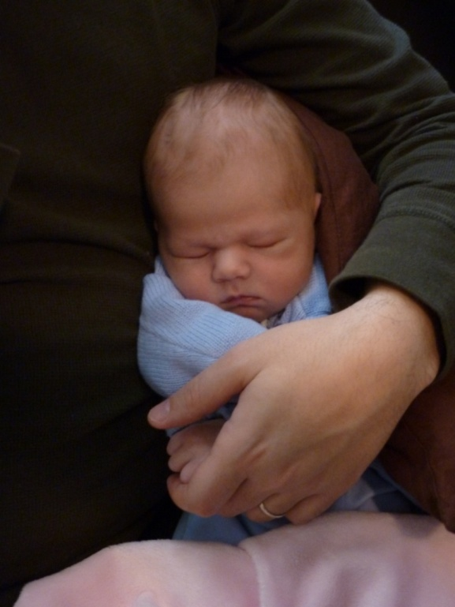
Activity
Attachment Relationships
HANDOUT I/T1.6
Notes:
Following the video observation, ask participants to pair up with another person and to think about and briefly discuss the vignettes on the handout. Each of them should think about the vignettes from their role as child care providers, family care providers, home visitors, therapists or educators, in supporting the infant-parent relationship.
Use Handout I/T 1.6. Attachment Relationships.
After you have allowed a brief time for discussion, ask the group to share their comments about the vignettes from the perspective of their role. Make an effort to have participants from a variety of provider roles participate in the sharing. Use the following to facilitate the discussion about the intentions of the provider:
For Vignette 1, elicit comments such as:
The home visitor can put away her papers, watch, and ask the dad how he knows how to play with his daughter so well.
• By allowing dad to talk about what he is doing and why, she can base her response on his thoughts and follow his lead about what he is doing.
For Vignette 2, elicit comments such as:
She needs to think about what this baby is learning about her ability to protect him and keep him safe, even if she cannot consistently ease the pain in his tummy.
• She can use a sling to keep him against her body while she also provides care for other children.
For Vignette 3, elicit comments such as:
Toddlers can be reassured of their safety across small distances when adults maintain eye contact, smile, show interest in what the toddler is doing, and use words and facial expressions to convey that the situation is safe.

Slide 25
Building Relationships with Children
Why is it important?
The relationships that we build with children, families, and colleagues are at the foundation of everything we do. It is important to build these relationships early on rather than waiting until there is a problem.
Children learn and develop in the context of relationships that are responsive, consistent, and nurturing.
Children with the most challenging behaviors especially need these relationships, and yet their behaviors often prevent them from benefiting from those relationships.
Notes:
As we move into a focus on children ages 3 – 5, remember that the relationships we build with children, families, and colleagues are at the foundation of everything we do with children. We know about the importance of relationships in terms of children’s development and success in school. It is important to build these relationships with all children as a context for supporting their social emotional development and preventing challenging behavior. It will be easier to address challenging behavior if we already have a relationship with the child.
Let’s review 5 facts about the importance of building relationships with children, families and colleagues.
(be sure to point out the key phrases that are underlined)

Slide 26
Building Relationships with Children
Why is it important?
Adults’ time and attention are very important to children, and we need to be sure that we are giving them that time and attention at times other than when they are engaging in challenging behavior.
Parents and other colleagues (such as mental health providers and therapists) are critical partners in building children’s social emotional competence. We should all work together to ensure children’s success and prevent challenging behavior.

Slide 27
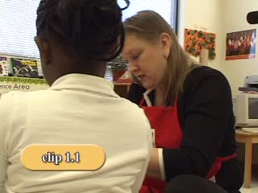
Adult Child Conversations
What does this teacher do to build a relationship with this child?
PS
PS
Notes:
Adult Child Conversations VIDEO PS 1.1 Introduce the video as follows:
This video shows one teacher engaged in conversation with a child as they play. While you are watching, think about what the adult is doing to develop and continue to build a relationship with this child. We will talk about what you saw after the clip.
(To play video, double click on the photograph on the slide. To advance to the next slide, click the down arrow on your keypad.) Note to Presenter: the videos in these modules are designed to provide examples that can be used to describe, reflect, and refine teachers’ practices. They are not intended to be the best way, the only way, or the right way to do something.
What things does the teacher do to build relationships with children?
Participants might comment on how the teacher talked about things the little girl does at the afterschool program and at home, participated in play as a partner, sat at the children’s level, was a responsive listener, asked open-ended questions, voice intonation, was excited, shared stories of her childhood, etc.

Slide 28
Activity:
Connections with Children
CONNECTED
DISCONNECTED
When adults are ___________with children, what does this look like? What do you see? What is happening?
28
Notes:
Introduce the Connected/Disconnected Activity. Use the graphic for connected/disconnected. Show the slide and write responses on chart paper (or have participants share their thoughts but not chart).
Ask the group to think about when teachers are disconnected from children...What would they see in the classroom? What would it look like? Write the ideas on chart paper. Focus on the graphic for connected... What does it look like when teachers have good connections with children? What do you see? What is happening? Write the ideas on chart paper. Make the point that this is what we are seeking to put in place to build relationships with children.

Slide 29


Activity:
Connections with Adults
CONNECTED
DISCONNECTED
When adults are ___________with each other, what does this look like? What do you see? What is happening?
29
Notes:
We should also examine the relationships between adults (including family members) on the team. What does it look like if adults are disconnected in a classroom or in a program? Write ideas on chart paper. What about when adults work together well and are really connected. How can you tell?
How does this affect the children?

Slide 30
Building Positive Relationships with Children
Play
Happy
Grams
Home
visits
Empathy
Notes
home
Time &
Attention
Share
Carolyn Webster-Stratton
Making deposits into children’s emotional banks.
Notes:
Then move into figuring out what we should do to build these relationships.
How do we build relationships with children? Present the metaphor, adopted from the work of Carolyn Webster-Stratton, of a “piggy bank” to illustrate “making deposits into children’s emotional banks” as a way of building positive relationships (Webster-Stratton, 1999).
Instead of a piggy bank, other metaphors might be a garden (growing) or basket (filling). Ask participants to generate other possible metaphors. We make deposits when we do things to build relationships while we make withdrawals when we engage in behaviors that are detrimental to relationship building.
Recap some of the strategies observed in the video, emphasizing the power of play in building positive relationships (e.g., talk about things adults can do at home or in other settings during play: actively engaging in children’s play, participate as a play partner, sit at children’s level, joke and laugh with children, spend time with children doing what they love to do).

Slide 31
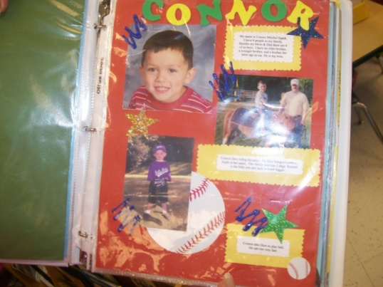
Ideas for Building Relationships
Greet every child at the door by name
Post children’s work around the room
Have a “star” of the week who brings in special things from home and gets to share them during circle time

Slide 32
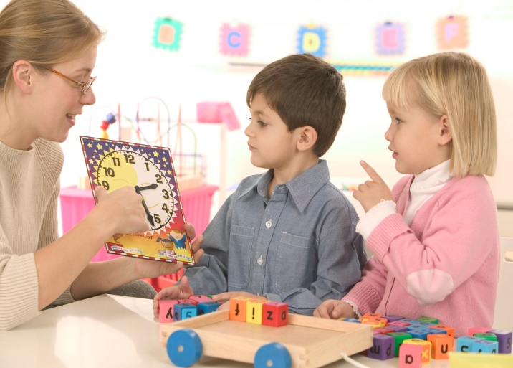
Ideas for Building Relationships
Call a child’s parent in front of them to say what a great day she is having or send home positive notes
Call a child after a difficult day and say,
“I’m sorry we had a tough day today
I know tomorrow is going to be better!”
Give hugs, high fives and thumbs up upon accomplishing tasks

Slide 33
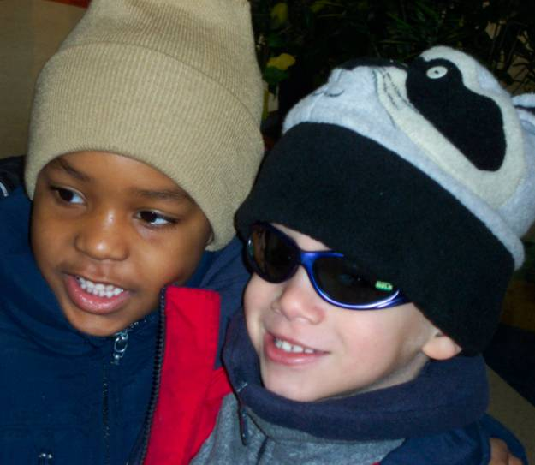
Ideas for Making Deposits
When a child misses school tell him how much he was missed
Write on a t-shirt all the special things about a given child
Find time to read to individual children or a few children at a time

Slide 34

Ideas for Making Deposits
Acknowledge children’s efforts
Find out what a child’s favorite book is and read it to the whole group
Use descriptive, encouraging comments
Play with children, follow their lead
Let children make “All About Me” books and share them at circle time

Slide 35
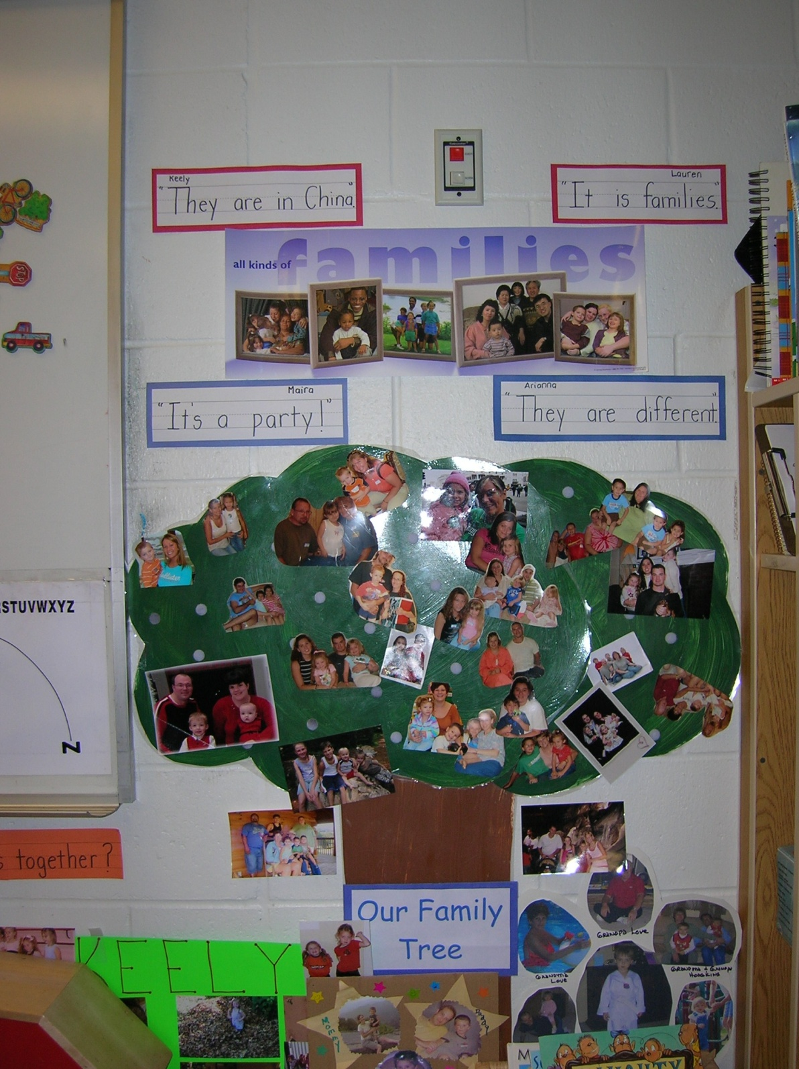
Our Family
Tree
Notes:
How does this family tree help to bridge connections between home and school and build relationships with young children and their families.

Slide 36
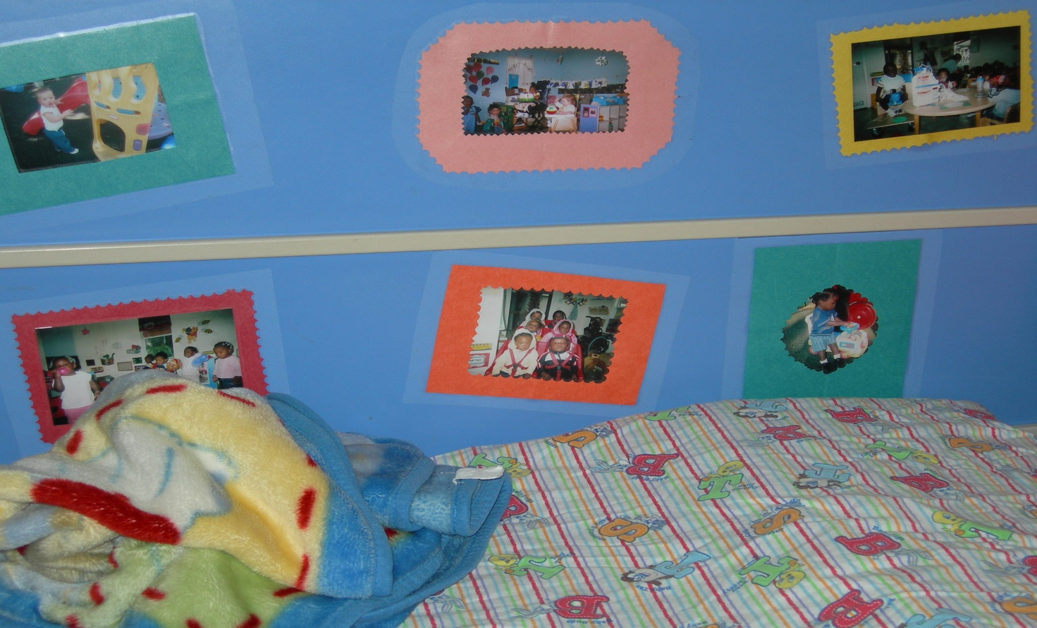
Building Relationships
Notes:
Example of how adults can create relationships with children by bridging home to school through the use of photos from home, and celebrating important events in children’s lives. This home care provider asked parents to bring in pictures of their families to put on the wall near a quiet, cozy area.

Slide 37
Activity Building Relationships
How do you build positive relationships with:
Brainstorm things you could do to build or strengthen relationships with children, families, or other colleagues
Share with the large group
Identify 2-3 things you are going to do to build stronger relationships with children, families, and colleagues
Children | Families | Colleagues
Notes:
Activity: Ask participants to think about all of the ideas they have heard regarding relationships and all of the ideas they currently use. You can use chart paper divided into 3 columns and ask people to share out their ideas, listing them in each column. OR ask small groups to work on this at their table and then you can have a report time. OR put up 3 large chart papers, each with the title of one of these areas. Ask people to put up their favorite ideas during a break or as part of a timed activity. Then everyone can read these and end up with many ideas gathered from everyone. This activity also gives you a chance to see what your participants have learned or what they are already doing in this very important area of relationship building. The following description of this activity gives you even more concrete directions.
Group Activity: Strategies for Building Relationships with Children, Families, and Colleagues
Have participants work with people at their table or select a partner, depending on the size of the group. Give each group markers and chart paper. Assign each group one of the following: (a) children, (b) families, or (c) colleagues. The small groups should brainstorm a list of things they can do to build relationships with children, families, or other colleagues. Give participants about 10 minutes to complete this task. Teams should report back to the large group with examples. Other participants can be encouraged to add to the list. After the groups have reported back, ask them to take 5 more minutes in their small group to answer the following question: “What specific strategies might you use to build a relationship with that one child, family, or colleague who is most challenging to you or who most pushes your buttons?” Have teams report back.
Included below are some examples of the types of things that you might highlight or use to prompt participants to think more broadly about how to build relationships with children:
Pay attention to each individual child.
Joke and laugh with children.
Know what interests each child and talk to the child about that interest.
Respect each child’s approach to situations and people.
Talk to the child seriously when the topic is serious or important to the child.
Ask children to tell you what makes them happy and sad, and respect their feelings.
Show children that you are happy they are there.
Learn and remember personal information about children (e.g., best friend’s name, pet’s name, type of pets, sibling, activities they do outside of school), and use this information in your conversations with them.
Give children genuine choices, and assist them in following through with their choices.
Show respect for children’s cultural, linguistic, and religious beliefs.
Listen to children when they speak to you, and respond appropriately to their questions.
Spend time with children doing what they love to do.
Smile at children.
Respond to children consistently.
Here are some ideas for building relationships with families.
Keep lines of communication open between program and families (e.g., notes, orientation, or phone calls).
Support and encourage parental involvement in activities.
Learn from family members about their children, and home and family life.
Share resources with parents about how to support the child’s social emotional development.
Share positive things the child did at the program (e.g., Happy grams).
Conduct meetings with parents in an environment and time convenient for them.
Assure parents about confidentiality and privacy rights.
Implement activities that bring families together.
Show respect to parents by acknowledging the good things that they are doing with their child.
Ask parents to share their unique resources with your program (e.g., talents, access to other resources).
Here are some ideas for building relationships with colleagues:
Encourage teamwork
Provide support
Build trust among colleagues
Be honest and kind to one another
Respect co-workers’ talents and abilities
Acknowledge accomplishments
Understand and respect each other’s backgrounds
Develop a shared vision, goals, and mission
Have a sense of humor
Build cooperation

Slide 38
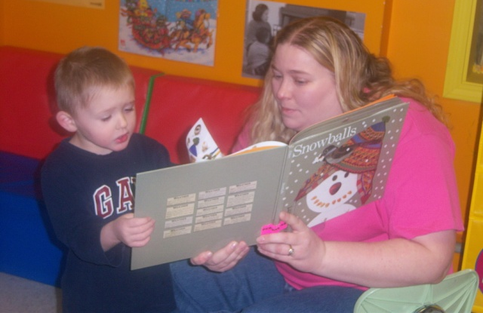
Building Positive Relationships
With Young Children
Gail E. Joseph, Ph.D., & Phillip S. Strain, Ph.D.
University of Colorado at Denver
Handout PS 1.5
Notes:
There are several ways you can use this article Handout PS 1.5 (think about how much time your have to do this):
Ask people to read on their own time and highlight key information.
Divide into small group and assign one page/group. They read their page and prepare a 2 minute report about key facts. Come back to large group and each small group gives their report.
Most of this is information we have already discussed, so the article can be used as a review.
At this point, you should highlight the importance of play as a context for building relationships with children. Explain that play gives the adult an opportunity to follow the child’s lead, comment on what the child is doing, and build positive interactions.
Talk about how easy it is to spend most of our time giving directions and correcting behavior, and point out that play provides a context for focusing on more positive behaviors and interactions and promoting children’s social skills and emotional development.

Slide 39
Temperament in Infants/Toddlers:
How it Impacts on Attachment & Self Regulations
Appears to be biologically based
Fairly constant over time
Affects a child’s reactions to other people and the environment
Goodness of fit
(Wittmer & Petersen, 2006 based on Thomas, Chess, Birch, Hertzig & Korn, 1963)
Notes:
Now let’s talk about the development of Temperament for infants and toddlers. Point out that each baby’s ability to regulate his/her reactions is dependent in part on his/her own biology and in part on how sensitively adults are able to provide support. The biological aspects of regulation are often best understood as temperament. Each child is born with his/her own temperament or individual way of approaching the world. A child’s behavior and approach to the world is shaped by his/her experiences and interactions with the adults in his/her life. Understanding a child’s temperament helps us provide more responsive and sensitive care. Make the point that some aspects of temperament are noticeable from birth and continue throughout life.
Right from the start, all of us have our own unique genetic makeup which includes our nervous system and the way we take in sensory stimulation. For example, some people may like bright lights and loud music. Others prefer the lights low and the music quiet. Some people eat and sleep in pretty regular patterns; others have no pattern at all. The concept of temperament helps us understand that children engage with the world according to their inborn characteristics. Point out that a large part of a caregiver’s job is to adapt his or her own temperament to meet the needs of the infant. For example, a caregiver who likes bright lights and loud music may need to provide less stimulation by talking more softly, reducing the lights and other noise.
The degree to which this is managed is referred to as “goodness of fit.” The sensitive adult adapts his or her behavior in such a way as to not require the infant to make the adaptation, knowing it would be stressful for the infant. The adult seeks to match her behavior to meet the infant’s needs. Make the point that it is also important to understand the impact of inborn, biological differences on the behavior of individual children. Each infant is born with his or her personal style – his or her typical way of approaching or reacting to the world. Learning about temperament can help providers understand more about how these inborn traits play a major role in a child’s pattern of behavior and may eventually have a major influence on how a child feels about him or herself. Understanding an infant’s or toddler’s temperament can help us begin to anticipate what situations may be easy or more difficult for him/her. Understanding an infant’s or toddler’s temperament can also help us be better caregivers.

Slide 40
Temperament Types
Flexible | Fearful | Feisty
Regular rhythms | Adapts slowly | Active
Positive mood | Withdraws | Intense
Adaptability |  | Distractible
Low intensity |  | Sensitive
Low sensitivity |  | Irregular
 |  | Moody
Notes:
There are three temperament types into which many children fall. Each of these three common temperament types is characterized by a trait that may dominate the child’s behavior.
Note to trainer: It is important to point out to participants that we are not trying to “label” children. We are discussing different temperament types to help us become better observers of young children’s needs. It is the caregivers’ responsibility to adjust their own temperament to better match the temperament of individual infants and toddlers.)

Slide 41

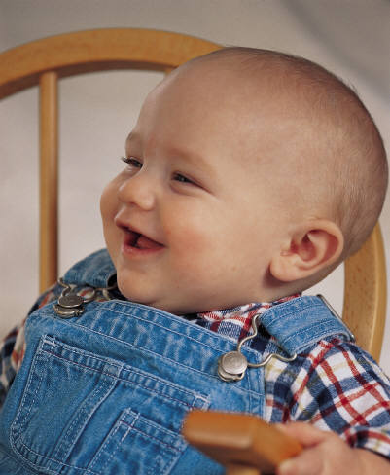
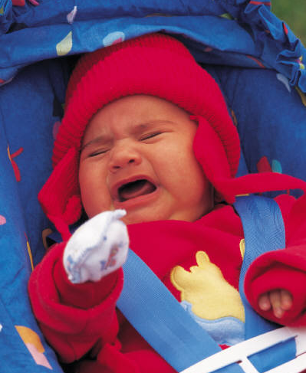
Temperament Types
Flexible, Fearful, and Feisty
istockphoto.com/LisaSvara
http://office.microsoft.com/en-au/default.aspx
http://office.microsoft.com/enau/default.aspx
Notes:
The easy or flexible child is generally easy to care for. She adapts quickly to new situations, is biologically regulated, is optimistic in her approach to new people, and generally has a positive mood. She tends to learn to use the toilet without a lot of difficulty, sleeps through the night, and has regular eating and sleeping patterns. She enjoys new people and places and typically gives mild signals of distress. Even when very unhappy, this child may cry little.
The feisty child is often the opposite. This child may be hard to get to sleep and sleeping and eating patterns are irregular. Toilet training may be more difficult because of irregular bowel patterns. This child may fuss or cry at loud noises, and is often wary of new people and things. He is slow to warm up and may escalate to temper tantrums quickly if frustrated. He may have frequent unhappy moods. This child may be very noisy when even slightly unhappy.
The third group of children often has difficulty in adapting to new people and places. They are often called fearful, shy, or slow-to-warm. Their mood may not be easy to gauge because it takes longer for them to engage with a group or a new activity. Their biological rhythms may or may not be regular.
To help describe a child’s temperament, you might think about:
i. What is the child like?
ii. How calm or active is she?
iii. How does she respond to changes in routines?
iv. How does she deal with a lot of stimulation?
v. How does she let you know she likes
something, dislikes something, etc.?

Slide 42
Temperament Traits
Activity level – always active or generally still
Biological rhythms – predictability of hunger, sleep, elimination
Approach/withdrawal – response to new situations
Mood – tendency to react with positive or negative mood, serious, fussy
Intensity of reaction – energy or strength of emotional reaction
Notes:
How do you think temperament can impact attachment?
Have participants pair up and discuss which traits best represent themselves. When training providers it can also be helpful to have a discussion about the children with traits that the providers may have the hardest time connecting with- could this be part of the problem they are having with the child’s behavior?

Slide 43
Temperament Traits
Sensitivity – comfort with levels of sensory information; sound, brightness of light, feel of clothing, new tastes
Adaptability – ease of managing transitions or changes
Distractibility – how easily a child’s attention is pulled from an activity
Persistence – how long child continues with an activity he/she finds difficult Adapted with permission from Wittmer and Petersen, 2006

Slide 44


Activity:
Considering Temperament Booklet
HANDOUT
I/T 1.5
Notes:
Point out that sometimes it is helpful when we feel challenged by the behavior of a baby or toddler to try to take his/her point of view. Tell participants that they’re going to create a book that may help them look at things from the child’s point of view. Use Handout 1.5 to create the Considering Temperament Booklet.
Ask each participant to think again about a particular child they find challenging (remind participants that they might want to use pseudonym for the child for confidentiality purposes).
a. On the front page (A) of the booklet, ask participants to write down the temperament traits of the child they are thinking about. Have them refer back to the previous slide “Temperament Traits” if helpful. Give participants a minute or so to write.
b. On the second page (B) in the booklet, ask participants to take the child’s point of view and write a sentence or two in which the child describes what it is like to be him or her. The page says, “Let me tell you about me…” Give the participants another couple of minutes to do this.
c. If the participants have difficulty getting started, use examples like “What’s it like to be fussy all day; to be so distractible; to have trouble with every new situation – even predictable, daily transitions?”
d. Next, ask the participants to move on to the third page (C) of the booklet and, again taking the child’s point of view, have them write down something they do that may be hard for the child because of his or her inborn temperament traits. The page says “I don’t like it when you …” Ask participants to fill in the blank and to search their memory for experiences with that child. Give at least 5 minutes for this piece.
e. If participants need examples, say: “Tell me to quit crying” or “Tell me I’m not being nice” or “Ask me in a grumpy voice why I can’t lie still while you diaper me.”
f. On the fourth page (D), the back of the booklet, again from the child’s point of view, ask participants to speculate about what would be helpful to that child. Ask them to finish writing the sentence that might begin “It would help me if you would…” Give participants 3 to 5 minutes for this piece.

Slide 45
Regulation and Stress in
Young Babies
Signs of Regulation | Signs of Stress
Regular, even breathing; warm body temperature; even skin color. | 1. Yawning, drooling, hiccupping; chilled or clammy; pale or blotchy skin.
2. Good muscle tone; can lift arms and legs against gravity. | 2. Poor muscle tone; flails arms and legs loosely or cannot pull up against gravity; trembling.
3. Moves easily (with little comforting) between being awake and being asleep; when awake, is sometimes quiet and alert, sometimes active and alert; can become calm when crying. | 3. Awakens screaming; cannot relax to fall asleep or falls asleep suddenly in the midst of noise and commotion; has trouble focusing when awake.
4. Startles briefly at loud noises but recovers; tolerates handling even during diaper changes. | 4. Startles at noise, light, and touch, and cannot recover.
Notes:
45
Briefly work though the chart that organizes indicators of stress and regulation in young infants.
Here see that the left column shows the behaviors that indicate that an infant is achieving the regulation of his sensory intake and moving toward increased organization of his/her body. The right column, in contrast, lists the physical and behavioral indicators that might demonstrate the infant is experiencing stress. Make the point that when we say stress we mean that the infant is uncomfortable, that his or her body is experiencing sensations or signals such as those from the central nervous system or digestive system, that keep him or her in an uncomfortable or stressful state.
It is important to note that sometimes the same behavior can indicate different things. For example, when a baby hiccups or yawns, it may mean that s/he has just taken milk too fast or is sleepy. These behaviors, though, combined with other signs of stress such as turning away from the caregiver or flailing her arms, can indicate that the baby is stressed and needs help to calm down

Slide 46
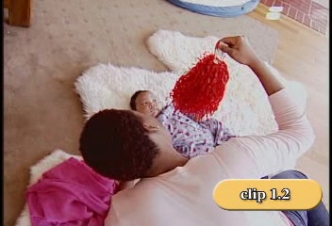
I/T
Notes:
Explain to participants that they are going to watch a video I/T 1.2 of an interaction between a caregiver and infant. Ask them to observe the multiple sensory experiences the infant is encountering, how the infant reacts to the stimuli, and what the adult does to assist the child.
1. After viewing the video, ask participants what they observed. Elicit responses that identify the multiple sensory experiences the infant is encountering as well as the infant’s reaction to the stimuli. Ask participants
what they see the adult doing to assist the infant.
Possible observations might include:
• multiple sensory experiences the infant is encountering – sound of caregiver’s voice, movement of pompom, bright color of the pompom, the feel of the pompom on his skin, sound the pompom makes, etc.
• how the infant reacts to the stimuli – follows pompom with his eyes and head, makes faces, hiccups, moves his legs, vocalizes, blinks eyes, etc.
• what the adult does to assist the child - talks about what she is doing, touches child hands with pompom and moves it away, says – “I think you like the pom-pom,” soft voice, etc.

Slide 47
Strategies for Helping Babies
Self-Regulate
Containing their limbs with swaddling, cuddling, and bringing them close to your chest and heartbeat
Providing something to suck: a pacifier, their own hand, their fingers
Limiting the stimulation in the environment
Helping baby to awaken or to fall asleep with rocking, cuddling, gentle patting, quiet voice, singing, or simple chant
Using a firm, gentle touch
Notes:
Explain that adults help babies to be calm and to be able to quietly pay attention to the things that interest them. In the first months, adults and babies co-regulate, or work together, to help babies learn over time to manage or regulate their reactions.
Point out that generally adults are able to comfort and help babies regulate pretty easily. But for some babies, it is a hard process. It can be helpful to think about different behaviors in terms of regulation and to think about what strategies we might use if regulation is the cause of difficulty for the baby.
Point out that most strategies that help babies self regulate are directed at assisting them to move from one state of alertness to another. The short term goal for the infant is to become more comfortable and less stressed. The long term goal is for the infant to self regulate or for the infant to be able to do what keeps him/herself calm.

Slide 48
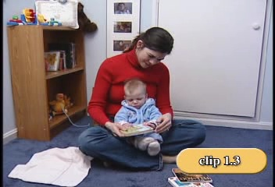
I/T
Notes:
Video I/T 1.3 Ask participants to observe what the baby is doing, what they see the caregiver doing to help the infant regulate himself, and if the caregiver’s efforts are successful. Examples of possible questions and responses are listed below:
• What did you see the baby doing? – chewing on the book, looked at book for a few seconds, fussing, crying, grabbing the book, holding the book, reaching for the book, etc.
• What did you see the caregiver doing to help the infant regulate himself? - explained in a calming voice what was happening, labeled what the child
was doing/feeling, responded to child’s need to chew the book, followed child’s lead, let the child grab and hold the book, talked for the child, etc.
• Were her efforts successful? – child was happy at the end of the interaction when he was chewing on the book, while she was not able to read the book,
she said “that’s so much better (when child was chewing book) – do you want to read another book?”
Elicit the observation that any one strategy does not always work, so we need to observe the infant carefully and, if necessary try several different things. Babies have a lot to learn to manage their bodies, so they require a lot of support and
patience

Slide 49

Children’s Social & Emotional Development within the Context of Families
Notes:
Share with participants that when working with young children, it is critical to collaborate with parents to best meet the needs of the child.

Slide 50
Each baby is born into a unique family that has its own culture and history, its own strengths, and its own way of coping with stress and adversity.
(Parlakian & Seibel, 2002)
Notes:
Read aloud or have a participant read aloud each of the two statements on this slide and the following slide. Make the point that it is within their families that infants and toddlers learn about their culture and experience relationships that influence their sense of who they are and who they will become. Because most of us are trained to focus on children, we may not necessarily think about the importance of healthy parent-caregiver relationships. We all have culture and our cultural identity is made up of many aspects of our lives. Culture influences our values, attitudes, beliefs, and assumptions about caring for and teaching young children. It isn’t static, however, and may change with new experiences. The most important influence on how family members parent their children is their own experiences with relationships as children. Culture is one aspect of that influence. That’s why it is so important to reflect on our own experiences in being parented. Without reflecting on our own upbringing, we may, without realizing it, adopt parenting or caregiving practices that did not feel good to children and that do not help us feel good about ourselves. It is important to understand what infants and toddlers learn in their relationships with family members and their culture that they bring to their interactions with teachers and peers. This helps us understand who children are and why they behave as they do. As early childhood providers, we need to be aware of cultural differences among families and colleagues and learn constructive ways of talking about and resolving differences or misunderstandings. Even our briefest contacts with parents can be helpful in building connections of support, needed information and guidance.

Slide 51
Families have the most continuous and emotionally charged relationship with the child. Infants and toddlers learn what people expect of them and what they can expect of other people through early experiences with parents and other caregivers.
        (Day & Parlakian, 2004)

Slide 52
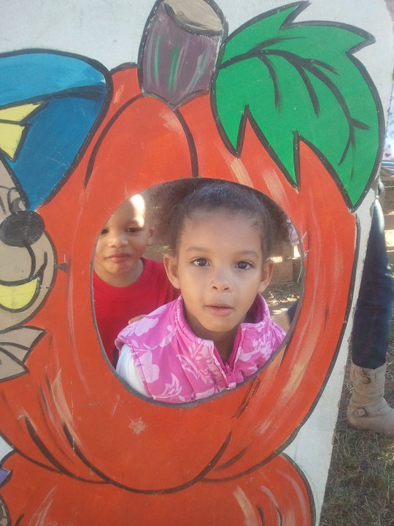
Activity
Learning About, Expressing, and Managing Emotions
HANDOUTS I/T 1.9 & I/T 1.10
Notes:
HANDOUTS IT 1.9 and IT 1.10. Have participants read Vignettes 1 and 2.
We will be doing an activity to build on the ideas we just discussed concerning families and culture. Read the vignettes to yourselves and note responses as you read.
Develop a discussion with the group about each question on the handout for Vignette 1 by beginning with a request for participant to offer some of their responses. Move onto Vignette 2 and do the same.
As participants offer responses, facilitate the discussion to cover the following points:
Vignette 1. Elicit responses that explore the possibilities for:
Lei’s cultural group
Heather’s cultural group
The values the home environment expresses
Lei’s family culture
Lei’s influence, because of her family culture, on her boys
Boys’ behavior in school may be similar to how they behave at home or they may use school to experiment outside the norm at home
Norms for behavior in school may affect the boy’s behavior at home. Lei’s reaction to the changes will be important
Supporting the children when such differences occur
How alike or how different from one another the boys are may reflect individual differences
What specifically the boys have been taught at home about the management of emotions, animation or intensity of emotions, volume of speech, expression of emotion
Values about all of the above are heavily influenced by the family culture
Ways that Lei and Heather can communicate about all of the above. Continued…

Slide 53


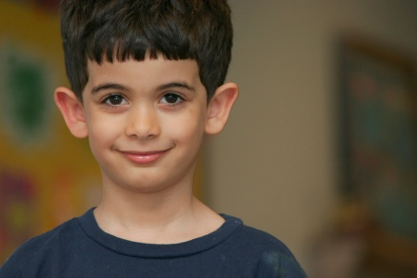

Activity
Notes:
As participants offer responses, facilitate the discussion to cover the following points:
Vignette 2. Elicit responses that explore the possibilities for:
The differences in behavior as a reflection of the issues each family may be dealing with, the parent’s ability to cope, as well as each family’s cultural background.
The behavior of each child and how a wide range of behaviors may be based on different circumstances
Myra may express a healthy range of emotions from being very sad to being very happy
Haniya may experience difficulty expressing strong emotions and might tend to avoid adults and peers. She may also show anger because her emotional needs have not been met. She may focus more on toys than people
Tia may want to stay close to the adults in the program and hesitate to play with peer
Issues of how behavior in the group is managed in the light of the family problems
The impact on the various relationship: teacher/parents, child/peers, teacher/child
Trust with caregivers in out-of-home environments is important regardless of family issues and culture
Children having their needs met in out-of-home environments
Experiencing a range of emotion and its importance for social emotional wellness
Influences on a family’s relationship with their children
Point out that there are many influences that interact with a parent’s experience of emotions and relationships that impact on how they interact with their children.

Slide 54
Factors That Create Challenges for Families
Poverty
Nonflexible work situations
No maternal or paternal leave
Little support from other family members or neighbors
Challenging relationships with their own families
Substance abuse
Domestic violence
Notes:
Factors that Create Challenges for Families.
There are many factors that can negatively impact the ability of families to function well and interact effectively with their children. Those on the list are known to have a negative impact on the social emotional development of young children.
Read each factor aloud.
Ask the participants if they have additional challenges they would like to add to the list. Write these ideas on the FLIP CHART.

Slide 55

Activity
Working with Families Inventory
I/T HANDOUT 1.11
Notes:
Handout 1.11 Working with Families Inventory (Wittmer & Petersen, 2006). The purpose of this activity is to give participants an
opportunity to think more about how they work with the families of the infants and toddlers they serve. Ask participants to take into consideration the cultural issues and challenges that we just discussed as they reflect on their practices.
Hand out the Inventory and ask participants to complete it with a partner by checking the bulleted items they feel they currently do in their program. Instruct the participants to put an x on the bullets they feel they would like to work on in their program. Ask participants to discuss, with their partner, the ways in which they can improve their practice with families of the children in their programs. They can make notes of the ideas for improvement on the Inventory.

Slide 56

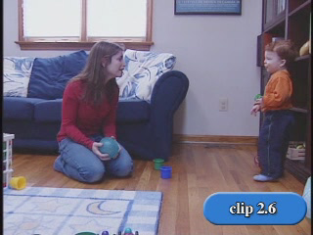
Notes:
VIDEO CLIP IT 2.6. Working in Partnership with Families
Families play a huge role in supporting social emotional literacy in very young children. It is within the family that children first begin to learn to read other people’s responses to their feelings and behaviors.
From a very early age, children learn about how emotions can be communicated by the ways they are expressed by family members.
Children learn about acceptable social emotional expression not only from what family members say but also from their facial expressions and body language.
When parents talk to their babies and toddlers and then pause for a response, they send a message to the child that they are interested in his response. Here is an example of a parent who asks questions and listens to the responses of her toddler as they play together.
Show Video IT 2.6.
When the baby responds and the parent mirrors the baby’s tone and demeanor and responds in turn, the baby learns that he is being heard and that what he has to “say” is important.
The baby learns that his efforts to communicate, initially through coos, grunts, and crying and then increasingly through words, are important to the adults he cares about. This “dance” of communication tells him that he is worthy of attention and that his parents will respond to his efforts to communicate.
This, of course, is not always the situation that babies and toddlers encounter in their families. The challenges that families face as a result of poverty, drug abuse, family violence, social isolation, and other stressors may make them less than responsive to the social emotional needs of infants and toddlers. In such cases, infant-toddler caregivers can play a very important role in partnering with and supporting these families to better meet the needs of their young children.
In order to offer the most support to the social emotional development of infants and toddlers we need to first form an alliance with the child’s parents.
Our role is to assume that each parent wants the best for his or her child and to respect the expertise parents have about their children.
An indication that you see yourself in the role of a loving secondary attachment figure rather than in the role of the expert or teacher may be helpful as you work to develop a bridge between the practices in the home and the practices in the care setting.
The same skills used to develop relationships with young children are used to develop relationships with their parents. The development of respect and trust between parents and providers of child care or home visitation services may present the most challenging aspects of relationship building.

Slide 57
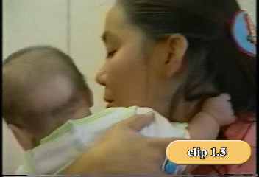
I/T
I/T
Notes:
Video Clip I/T 1.5 Another example for participants to consider the importance of families to the caregiver as she works on behalf of the very young children in her care.

Slide 58
Activity
  Vignettes: Supporting
  Parent-Child Relationship
HANDOUTS IT 2.10, IT 2.11, IT 2.12
Notes:
ACTIVITY: Vignettes: Supporting Parent-Child Relationships.
Distribute HANDOUTS IT 2.10, IT 2.11, IT 2.12.
Divide the large group into smaller groups of 4 to 6. In general the goal of this exercise is to encourage the participants to consider the fact that there may be multiple explanations for the behaviors we see between parents and children.
Our goal is to partner in such a way that we will be able to understand both the children and the parents.
Take a few minutes to read the vignettes and to think about how caregivers could help support the parents in the vignettes in ways that might enhance the parent’s long term ability to attend to their children’s social emotional development.
Ask that the small groups discuss a vignette and answer the questions.
Bring the large group back together and develop a discussion with the total group about the role of the caregiver with the family in each vignette.
Write out responses on the FLIP CHART.
The following examples of responses may be used to guide the discussion about parent partnerships.
Refer to script for vignettes.

Slide 59
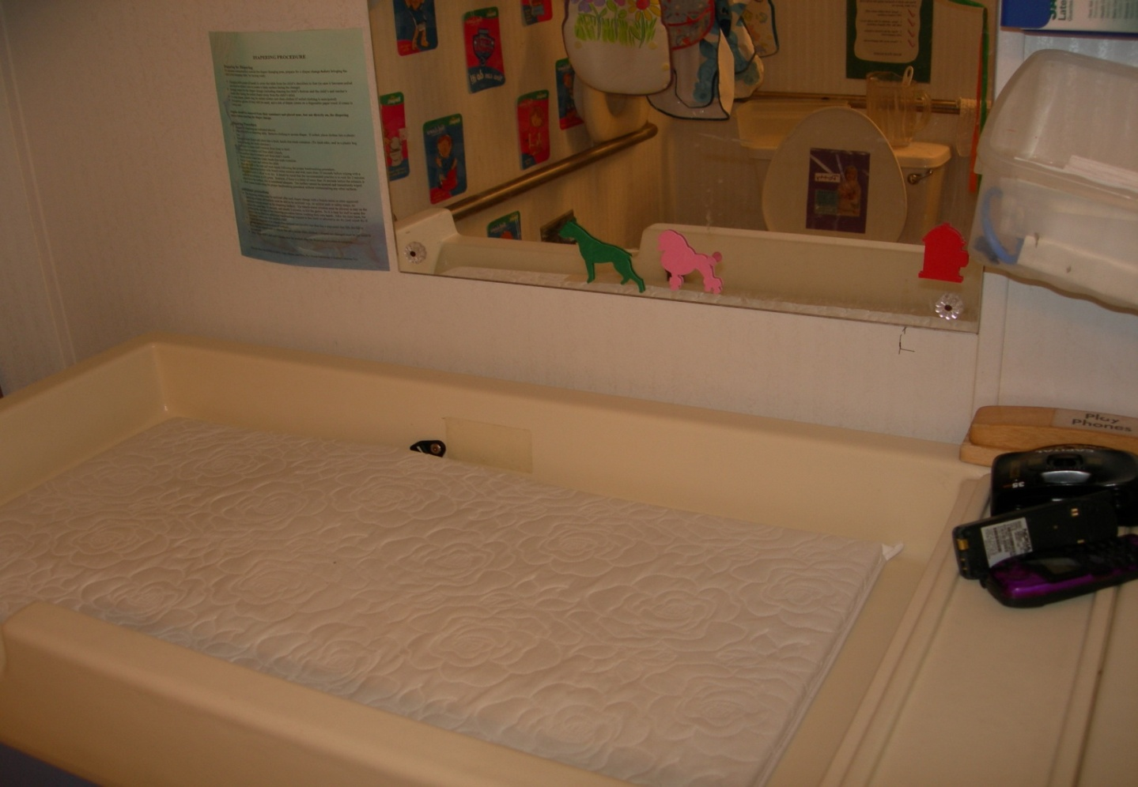
Building Relationships
Notes:
This slide shows a mirror near the changing table-a way to build relationships with children during diaper changing. Here are some ideas for building relationships with families.
Keep lines of communication open between program and families (e.g. notes, orientation, or phone calls).
Support and encourage parental involvement in activities.
Learn from family members about their children, and home and family life. Share resources with parents about how to support the child’s social emotional development.
Share positive things the child did at the program (e.g. Happy grams).
Conduct meetings with parents in an environment and time convenient for them.
Assure parents about confidentiality and privacy rights.
Implement activities that bring families together.
Show respect to parents by acknowledging the good things that they are doing with their child.
Ask parents to share their unique resources with your program (e.g. talents, access to other resources).

Slide 60
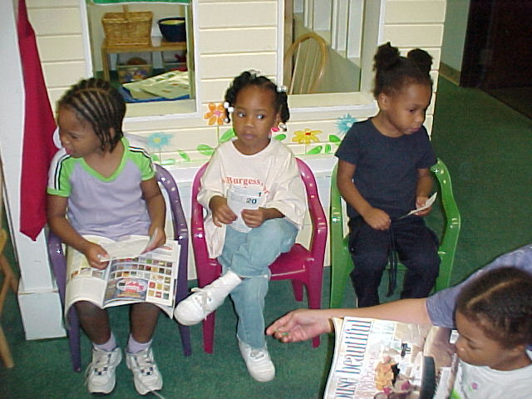
Pulling it all Together!
Notes:
Pulling it all together
Now we have come to the conclusion of our face-to-face training together.
Let’s take a moment to reflect on a few key take home thoughts.

Slide 61
Major Messages to Take Home
Attachment is a pattern of interaction that develops over time as young children and caregivers engage and form an emotional bond
Caregivers help children express emotion; develop emotional regulation; and form close, secure relationships
Develop a pattern of positive interactions with young children to enhance the attachment relationship
Notes:
Review the following take home message:
Attachment is a pattern of interaction that develops over time as young children and caregivers engage and form an emotional bond
Caregivers help children express emotion; develop emotional regulation; and form close, secure relationships
Develop a pattern of positive interactions with young children to enhance the attachment relationship

Slide 62
Major Messages to Take Home
Relationships are different from interactions. However, positive interactions over time lead to the formation of a good relationship with young children
Early social emotional wellness develops within the context of relationships
The relationships we build with children, families and colleagues is the foundation of everything we do with children
Notes:
Major Messages to Take Home:
Read each message and remind participants of the importance of their role in making this happen!
Relationships are different from interactions. However, positive interactions over time lead to the formation of a good relationship with young children
Early social emotional wellness develops within the context of relationships.
The relationships we build with children, families and colleagues is the foundation of everything we do with children

Slide 63
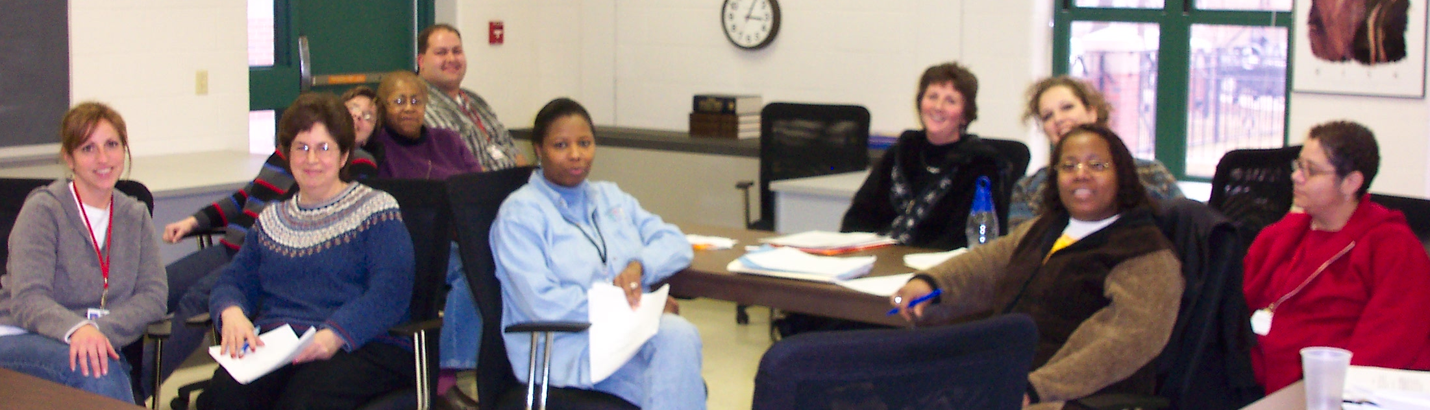
If there is anything that we wish to change in the child, we should first examine it and see whether it is not something that could better be changed in ourselves.
Carl Jung – psychiatrist
Notes:
Have participants read the quote then share with an elbow partner how this quote is a powerful summary of the information presented in this training. Discuss partner responses.

Slide 64
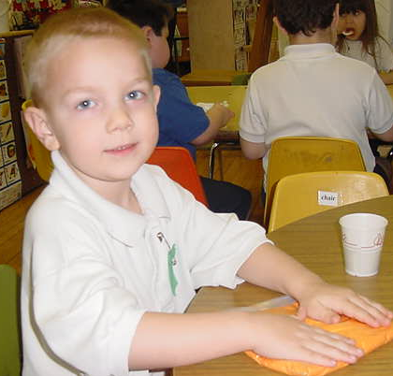
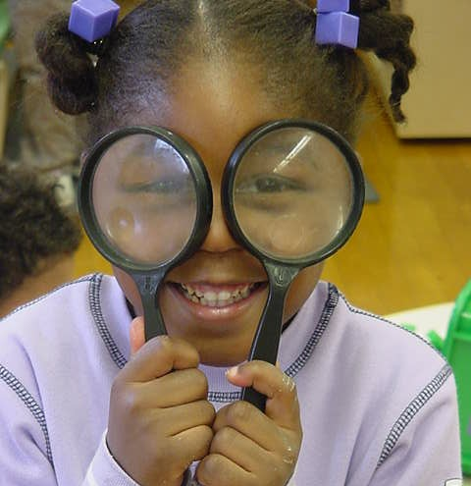
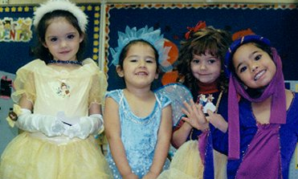
Be the change you wish to see in the world.
Mahatma Ghandi
Review your Personal Action Plan
Notes:
Action Planning Activity.
Have participants complete their Action Plan Form, filling in the grid with ideas of changes they want to make in their early childhood settings as a result of today’s session, as well as methods for evaluating their progress in making these changes.
Ask if anyone is willing to share some ideas that they hope to implement “back home.” Encourage a few participants to share ideas gleaned from today’s session.

Slide 65
Resources
Childcare and Youth Training and Technical Assistance project: http://www.extension.unl.edu/web/child/cyttap
Better Kid Care: http://betterkidcare.psu.edu/
CSEFEL : http://csefel.vanderbilt.edu/
Notes:
Review each of the resources and if time permits visit the corresponding website.
Be sure to point out the following key characteristics of each resource:
CYTTAP website: Visit website, click on Rock Solid Foundations Link. Additional training resources available as well as information on the project.
BKC: visit website to show how to sign up for the newsletter as well as how to access the online learning modules and resources that have been developed.
CSEFEL: Again explain how this training selected pieces of the more comprehensive program of CSEFEL. Therefore if they would like additional resources, materials, information and strategies they can visit the CSEFEL website.

Slide 66
Evaluation
Notes:
Evaluation: Thank participants again for their time and ask them to complete the evaluation form. However there is an option to complete the evaluation online. Link will be provided. Details about the evaluation procedures will be outlined and can be accessed on the CYTTAP website under instructor resources/Rock Solid Foundations. (If credits or certificates are available do not provide until evaluation is submitted. Same applies for the “incentive” item we provide).

Slide 67
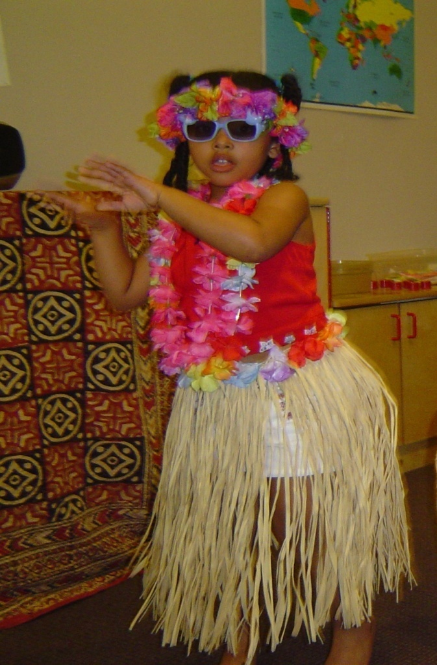
¡Gracias!
Thanks
beaucoup
شكرا
Notes:
Express your gratitude in having the opportunity to share with them the CSEFEL resources and strategies.
Remind participants as stated at the beginning of the presentation that this training is the beginning of ongoing support and resources.
Explain that the CYTTAP team will be offering trainings for the next two years and look out for future training opportunities.

