Slide 1
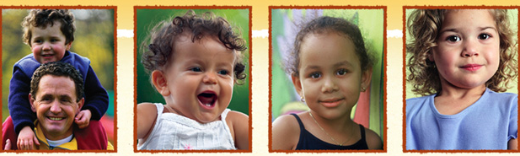
Rock Solid Foundations: Promoting the Social & Emotional Competence of
Young Children & Preventing Challenging Behaviors:
Friendship and Play Skills
Notes:
NOTES TO INSTRUCTOR:
Script and instructor notes are included on each slide.
Handouts and videos are labeled with ‘IT’ if from an Infant Toddler module and ‘P’ if from a Preschool module.
3. Although the videos are embedded in this presentation throughout, you must double check them to ensure that they are compatible to your computer. Also a technology consideration is to play within the presentation, the videos must be in the same folder in which the PP is located in order to effectively play. In case you have to reinsert the videos for compatibility purposes, they can be found in the Instructors Resources section under Rock Solid Foundations in both mpg and mp4 formats.
You may choose to insert your name, contact, date, etc. on this slide. Remember to add your own pictures to enhance the points on the slide and engage participants in the topic.
Welcome! I’m so glad that all of you decided to join us today to learn more about Rock Solid Foundations: Promoting the Social and Emotional Competence of Young Children. This training utilizes The Pyramid Model, research based strategies and resources from the Center on the Social and Emotional Foundations of Early Learning (CSEFEL), focusing on the social emotional development and school readiness of young children. I’m sure that everyone here would agree that promoting children’s social and emotional competence and preventing and addressing challenging behaviors is an important topic that touches every early care and education program and every classroom across the country.

Slide 2

Introductions
Your name, program.
What is your role?
What will you do with the information you will learn today?
INSERT PICTURE OF
STATE WHERE DOING
TRAINING
Notes:
First introduce yourself and provide a description of your experiences and the training you received on the CSEFEL modules.
Ask participants to introduce themselves. If you have time, each person can introduce themselves or if time is limited or the group is too large, you can ask them to either introduce themselves to others at their table or get up and find someone they don’t already know and introduce themselves.
(put a ClipArt pic of the state your are working in)

Slide 3

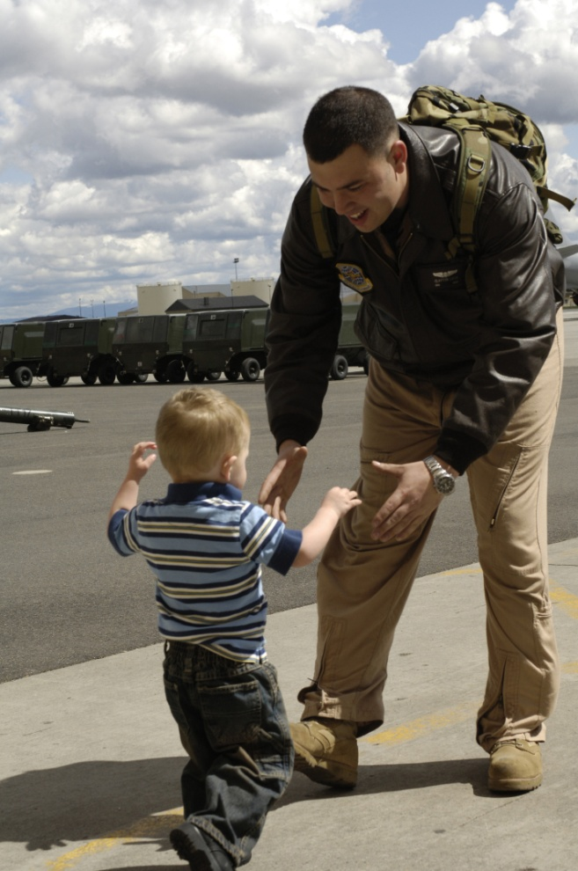
CYTTAP
Allison Silberber, 2007
Notes:
Show 3-minute video which will help illustrate the scope of the Childcare and Youth Training and Technical Assistance project. You will need to download the 3 minute video from the CYTTAP website under the Instructor Resources for Rock Solid Foundations. The video is labeled: Military Extension Partnership Video. Participants may contact Dr. Kathleen Lodl klodl@unl.edu or Dr. Tonia Durden tdurden2@unl.edu for further information or inquiries about the project.

Slide 4
Promote Children’s Success
Create an environment where EVERY child feels good about coming to school
Design an environment that promotes child engagement
Focus on teaching children what To Do!
  Teach expectations and routines
  Teach skills that children can use in place of challenging behaviors
Notes:
We know that supporting children’s social and emotional development is key to school readiness and overall healthy growth and development. Today we are going to introduce several evidence-based practices and resources taken from the Center on the Social and Emotional Foundations of Early Learning (CSEFEL).
Our discussions will include infants, toddlers, and preschool age children. If you currently care for only one of these age groups you will benefit from learning about the entire birth to five developmental spectrum. You will then understand what your children have already achieved and what lies ahead.
Although this is a six hour training, we intend to continue to provide you with online support as you implement these strategies and practices in your center or home. We’ll begin with exploring how to promote children’s success.
Ask participants to name some ways to support children’s social and emotional development then go over the three bullet points.

Slide 5
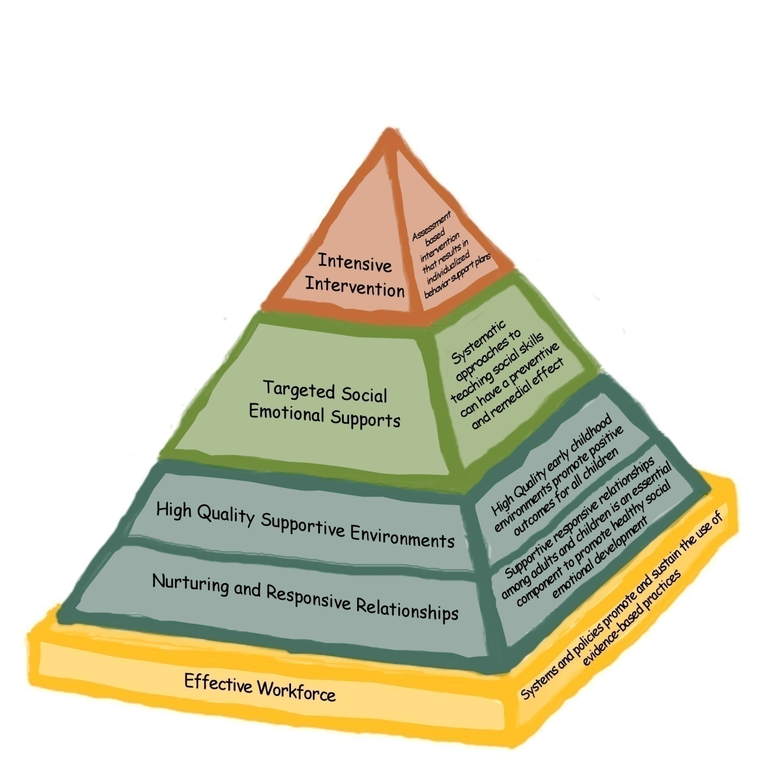
CSEFEL Pyramid Model
Notes:
Introduce the CSEFEL Pyramid.
Along with learning about infant, toddler and preschool development and how to understand individual children, this session will offer strategies for:
creating group care environments and practices that support social emotional well-being of infants, toddlers and preschoolers;
working with families to support the well being of very young children;
problem-solving when behavior is of concern.
In order to understand and respond effectively to behavior that center and family care providers, home visitors, and other professionals and parents experience as challenging, we all need to understand how typical social emotional development unfolds during the first five years.
We also need to spend some time examining our own emotions and responses when children’s behavior is unusual and persists despite our best efforts. The definition of challenging situations or behavior may be different for different caregivers and we will explore that issue.
There are a number of strategies that can be used to support the social emotional development or competence of very young children. The Pyramid is a model that represents components of adult behavior and strategies that parents, caregivers, teachers and other professionals can use to assist children in developing social emotional competence.
The primary focus of the Pyramid is on promotion of social emotional development and prevention of challenging behaviors for all children, moving on to individualized interventions only when the bottom of the Pyramid is in place and children continue to engage in challenging behavior.
Strong relationships form the foundation of the Pyramid and are necessary for everything else we do with young children.
Well designed environments support children’s appropriate behaviors and make it less likely that children will need to engage in challenging behavior. In addition, environments can be designed to help children learn about expectations and promote their engagement and interactions.
The emphasis of this session is on the blue and green levels of the Pyramid.

Slide 6
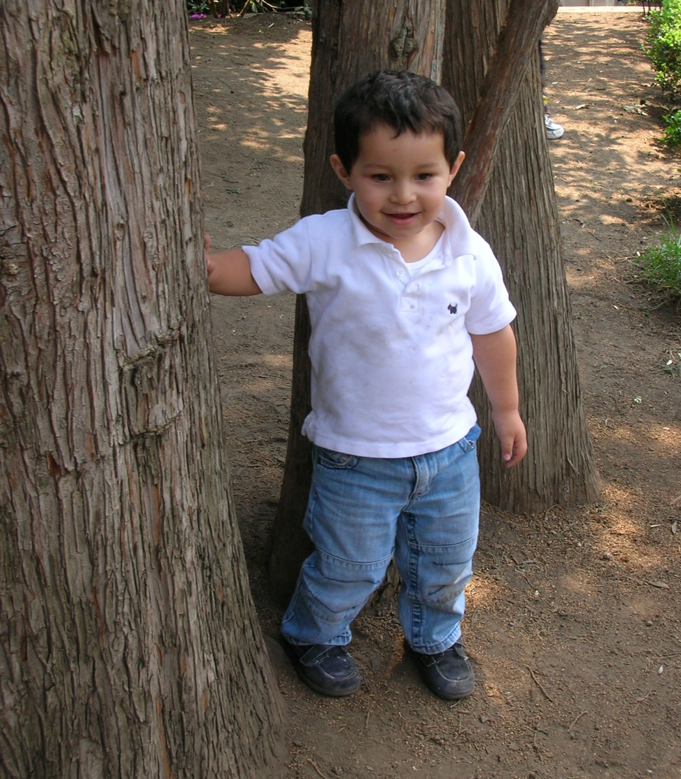
Definitions, Research and Rationale
Notes:
The primary goals of the CSEFEL materials are to promote young children’s social and emotional development and to prevent and address challenging behaviors. Before we get into the materials, it will be helpful to discuss definitions for these terms as well as discuss developmental milestones for young children’s social and emotional development.

Slide 7
CSEFEL Definition of Social Emotional Development
The term social emotional development refers to the developing capacity of the child from birth through five years of age to form close and secure adult and peer relationships; experience, regulate, and express emotions in socially and culturally appropriate ways; and explore the environment and learn - all in the context of family, community, and culture.
Caregivers promote healthy development by working to support social emotional wellness in all young children, and make every effort to prevent the occurrence or escalation of social emotional problems in children at-risk, identifying and working to remediate problems that surface, and, when necessary, referring children and their families to appropriate services.
Adapted from ZERO TO THREE, 2001
HANDOUT: IT 1.2
Notes:
HANDOUT: IT 1.2
For the purposes of this training, we will use the CSEFEL definition of social emotional development for children birth through five years on this slide and your handout.
Ask the participants to read the definition and underline key points as they think about the children in their care.
Lead a discussion by asking participants for their ideas about what each of the phrases means.
You may want to use some of the following ideas:
“Developing capacity” – Children grow and change quickly, gaining more skills in all areas of development: physical, cognitive, and social emotional. Think about the different abilities of a newborn, a 1 year old, 2 year old, 3 year old, 4 year old, and 5 year old.
“Form close and secure adult and peer relationships” – Young children require nurturing relationships with adult caregivers for healthy social emotional development. When adults are loving, responsive and consistent in their care, very young children learn that they are valued and that their world is primarily satisfying and predictable. They learn through these relationships how to interact with their peers. In the first few years they require a lot of support in managing peer relationships.
“Experience, regulate, and express emotions in socially and culturally appropriate ways” – Joy, sadness, and frustration are just some of the emotions that all children experience during their first years. Infants and toddlers watch important adults to figure out how they should feel and act in certain situations. With adult help, they increasingly learn how to control or regulate their emotions so that they don’t get overwhelmed by them. The family’s culture affects the way in which parents interact with their very young children as their values, beliefs, goals, expectations, and resources are expressed in their child-rearing practices.
“All in the context of family, community, and culture” – Young children first learn about relationships and feelings as part of a family. As was just mentioned, culture influences the relationship between children and caregiving adults. Communities, too, play a role in shaping how adults and children interact and how they are supported (or not) through public policies and the availability of resources.
The primary focus will be on developing relationships. One of our most important roles in supporting positive social emotional development with young children is to establish nurturing and trusting relationships. It is through these relationships that infants and toddlers learn about their world and their place in it. They learn that the world is safe and responsive to their needs. They learn to form satisfying relationships with others, to communicate, to face challenges, and to experience and regulate their emotions.
Since relationships are constantly adjusting to changes in development, we need to understand the course of social emotional development. Building positive relationships with both children and parents is essential for a child’s healthy development. Young children observe our relationships and what they observe shapes their expectations for how people treat each other. Relationships are established with each individual child and family and, therefore, look somewhat different with each. Those of us who provide care to young children and their families build our skills in carefully observing the social emotional cues provided to us by the children in order to respond to them with interactions that build responsive, nurturing relationships.

Slide 8
What is Social-Emotional Development?
  The developmentally and culturally appropriate ability to:
Manage Emotions | Relate to Adults
Relate to Peers | Feel Good About Self
Notes:
Source: Jane Knitzer, NCCP
If time permits complete this activity as well.
Share with participants that this definition plays out in many ways. Ask participants to work together to write down things/strategies/activities/ideas that they do to promote children’s social and emotional development in each of the four areas (i.e., manage emotions, relate to adults, relate to peers, and feel good about self.) If needed you can provide an example in each area. This activity gives them a chance to acknowledge the great work they are doing and to hear new ideas from other participants and yourself.
Have them talk in pairs or small groups, jot down their ideas, and then report out. You could have one piece of large chart paper for each area, OR just have each group share 2 of their favorite ideas, etc.
There are many variations of all of the activities. When you are making decisions about how to do an activity take into consideration how much time you have, the understanding level of your participants (you may be aware that your group REALLY needs to spend time on a certain topic), and the engagement of your participants in the topic at hand.
Return to this activity or the wall charts at the end of the day--- do participants have more ideas/strategies to add to the list?

Slide 9
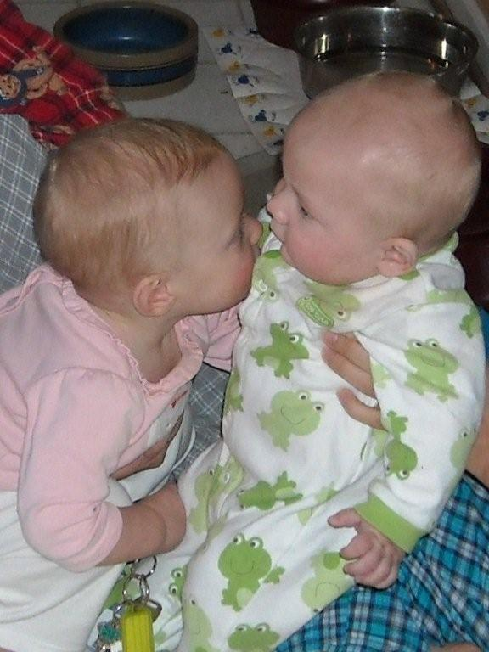
Friendship Skills Part 1
“Who would choose to live, even if possessed with all other things, without friends.”
Aristotle
Notes:
Strategies to Build Social Skills. Introduce this section by saying we want to talk more about the development of social skills in young children. Begin this discussion by asking participants to describe some of the types of positive peer interactions they have seen with the children in their care. Ask how they believe these interactions develop.
Ask them how these behaviors differ for infants/toddlers and preschool-aged children. Point out how important it is to begin with infants and toddlers to develop a foundation of social and emotional skills that children can build upon over time.
Elicit from the group a short list of the caring and helping behaviors of infants and toddlers that demonstrate their ability to understand what adults and peers might want or feel. Ask for a specific description of the child’s behavior and when they tend to observe the behavior.
2. Build on comments from the group to make the point that peer relationships are complex. Make the point that when we think about social skills and the development of friendship skills, we often think of older children. Yet, how we as adults interact with children from the very beginning fosters social development. The way we interact with children every day, provides a model for how they learn to interact. How we model interacting with others is how children learn to interact and behave toward others.
3. Go on to make connections for participants between the skills that infants and toddlers show and those that older (preschool-aged) children exhibit.
Use this conversation to lead into next slide about children who are well-liked and the skills they display.

Slide 10
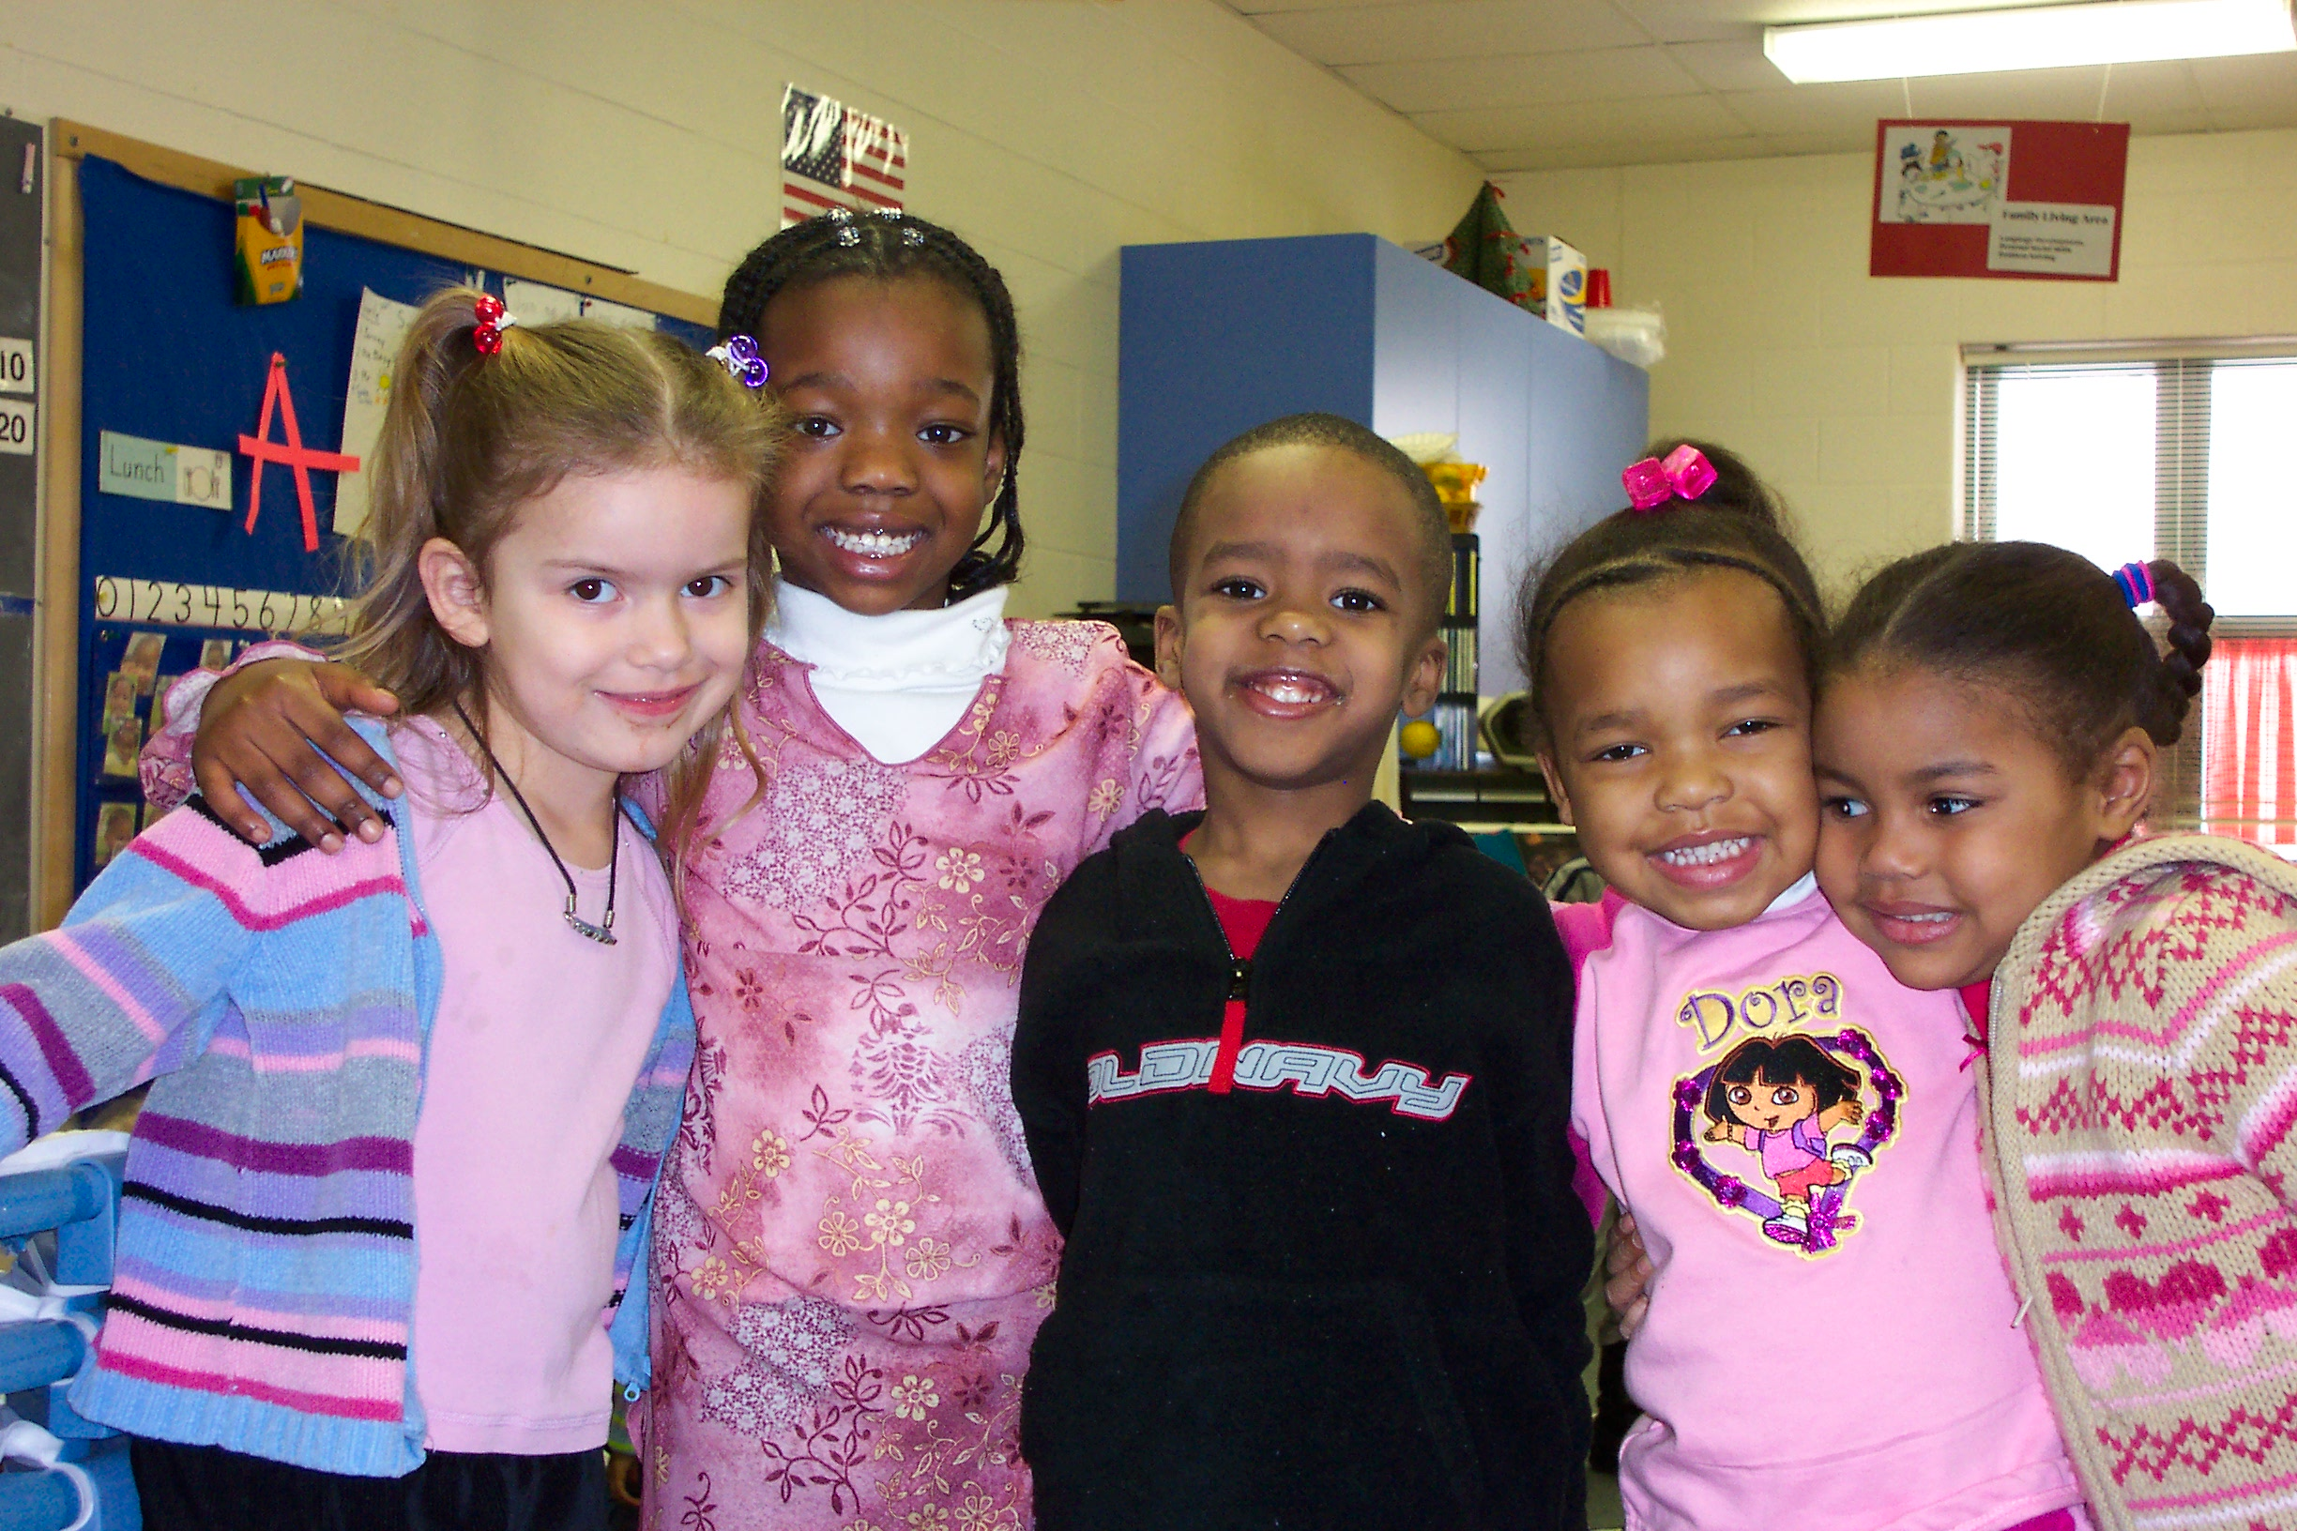
Think about children who are well liked and friendly…
What do you notice about their behavior that makes it easier for them to make friends?
Notes:
What Behaviors Lead to Friendship Skills?
We are now going to talk about friendship skills for preschool age children. Think about children who have lots of friends. What have you noticed about these children that makes it easier for them to make friends?
Write responses on chart paper. Think about how children develop these skills you have just listed. You already use many teaching strategies to help children of all ages develop friendship skills, like the ones you have listed. As we move through this section, we will be talking about some strategies you already use and you will have the opportunity to learn about some new ideas as well.

Slide 11
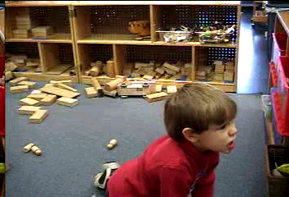
When Do We Teach These Skills?
Notes:
We are going to begin our discussion of Friendship Skills by talking about “when” during the day we might teach these skills.
1. Describe a typical situation that might happen in a classroom or child care setting. For example, Trey is building a castle in the block area. Blair comes to the block area to play and decides that she needs the block that is right in the middle of Trey’s castle. Blair grabs the block, and Trey’s castle crumbles. Trey hits Blair and takes the block away. Blair starts crying (red arrow).
2. Ask participants to generate ideas about what teachers or child care providers might say to Trey and Blair at this point (e.g., “Use your words.” “Hitting is not okay.” “Say you’re sorry.” “Ask nicely if you want something.” “Get an adult if you need
help.” “Calm down.”).
3. Point out that it is often at the crisis (red arrow) point that teachers try to teach new social skills. Discuss that while this is a teachable moment, and can be a social skills lesson for Trey and Blair, this might not be the most effective teachable moment
because:
a. The incident has already happened.
b. Both children are upset.
c. Blair may find the teacher reinforcing (“Wow, I might do this again so I can get the teacher’s attention!”).
4. Discuss effective teachable moments (referring to the green arrows at the left-hand side). The main point here is that we want to make sure that these “crisis moments” are not the only time that we are “teaching” social skills! Social skills can be embedded into almost any part of the daily schedule—Intentional, planned times as well as taking advantage of naturally occurring moments
throughout the day.

Slide 12
TEACH ME WHAT TO DO!!
“If a child doesn’t know how to read, we teach.
If a child doesn’t know how to swim, we teach.
If a child doesn’t know how to multiply, we teach.
If a child doesn’t know how to drive, we teach.
If a child doesn’t know how to behave,
we……..... …….teach? ……punish?
Why can’t we finish the last sentence as automatically as we do the others?” Tom Herner (NASDE President ) Counterpoint 1998, p.2)
Notes:
This is a choral reading.
I will read the first part of each sentence and you can read the last few words that are in italics.
(Make the point that a VERY important part of our work with young children is to help them develop healthy social and emotional skills.)

Slide 13

Development of Play Skills for
Infants and Toddlers
Age | Play
Birth to 3 Months | Responds to caregivers Coos and smiles Responds to familiar voices Focuses on objects
4 to 7 Months | Enjoys social games with caregiver Likes exploratory play supported by caregiver Plays some games with caregiver like peek-a-boo and patty cake
8 to 12 Months | Begins to imitate play actions or behavior of others, especially caregivers Play hiding games, songs and rhymes with caregivers Play alone with caregivers for a short time
Notes:
We just discussed when it is and is not appropriate to teach social and emotional skills. We also talked about some of the skills children typically use to show they are developing social and emotional skills. Point out that it is important to understand typical play skills for children in order to know what skills need to be taught. Understanding and being able to share what is typical development is also an important tool in developing partnerships with families. Go through the age groups and talk about and expand on the progressive development of play skills in the typically developing child. Remind participants that the primary play mode of the child under three is playing alone with objects. His skills in language and his desire to interact with others are growing but he still has limited ability to negotiate or engage in extended interaction without the support of adult caregivers.
Depending on how much time you have, you may want to ask participants to discuss what they see in their children that relate (or do not) to what is listed as “typical” development.

Slide 14
Development of Play Skills for
Infants and Toddlers
Age | Play
13 to 24 Months | Enjoys play with objects Increased interest in watching other children play (onlooker) Primarily plays alone (solitary) May offer toys to caregiver or other children May choose independent play close to other children (parallel) but not interact with them
25-36 Months | May play with other children but in an occasional or limited way (associative) Some cooperation and talking with other children May take leader/follower roles in play Some pretend play Still plays alone frequently Interactive level moving toward cooperative play
Notes:
Even though there are not slides for typical play development for children ages 36-60 months (3-5 years), you may want to lead a discussion on what is “typical” for these ages as well. Discuss the progression from solitary play to parallel play to cooperative play.

Slide 15
Progression of Play to Friendship Skills in Infants & Toddlers
  Positive interactions with adults
  Showing awareness of other children by:
    - Smiling and cooing
    - Watching children playing
    - Reaching out to other children
    - Copying what other children are doing
  Playing briefly with other children
  Wanting what others have
  Practicing turn-taking and sharing
Notes:
Go through the age groups and talk about and expand on the progressive development of play skills in the typical developing child. Remind participants that the primary play mode of the child under three is playing alone with objects. His skills in language and his desire to interact with others are growing but he still has limited ability to negotiate or engage in extended interaction without the support of adult caregivers.

Slide 16
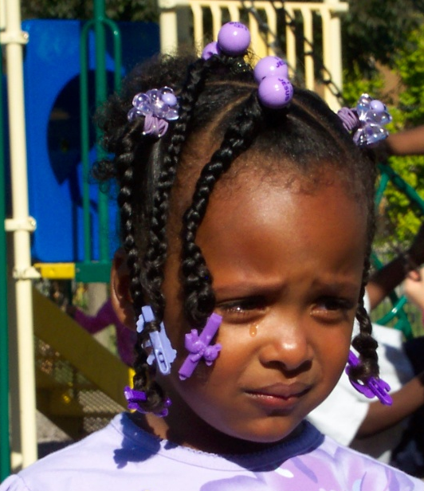
Setting Up the Environment for Developing Play & Friendship Skills
Examine the physical space to ensure that there is enough space for infants and adults to engage in social activities
Examine physical environment for spaces for two or more children to enjoy side by side activity and for adults to be close for supervision
Notes:
Now that we have discussed what is “typical” development of play, let’s spend a few minutes talking about how we can support children so their play skills continue to develop over time. Be sure to also point out how play skills are closely linked to children’s social and emotional development.
We have talked about some of the ways we can support the development of more advanced cooperative play or friendship skills. What are some ways that routines and supportive environments might help promote cooperative play or friendship skills?
Give examples or have the group offer examples. Use the examples provided if needed.
1. Examine the physical environment to ensure that there is enough space for children of varying ages and adults to engage in social activities. Safe rocking chairs, small sofa, small and medium size chairs, etc….
2. Examine the physical environment for spaces for two or more children to enjoy side by side activity and for adults to be seated close by for supervision. Examples: lofts, rocking boats, block areas, climbing boxes or play houses.

Slide 17
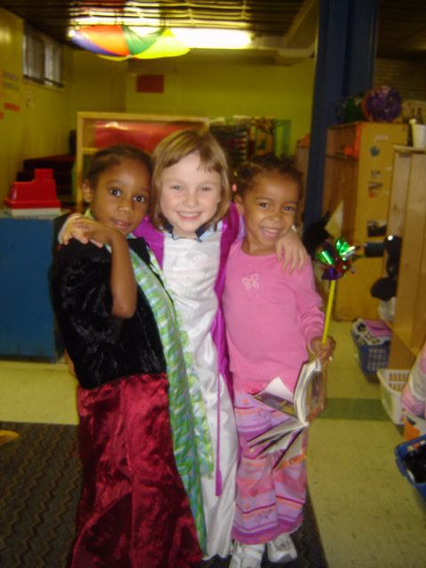
Setting Up the Environment for Developing Play & Friendship Skills
Examine schedule for opportunities to develop play skills each day
Look at equipment choices that encourage two children to interact
Ensure that there are enough materials for two or more children to use at a time
Notes:
3. Examine the schedule for multiple opportunities to develop play skills each day. Examples: reading times, eating times, play times.
4. Look at equipment choices for items that encourage two children to interact. Examples: grocery carts, doll strollers, blocks, trucks, kitchen equipment, books.
5. Ensure that there are enough materials for two or more children to use at a time. Examples: stacking toys, cars, dolls, puzzles, or other manipulative materials.

Slide 18
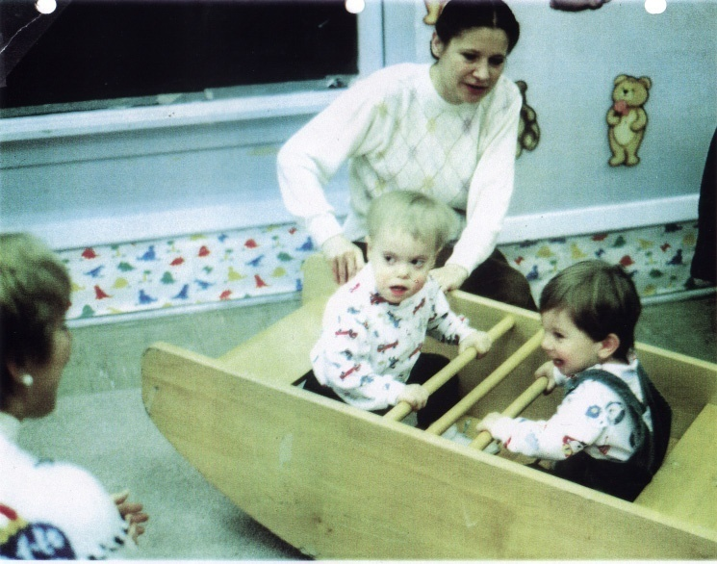
Promoting the Development of Friendship Skills - Toddlers
Set up activities for only two children.
Encourage children to help each other and do routines together
Provide positive verbal support for play between children
Read books about friends, playing together, helping each other, etc.
Practice turn-taking & sharing
Notes:
Let’s discuss other ways to promote the development of friendship skills in young children. Provide examples or ask for examples from the group. Use examples provided if necessary.
Set up activities for two children rather than more than two. Examples: getting ready for snack, singing a song or reading a book together, dress up hats.
b. Encourage children to help each other and do routines together. Examples: hand washing, brushing teeth, cleaning up toys.
c. Provide positive guidance and verbal support for playing together and helping each other. Examples: “Maria and Tasha, you are doing such a good job rolling out the play dough together.” “Tasha, please hand Maria her spoon.” “Gabriel, will you take this book to Benji?”
d. Read books about friends, playing together, helping each other, etc.
e. Practice turn-taking and sharing. Remind participants that turn taking is an important exchange both between adults and children and between two children. For example play games that involve “your turn, my turn.” When interacting with infants, play turn-taking games by imitating infants sounds and then waiting for a response back from the infant. This is how infants start to learn “your turn, my turn.” Ask for examples from the group about how to help toddlers and older learn to take turns.

Slide 19
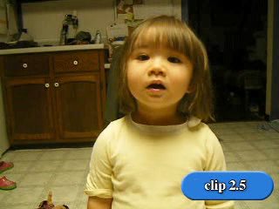
Notes:
Video Clip: IT 2.5 This video provides an example of a strategy a parent has taught this child to use to develop friendship skills. Ask participants to observe and consider the strategies this child has developed and how it could help her in developing and maintaining friendships. After they give responses you can share that the little girl in the video had been biting children at her child care center when they got too close to her or tried to take a toy she was playing with. Ask participants to note what the parent did to support her child and teach her what to do. Make sure that participants notice that Mom not only taught the child to “walk away, ” but they also practiced walking away. The same strategy was used in teaching her how to share.

Slide 20
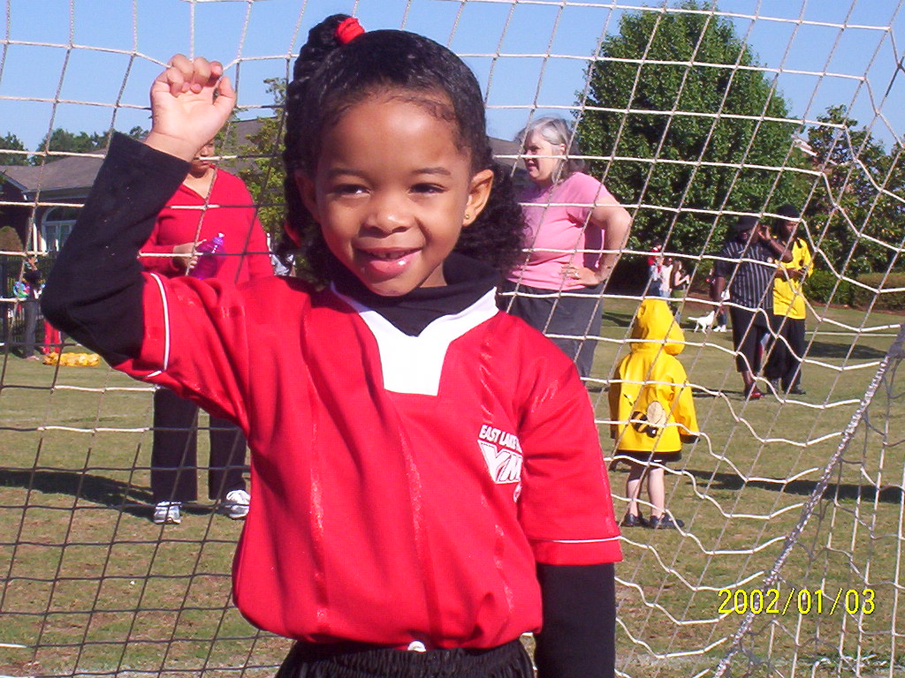
Friendship Skills Part 2
Notes:
WE are now going to begin talking specifically about children who are ages 3 – 5.

Slide 21
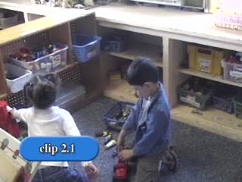
What helped the children be successful or
unsuccessful playing together as friends?
21
Notes:
Ask participants to watch the three children playing at center time shown in Video Clip PS 2.1.
What helped the children be successful or unsuccessful playing together as friends?
Discuss observations and chart.

Slide 22
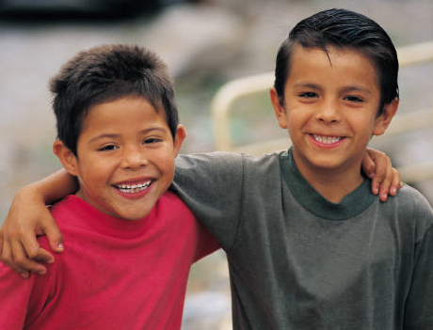
Friendship Skills
Gives suggestions (play organizers)
Shares toys and other materials
Takes turns (reciprocity)
Is helpful
Gives compliments
Understands how and when to give an apology
Begins to empathize
Tremblay et al., 1981
Notes:
Discuss that when children are successful at making friends, they have opportunities to learn and practice many social skills such as cooperation, sharing, turn taking, problem solving, and conflict resolution. Explain that there are several specific behaviors that young children engage in during play with each other that seem to be directly related to having friends (Tremblay et al., 1981). That is, children who do more of these behaviors are more likely to have friends.
Remember that children develop at different rates. Some of these skills are not expected until a child is maybe 5 – 6, depending on their rate of development in this area.
We need to be purposeful in our planning so that we are teaching children these skills and we are acknowledging their use of these skills. We want to teach all year long, not just once.
When you teach each skill you can follow this lesson plan format:
Talk to the children about why a skill is important (helps us be friends, so that we can all play with a toy, etc.)
Describe the skill using concrete examples (for #1, Let’s play trucks. You be the driver and I’ll put the logs on the truck)
Demonstrate the skill (show the right way and the wrong way for each)
Practice, give children an opportunity to practice the skill right now, in this lesson, role play, etc.
Promote opportunities for children to use the skill throughout the day. Promote, encourage, support.

Slide 23
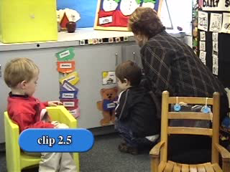
Notes:
Video PS 2.5 This very short clip gives us a chance to see a child’s spontaneous compliment. It is clear that this is an adult who models this behavior. This is a great example of what happens when the adults in a classroom give compliments – children begin to give compliments also!

Slide 24
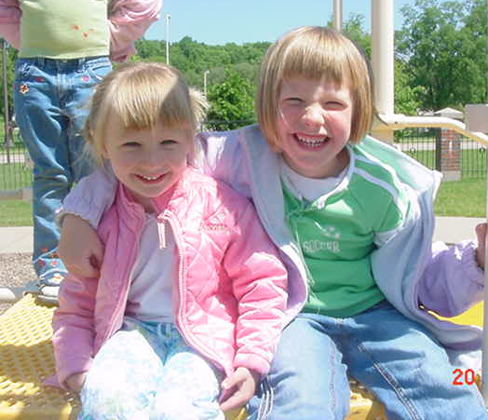
Setting the Stage for Friendship
Inclusive setting
Cooperative use toys
  (balls, puppets, wagons, telephones,
  rocking boat, board games)
Embed opportunities throughout the day
Social interaction goals and objectives (IFSP/IEP)
Atmosphere of friendship (adults and children)
Notes:
Prior to “teaching” friendship skills, adult caregivers need to set the stage by including the following five elements in their early childhood settings):
An inclusive environment where all children are meaningfully included in natural proportions is critical to setting the stage for friendships (Guralnick, 1990).
b. Having cooperative use toys and materials increases the opportunities for social interaction. Cooperative use toys are those that naturally lend themselves to two or more children playing together. Some examples of cooperative use toys are balls, puppets, wagons, two telephones, dramatic play materials, rocking boats, and board games.
c. Examine daily routines and embed friendship and social interaction instruction and practice opportunities throughout the day (refer back to the stages of learning discussed earlier).
d. In order to ensure that friendship and social interaction instruction gets the necessary attention, teachers and caregivers need to include related goals and objectives on a child’s IEP/IFSP. Although these goals are likely to be the most critical for the child’s later development, they often do not appear on IEPs or IFSPs (McConnell, McEvoy, & Odom, 1992), perhaps because many assessments do not include these skills as test items.
e. Most importantly, teachers and caregivers need to devote energy toward creating an atmosphere of friendship. When you walk into a classroom, child care, or home day care setting where an adult has successfully created this climate, you see adults giving time and attention to children when they engage in friendly behaviors, you hear adults talking nicely to one another, and you hear
children supporting one another’s friendly behavior. Overall, you get a sense that friendship is the ultimate goal. Ask participants what else they can do to promote this atmosphere of friendship.

Slide 25
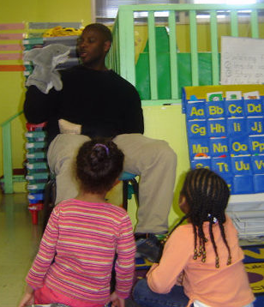
Strategies for Teaching Friendship Skills
Modeling
Modeling with video
Modeling with puppets
Preparing peer partners
Buddy system
Priming
Direct modeling
Reinforcement
(Webster-Stratton & Hammond, 1997)
Notes:
PRESENTERS: The script for this slide is VERY long. We suggest you read this and mention a few examples for each of the teaching strategy ideas. Consider your participants, and the amount of time you have for this content, and make decisions re: amount of content you will review.
Setting the stage is a necessary step in supporting children’s developing friendships and teaching the
critical skills described above. There are several ways to teach children these skills: teaching the concept, modeling appropriate behavior, providing practice opportunities with feedback, and supporting children’s use of the behavior in context. Discuss the following strategies:
Modeling. Modeling can include adults or peers demonstrating the friendship skill or video based modeling with short vignettes of children engaging in friendly behavior (Webster-Stratton & Hammond, 1997). Often, it is effective to model both examples and non-examples followed by opportunities for correct responding. There are three guiding principles of effective role-play modeling strategies:
1) Use invisible support, that is, call on the child who you are confident will model the skill appropriately before calling on a child who will need more support.
2) Sometimes when children are modeling the friendship skill in front of their peers, they can get carried away with being silly or inappropriate. It is important to give children another chance and more support so that they are successful in demonstrating the skill appropriately. This approach allows them to receive encouragement from the teacher and other children for doing the skill.
3) Because role-plays typically involve only one or two children at a time, it is necessary to plan ways for the rest of the children to be actively engaged. Strategies for including children who are not involved in the role-play include having them give a thumbs up for friendly behavior and a thumbs down for unfriendly behavior; patting themselves on the back if this is a behavior they do; clapping when the role-play is over; saying “ready, set, action” before the role-play begins; or having a Popsicle stick sign with a happy face on one side and a sad face on the other (children show the happy face when the behavior being modeled is friendly and the sad face when the behavior being modeled is unfriendly). It is also important to keep track of who has had a chance to role-play and ensure that all of the children in the class get a turn during the week.
4) Whenever possible, using small groups to teach these skills will be useful in terms of giving all children opportunities for practice.
b. Modeling with Video. The use of video to help model friendship skills can be very effective with young children. Video-based modeling is particularly effective for several reasons:
1) Videos can capture real-life examples of children using friendly behavior. These examples can be used to generate discussion about the friendly behavior and the context in which it is used in the video. Video vignettes can also display non-examples. These vignettes can be used to teach children to discriminate between friendly and unfriendly behavior and prompt children to develop and share alternative behaviors and solutions if initial ideas are not effective.
2) Video clips can be paused, and children can be prompted to attend to the salient features of the friendly behaviors and the context in which they occur. Children can also make predictions about “what will happen next” when the child featured in the video uses a friendly or unfriendly behavior.
3) Children love watching videos, which makes this format particularly powerful in engaging and keeping children’s attention.
c. Modeling with Puppets. Similar to videos, puppets are very engaging to young children:
1) Because adults are in control of the puppet, the puppet can always be a responsive play partner. The puppet can model friendly play and, when appropriate and planned, can model non-examples. Puppets in the image of children are particularly effective because they provide a proximate model. That is, children are more likely to emulate the behavior of models that look like themselves. But, any puppet will work!
2) Additionally, some children will disclose more about their feelings and friendship problems to puppets than to adults, especially if adults are historically not seen as trustworthy by the child.
d. Preparing Peer Partners. When typical children are assisting their peers with special needs to acquire friendships skills, it is necessary for them to learn to suspend social rules in order not to feel rejected. In the usual course of events, interactions between typical children are usually quite reciprocal. If someone asks nicely to play, they usually get a positive response. On the other hand, as some children begin to acquire peer interaction skills, they often reject the social overtures of their peers and they may not initiate play. Using role-play and rehearsal strategies, there is a well-researched set of procedures for teaching children to be persistent with their social behavior while their peers are becoming more fluent. For example, adults model peer rejection, provide verbal feedback (“That’s what might happen when you ask kids to play.”), and then provide a behavioral alternative that they reinforce (“If that happens, try again”—“good, you tried again.”).
e. Buddy System. Often it is helpful to utilize a “buddy system” when trying to increase the friendship skills of children. Right before a freeplay period, children are assigned to a buddy role, meaning that they begin free play in some planned play activity with a certain child. In utilizing a buddy system, there are several rules to follow.
1) It is important to always have two or more buddies for each child who needs them. This arrangement helps to keep the play interesting for the socially competent children, and it helps to create the conditions for maximizing the number of diverse play ideas.
2) It is also important to rotate buddies for several reasons: a) First, rotating buddies helps to ensure that children have the opportunity to engage in friendship skills with the widest variety of playmates. b) Second, rotating helps to avoid buddy burnout, a condition in which children come to respond negatively to their helper role because they always play with the same individual.
3) One can optimize the buddy system by pairing the most popular and liked children with those who need the most help. This type of pairing can lead to other children simultaneously helping their peers because the “cool” kids are doing it.
4) At the end of a play period, children should receive specific feedback for being buddies and, provided with feedback that specifically enumerates the friendship skills they used in interacting with their assigned partner.
f. Priming. Teachers can increase the likelihood of children using friendship skills with specific priming strategies. For example, prior to a freeplay period, teachers can ask children who they are going to play with; they can ask what specific toy or material they are going to share; and they can provide practice opportunities. A practice opportunity might include, “Hey, Jaymin, let’s pretend I am Cody and you are going to ask me to play trucks.” Jaymin would then practice asking, with or without adult prompting, and the adult would provide encouragement or feedback for Jaymin’s social initiation to play. Other play ideas include:
1) Teachers can increase the duration of peer play by providing suggestions or prompting role reversals.
2) Expanding play ideas can occur by suggesting new ways of playing with the materials, new ways for dramatic play to unfold, and new ways of including more children in a game or activity.
3) When a teacher notices that children are disengaging from play with one another, he or she can prompt the children to reverse dramatic play roles (“How about you be the mom now and she can be the baby?”). This strategy can reengage children in the play sequence and lead to more lengthy social encounters.
g. Direct Modeling. Another way to keep children engaged in friendly play is to directly model desired behaviors as a play partner. When teachers notice that children are becoming less engaged, they can join the play and provide specific models of friendly behavior. For example, a parent might join two children who are playing together and begin to share the materials available.
h. Reinforcement. Although it is important to acknowledge children for their use of friendship skills, it is also the case that the effective use of acknowledgement requires ongoing attention to several key factors:
Timing of reinforcement delivery is crucial. As long as children are engaged in friendly behavior, it is a good idea to withhold reinforcement. Although this approach may seem counterintuitive, evidence suggests that adults’ delivery of attention to children at play can have the immediate effect of terminating their play. Given this fact, it is advisable to comment on children’s friendly play shortly after the fact.
When commenting on children’s friendly play, it is essential to describe the specific friendly behavior(s) that you observed. Instead of saying, “You’re playing so nicely together,” say, “You are taking turns and saying nice things to each other.” This descriptive commenting provides children with specific feedback about what they are doing well.
3) For many children, caregivers may need to provide lots of reinforcement early on. Once children start to use their friendly behaviors, however, adults need to begin the process of slowly removing their specific feedback from the ongoing play. The goal is not to remove all adult reinforcement, but to provide sufficient opportunity for friendly play in and of itself to become reinforcing.

Slide 26
Activities to Support the
Development of Friendship Skills
Friendship Can – draw out a child’s name
Planting Seeds of Friendship – grass seed in a decorated cup
Friendship Tree/Compliment Tree – add leaves with observed skills
Books about Friendships – Fox Makes Friends, The Rainbow Fish, Big Al, Making Friends, OUR Class Book of Friendship
Notes:
It is very important to be aware that all of these activities build on the skills needed to develop friendships and allow children opportunities to practice using these skills. We don’t just use the word “friend.” These types of activities also help in establishing a classroom atmosphere of “being friends,” sharing and helping each other out.
a. Friendship Can – During large group time, have children generate a list of different things they can do to be a friend. Introduce the “friendship can” – which is a decorated can with names of all of the children in the can. Have each child draw out a
name. Children can then use their friendship skills to do something with or for their “friend” throughout the day. They can make something special for their “friend,” play with their friend, share with their friend, compliment their friend, help their friend, etc. During the day (as well as summarizing at the end of the day), children and teachers can talk about how they are using their
friendship skills with their friend.
b. Planting Seeds of Friendship – Have children plant seeds (“seeds” of friendship) in small cups throughout the year. As new children join the classroom, children can give them one of their “friendship cups” to welcome them to the classroom. Each “friendship cup” has a welcome note that was made by the children (along with their teacher!). To introduce this activity, tell the
children that you are all going to work together to make “seeds of friendship” so that new children will feel welcome and be able to make new friends! Talk about how hard it can be to be the “new” child! Ask children what friendship skills they can use to help new children feel welcome (play with new child, share toys, help new child learn the rules, schedule, names of other children, etc.).
c. Friendship Tree/Compliment Tree – Make a big tree without leaves that can be displayed on a wall. Have leaves made from construction paper stacked by the tree. As adults and children notice others using friendship skills, write the skill that was used on a leaf and add it to the tree. At the end of the day, “celebrate” the new leaves that were added to the tree. Describe the specific
friendship skills that were used each day. You can also use the same idea to make a compliment tree.
d. Books about Friendship – Use books that talk about “friends” and what it means to be friends. Some examples are: Fox Makes Friends, The Rainbow Fish, Big Al, and Making Friends. Ask participants to share books that they have used that Relate to Friends. Teachers can talk about what friendly behaviors the characters are using and have children guess what they think will happen next based on what the characters are doing. Teachers can also help children write a story together or individually about friendship.

Slide 27
Activities to Support the
Development of Friendship Skills
Friendship Quilt - pictures of children on construction paper squares, pictures of children demonstrating skills
Friendship Journal - skills and pictures of each skill
Music/Songs – class-made or commercial CD’s
Notes:
e. Friendship Quilt – Children make a quilt out of construction paper squares that hang together on the wall. Each square has pictures of children in the classroom (labeled with their names) as well as pictures of children using friendship skills like sharing, playing together, or helping each other (which are also labeled). This is a good activity to use at the beginning of the year to help children learn everyone’s name as well as friendship skills. Squares are added to the quilt as children use their new friendship skills. This is a great idea for home providers if they have children of different ages. They can make pictures that show what
children can do to be a good friend based on their age and skills.
f. Friendship Journal – Create a friendship journal that has friendship skills and pictures of the children in the classroom using these skills. This journal can be added to the book area for children to look at throughout the year.
g. Music/Songs - Teachers and children can make up songs about being friends. There are also commercial CDs that have songs about being friends.

Slide 28
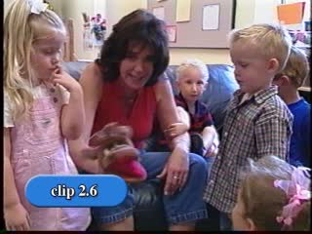
Notes:
Video Clip PS 2.6 An example of using puppets to teach friendship skills.

Slide 29
Embedding Friendship Opportunities into
Daily Routines and Activities
Arrival
Circle Time
Center Time
Lunch
Naptime
Outside
Snack
Story Time
Departure
29
Notes:
You can print out this as a full page handout, OR have participants write this down on their own paper.
Ask participants to think of ways that they can embed friendship opportunities throughout the day (or in other works – how they can be more intentional). Ask them to look at this schedule and in the right hand column, write down their ideas of how they could teach a skill during the day. Encourage them to change the schedule on the right to fit their typical day.
Examples:
a. Arrival – assign a child to be the “greeter” who greets the children by name as they arrive; find a “buddy” to walk with from the bus.
b. Circle Time – Select a child to pass out the circle time props to each classmate, as the child progresses around the circle, he calls each child by name and says “pick a ____.” Each child responds with, “Thanks (child’s name)”; children identify a friend to play with at center time and then decide together where they will play first.
c. Center Time – watch for friendly behavior, comment and encourage.
d. Small Group – plan cooperative art projects; teach children to play board games (examples: Barnyard Bingo, Candy Land, Don’t Spill the Beans).
e. Outside – pre-select cooperative use toys for outside play (wagons, tricycles, balls, etc.); adults organize peer play (Duck, Duck, Goose; Red Rover; tag).
f. Snack – have each child in charge of different snack items, children have to ask each other for the snack items.
g. Story Time – read books about friends; discuss what friendship skills the characters in the book used, write a classroom friendship book.
h. Good-bye Circle – have a compliment circle (children have a chance to give each other a compliment as they pass around the compliment bear); one child can pass out back packs; one child can say good-bye to each child as he or she leaves.
i. Transition – during center time instead of transitioning to a new center – transition to a new friend (could use a friend picture schedule); children can hold hands going from one activity to another.

Slide 30
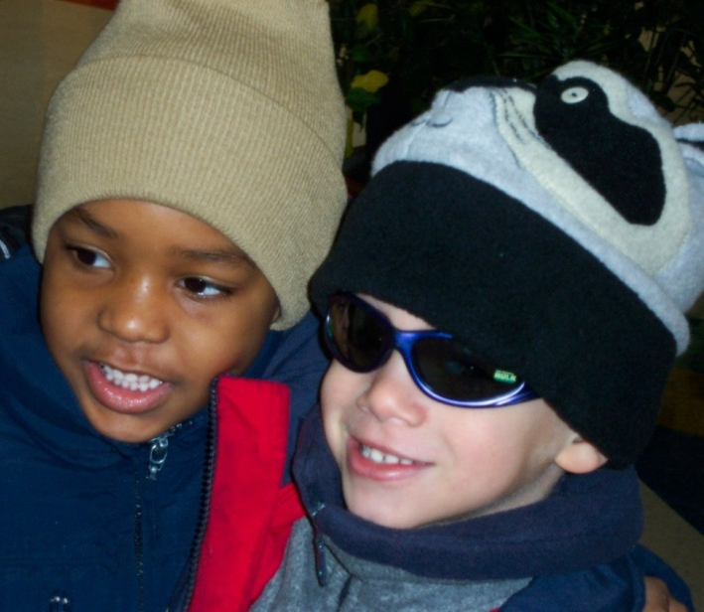
Article: Social Emotional Teaching Strategies
You’ve Got to Have Friends
Gail E. Joseph, Ph.D. & Phillip S. Strain, Ph.D.
Notes:
Refer participants to this article. You can decide how you want to use the article. PS Module 2 Handout 2.3: You’ve Got to Have Friends.

Slide 31
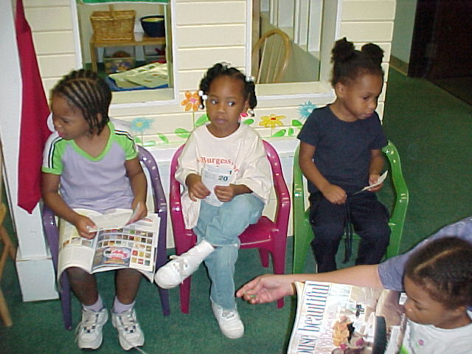
Pulling it all Together!
Notes:
Pulling it all together
Now we have come to the conclusion of our face-to-face training together.
Let’s take a moment to reflect on a few key take home thoughts.

Slide 32
Major Messages to Take Home
It is important for caregivers to set up an environment where play and friendship skills are developed and supported
It is important to be intentional about teaching children friendship skills
Embed friendship building opportunities in daily routine is essential to supporting children’s social and emotional development
Notes:
Major Messages to Take Home:
Read each message and remind participants of the importance of their role in making this happen!
Key for caregivers to set up an environment where play and friendship skills are developed and supported
It is important to be intentional about teaching children friendship skills
Embedding Friendship Building Opportunities in daily routine is key

Slide 33
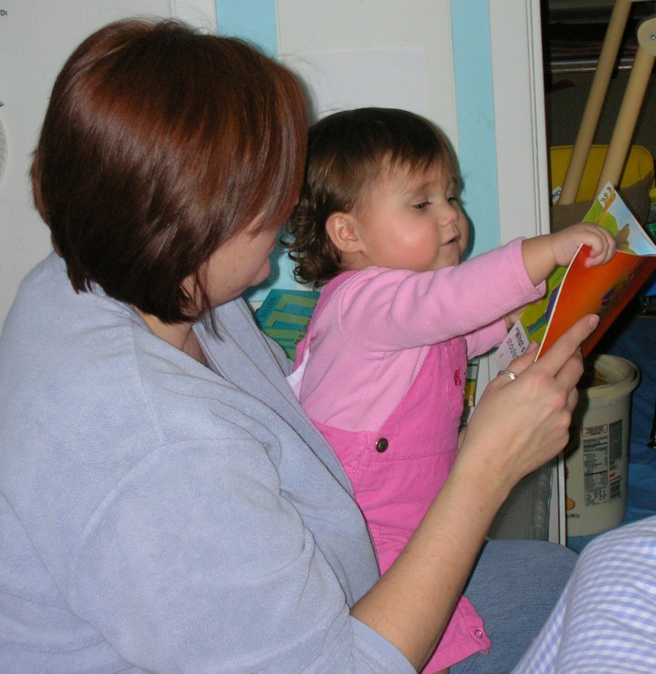
    If there is anything that we wish to change in the child, we should first examine it and see whether it is not something that could better be changed in ourselves.
    Carl Jung – psychiatrist
Notes:
It is often easier to change our behavior or our environments than it is to change the child.

Slide 34
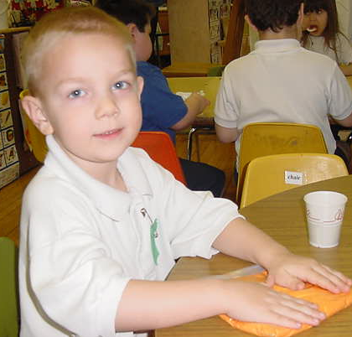
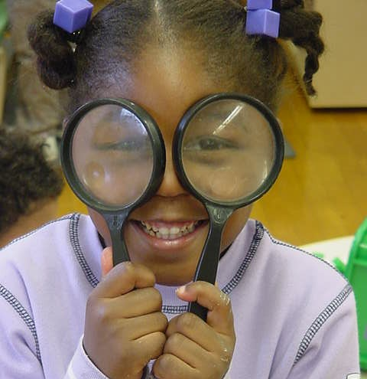
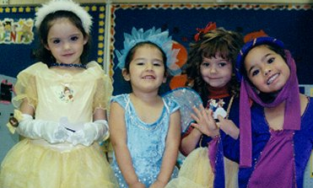
Be the change you wish to see in the world.
Mahatma Ghandi
Review your Personal Action Plan
Notes:
Action Planning Activity.
Have participants complete their Action Plan Form, filling in the grid with ideas of changes they want to make in their early childhood settings as a result of today’s session, as well as methods for evaluating their progress in making these changes.
Ask if anyone is willing to share some ideas that they hope to implement “back home.” Encourage a few participants to share ideas gleaned from today’s session.

Slide 35
Resources
Childcare and Youth Training and Technical Assistance project: http://www.extension.unl.edu/web/child/cyttap
Better Kid Care: http://betterkidcare.psu.edu/
CSEFEL : http://csefel.vanderbilt.edu/
Notes:
Review each of the resources and if time permits visit the corresponding website.
Be sure to point out the following key characteristics of each resource:
CYTTAP website: Visit website, click on Rock Solid Foundations Link. Additional training resources available as well as information on the project.
BKC: visit website to show how to sign up for the newsletter as well as how to access the online learning modules and resources that have been developed.
CSEFEL: Again explain how this training selected pieces of the more comprehensive program of CSEFEL. Therefore if they would like additional resources, materials, information and strategies they can visit the CSEFEL website.

Slide 36
Evaluation
Notes:
Evaluation: Thank participants again for their time and ask them to complete the evaluation form. However there is an option to complete the evaluation online. Link will be provided. Details about the evaluation procedures will be outlined and can be accessed on the CYTTAP website under instructor resources/Rock Solid Foundations. (If credits or certificates are available do not provide until evaluation is submitted. Same applies for the “incentive” item we provide).

Slide 37
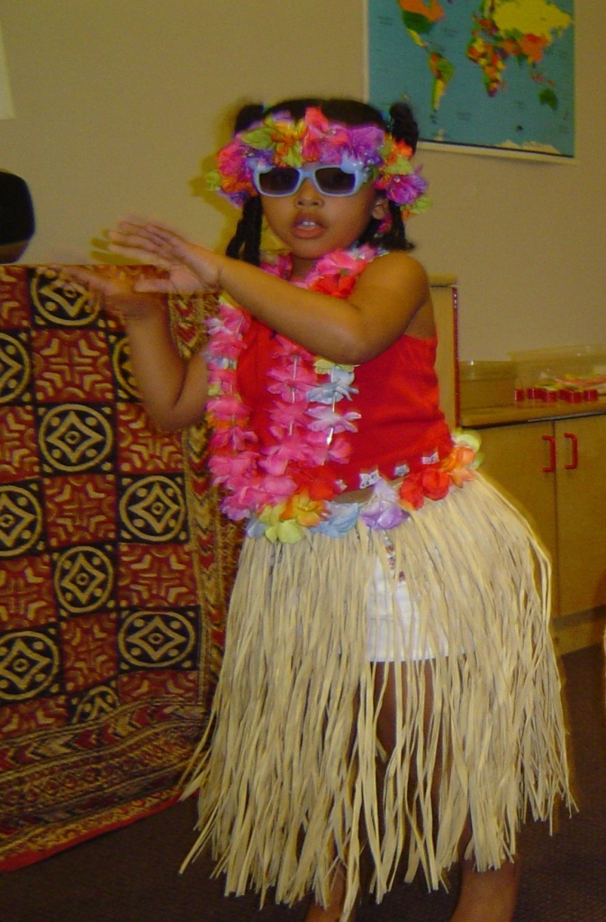
¡Gracias!
Thanks
beaucoup
شكرا
Notes:
Express your gratitude in having the opportunity to share with them the CSEFEL resources and strategies.
Remind participants as stated at the beginning of the presentation that this training is the beginning of ongoing support and resources.
Explain that the CYTTAP team will be offering trainings for the next two years and look out for future training opportunities.

