Slide 1
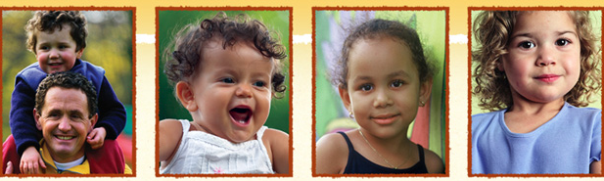
Rock Solid Foundations: Promoting the Social & Emotional Competence of
Young Children & Preventing Challenging Behaviors:
Enhancing Emotional Literacy
Notes:
NOTES TO INSTRUCTOR:
Script and instructor notes are included on each slide.
Handouts and videos are labeled with ‘IT’ if from an Infant Toddler module and ‘P’ if from a Preschool module.
3. Although the videos are embedded in this presentation throughout, you must double check them to ensure that they are compatible to your computer. Also a technology consideration is to play within the presentation, the videos must be in the same folder in which the PP is located in order to effectively play. In case you have to reinsert the videos for compatibility purposes, they can be found in the Instructors Resources section under Rock Solid Foundations in both mpg and mp4 formats.
You may choose to insert your name, contact, date, etc. on this slide. Remember to add your own pictures to enhance the points on the slide and engage participants in the topic.
Welcome! I’m so glad that all of you decided to join us today to learn more about Rock Solid Foundations: Promoting the Social and Emotional Competence of Young Children. This training utilizes The Pyramid Model, research based strategies and resources from the Center on the Social and Emotional Foundations of Early Learning (CSEFEL), focusing on the social emotional development and school readiness of young children. I’m sure that everyone here would agree that promoting children’s social and emotional competence and preventing and addressing challenging behaviors is an important topic that touches every early care and education program and every classroom across the country.

Slide 2
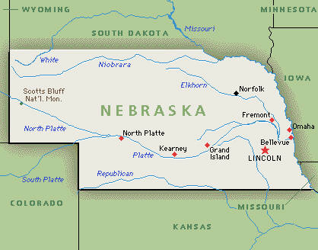
Introductions
Your name, program.
What is your role?
What will you do with the information you will learn today?
INSERT PICTURE OF
STATE WHERE DOING
TRAINING
Notes:
First introduce yourself and provide a description of your experiences and the training you received on the CSEFEL modules.
Ask participants to introduce themselves. If you have time, each person can introduce themselves or if time is limited or the group is too large, you can ask them to either introduce themselves to others at their table or get up and find someone they don’t already know and introduce themselves.
(put a ClipArt pic of the state your are working in)

Slide 3

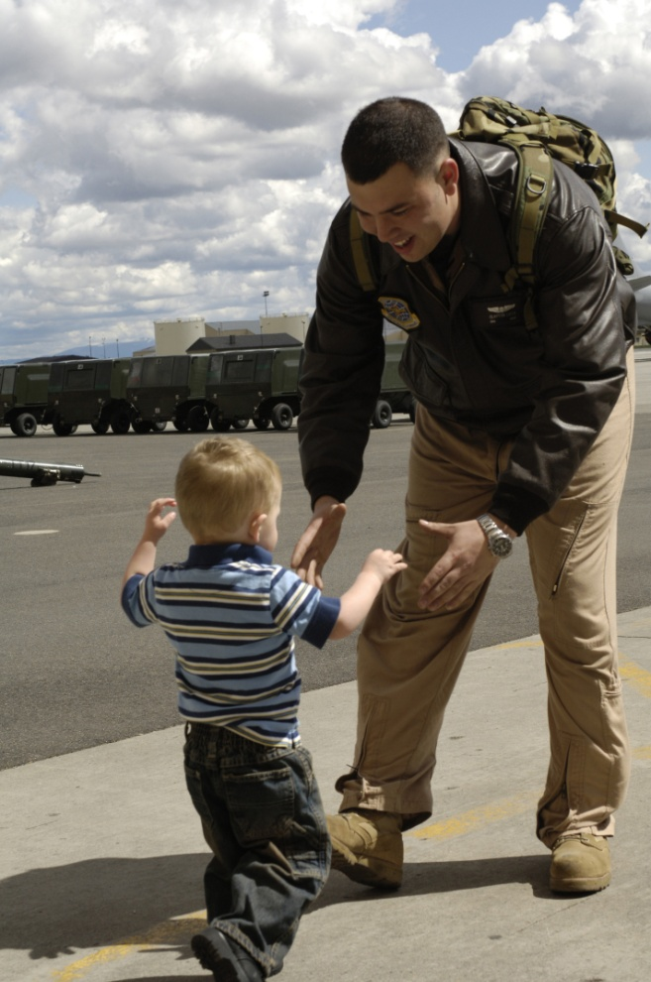
CYTTAP
Allison Silberber, 2007
Notes:
Show 3-minute video which will help illustrate the scope of the Childcare and Youth Training and Technical Assistance project. You will need to download the 3 minute video from the CYTTAP website under the Instructor Resources for Rock Solid Foundations. The video is labeled: Military Extension Partnership Video. Participants may contact Dr. Kathleen Lodl klodl@unl.edu or Dr. Tonia Durden tdurden2@unl.edu for further information or inquiries about the project.

Slide 4
Promote Children’s Success
Create an environment where EVERY child feels good about coming to school
Design an environment that promotes child engagement
Focus on teaching children what To Do!
  Teach expectations and routines
  Teach skills that children can use in place of challenging behaviors
Notes:
We know that supporting children’s social and emotional development is key to school readiness and overall healthy growth and development. Today we are going to introduce several evidence-based practices and resources taken from the Center on the Social and Emotional Foundations of Early Learning (CSEFEL).
Our discussions will include infants, toddlers, and preschool age children. If you currently care for only one of these age groups you will benefit from learning about the entire birth to five developmental spectrum. You will then understand what your children have already achieved and what lies ahead.
Although this is a six hour training, we intend to continue to provide you with online support as you implement these strategies and practices in your center or home. We’ll begin with exploring how to promote children’s success.
Ask participants to name some ways to support children’s social and emotional development then go over the three bullet points.

Slide 5
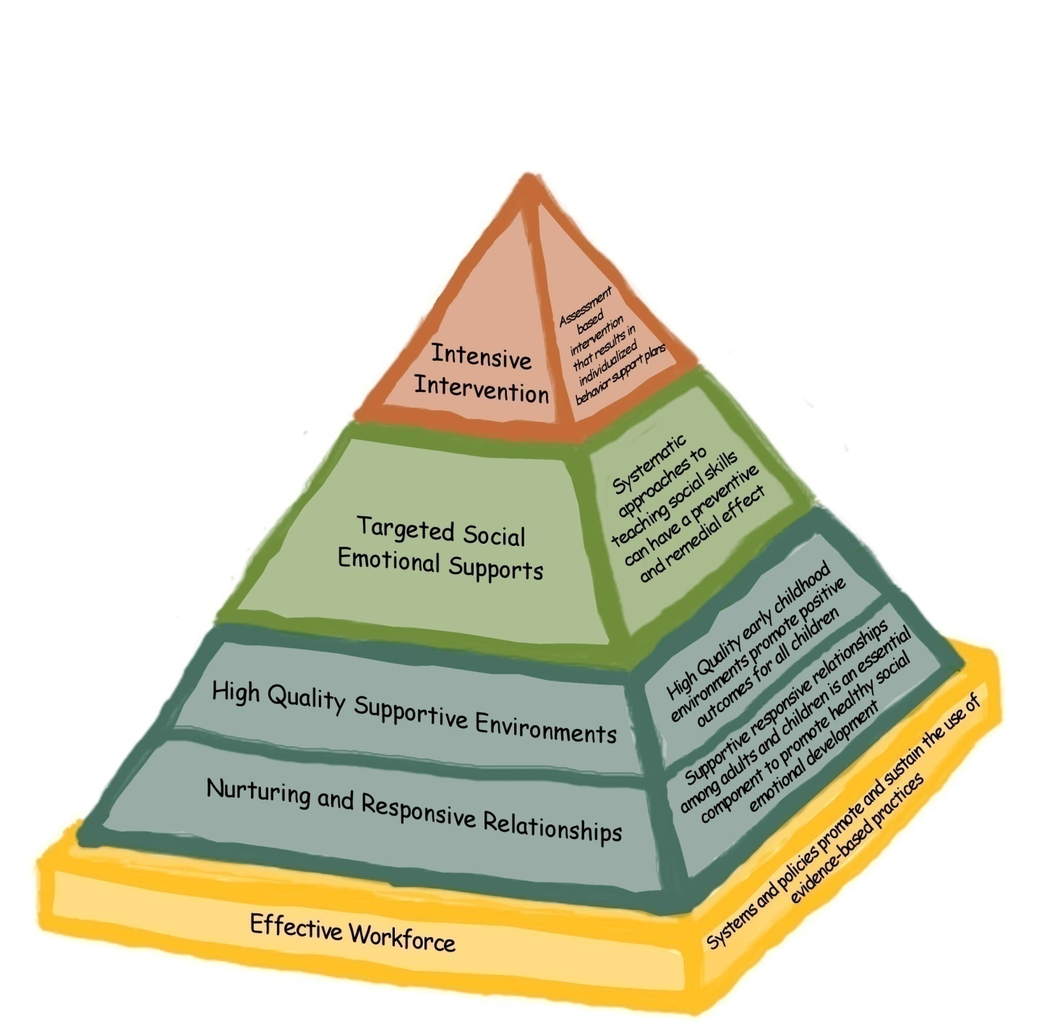
CSEFEL Pyramid Model
Notes:
Introduce the CSEFEL Pyramid.
Along with learning about infant, toddler and preschool development and how to understand individual children, this session will offer strategies for:
creating group care environments and practices that support social emotional well-being of infants, toddlers and preschoolers;
working with families to support the well being of very young children;
problem-solving when behavior is of concern.
In order to understand and respond effectively to behavior that center and family care providers, home visitors, and other professionals and parents experience as challenging, we all need to understand how typical social emotional development unfolds during the first five years.
We also need to spend some time examining our own emotions and responses when children’s behavior is unusual and persists despite our best efforts. The definition of challenging situations or behavior may be different for different caregivers and we will explore that issue.
There are a number of strategies that can be used to support the social emotional development or competence of very young children. The Pyramid is a model that represents components of adult behavior and strategies that parents, caregivers, teachers and other professionals can use to assist children in developing social emotional competence.
The primary focus of the Pyramid is on promotion of social emotional development and prevention of challenging behaviors for all children, moving on to individualized interventions only when the bottom of the Pyramid is in place and children continue to engage in challenging behavior.
Strong relationships form the foundation of the Pyramid and are necessary for everything else we do with young children.
Well designed environments support children’s appropriate behaviors and make it less likely that children will need to engage in challenging behavior. In addition, environments can be designed to help children learn about expectations and promote their engagement and interactions.
The emphasis of this session is on the blue and green levels of the Pyramid.

Slide 6
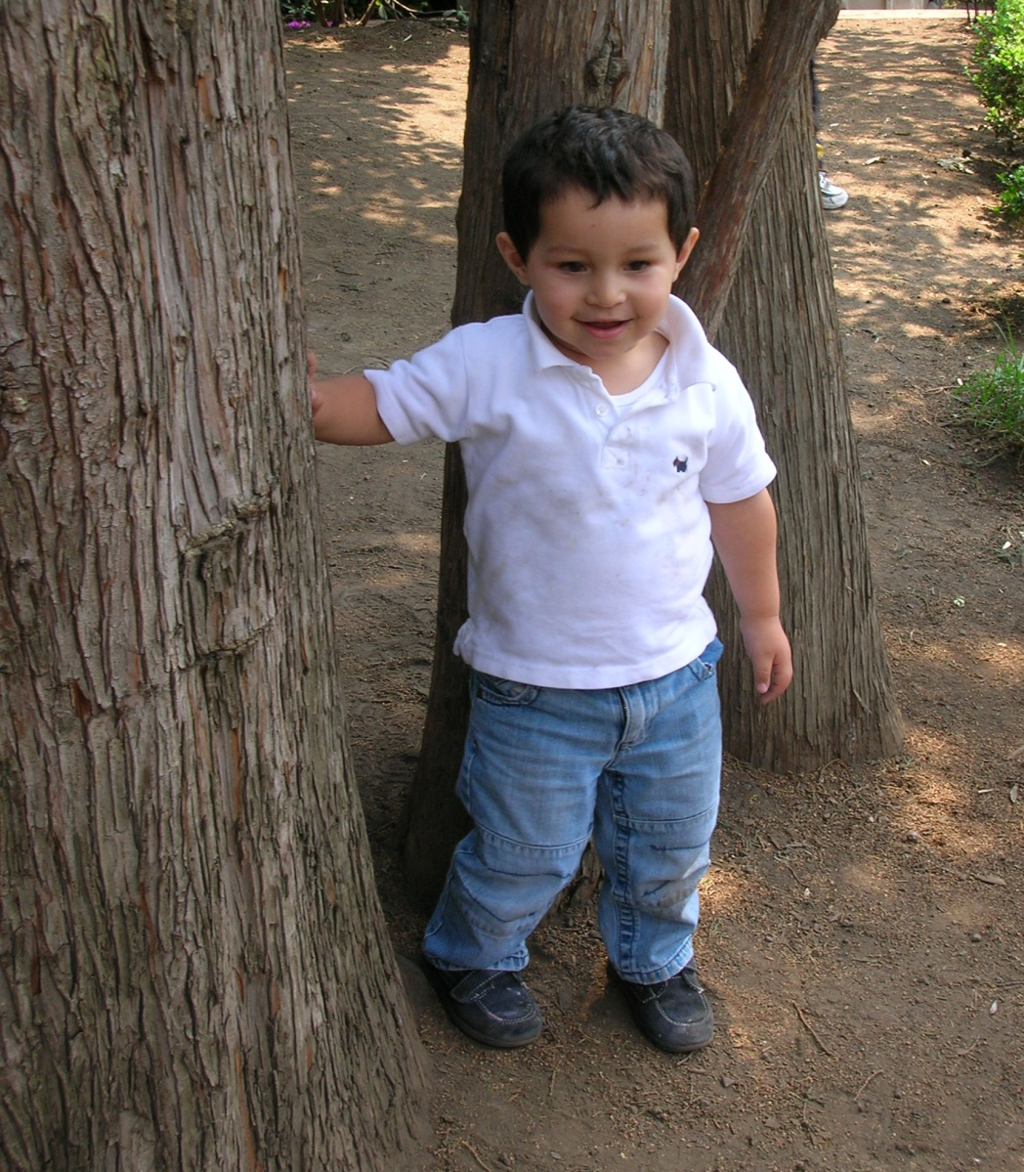
Definitions, Research and Rationale
Notes:
The primary goals of the CSEFEL materials are to promote young children’s social and emotional development and to prevent and address challenging behaviors. Before we get into the materials, it will be helpful to discuss definitions for these terms as well as discuss developmental milestones for young children’s social and emotional development.

Slide 7
CSEFEL Definition of Social Emotional Development
The term social emotional development refers to the developing capacity of the child from birth through five years of age to form close and secure adult and peer relationships; experience, regulate, and express emotions in socially and culturally appropriate ways; and explore the environment and learn - all in the context of family, community, and culture.
Caregivers promote healthy development by working to support social emotional wellness in all young children, and make every effort to prevent the occurrence or escalation of social emotional problems in children at-risk, identifying and working to remediate problems that surface, and, when necessary, referring children and their families to appropriate services.
Adapted from ZERO TO THREE, 2001 HANDOUT: IT 1.2
Notes:
HANDOUT: IT 1.2
For the purposes of this training, we will use the CSEFEL definition of social emotional development for children birth through five years on this slide and your handout.
Ask the participants to read the definition and underline key points as they think about the children in their care.
Lead a discussion by asking participants for their ideas about what each of the phrases means.
You may want to use some of the following ideas:
“Developing capacity” – Children grow and change quickly, gaining more skills in all areas of development: physical, cognitive, and social emotional. Think about the different abilities of a newborn, a 1 year old, 2 year old, 3 year old, 4 year old, and 5 year old.
“Form close and secure adult and peer relationships” – Young children require nurturing relationships with adult caregivers for healthy social emotional development. When adults are loving, responsive and consistent in their care, very young children learn that they are valued and that their world is primarily satisfying and predictable. They learn through these relationships how to interact with their peers. In the first few years they require a lot of support in managing peer relationships.
“Experience, regulate, and express emotions in socially and culturally appropriate ways” – Joy, sadness, and frustration are just some of the emotions that all children experience during their first years. Infants and toddlers watch important adults to figure out how they should feel and act in certain situations. With adult help, they increasingly learn how to control or regulate their emotions so that they don’t get overwhelmed by them. The family’s culture affects the way in which parents interact with their very young children as their values, beliefs, goals, expectations, and resources are expressed in their child-rearing practices.
“All in the context of family, community, and culture” – Young children first learn about relationships and feelings as part of a family. As was just mentioned, culture influences the relationship between children and caregiving adults. Communities, too, play a role in shaping how adults and children interact and how they are supported (or not) through public policies and the availability of resources.
The primary focus will be on developing relationships. One of our most important roles in supporting positive social emotional development with young children is to establish nurturing and trusting relationships. It is through these relationships that infants and toddlers learn about their world and their place in it. They learn that the world is safe and responsive to their needs. They learn to form satisfying relationships with others, to communicate, to face challenges, and to experience and regulate their emotions.
Since relationships are constantly adjusting to changes in development, we need to understand the course of social emotional development. Building positive relationships with both children and parents is essential for a child’s healthy development. Young children observe our relationships and what they observe shapes their expectations for how people treat each other. Relationships are established with each individual child and family and, therefore, look somewhat different with each. Those of us who provide care to young children and their families build our skills in carefully observing the social emotional cues provided to us by the children in order to respond to them with interactions that build responsive, nurturing relationships.

Slide 8
What is Social-Emotional Development?
  The developmentally and culturally appropriate ability to:
Manage Emotions | Relate to Adults
Relate to Peers | Feel Good About Self
Notes:
Source: Jane Knitzer, NCCP
If time permits complete this activity as well.
Share with participants that this definition plays out in many ways. Ask participants to work together to write down things/strategies/activities/ideas that they do to promote children’s social and emotional development in each of the four areas (i.e., manage emotions, relate to adults, relate to peers, and feel good about self.) If needed you can provide an example in each area. This activity gives them a chance to acknowledge the great work they are doing and to hear new ideas from other participants and yourself.
Have them talk in pairs or small groups, jot down their ideas, and then report out. You could have one piece of large chart paper for each area, OR just have each group share 2 of their favorite ideas, etc.
There are many variations of all of the activities. When you are making decisions about how to do an activity take into consideration how much time you have, the understanding level of your participants (you may be aware that your group REALLY needs to spend time on a certain topic), and the engagement of your participants in the topic at hand.
Return to this activity or the wall charts at the end of the day--- do participants have more ideas/strategies to add to the list?

Slide 9
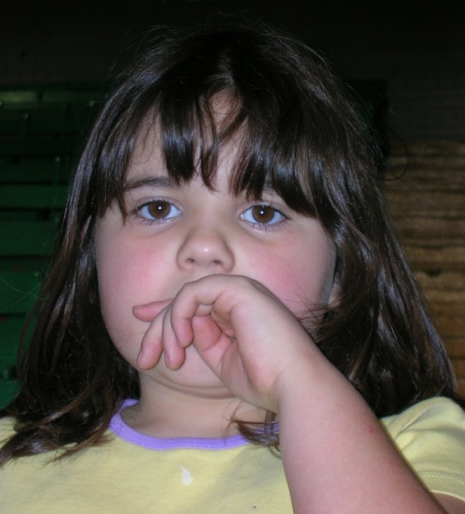
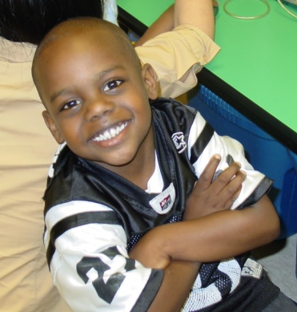
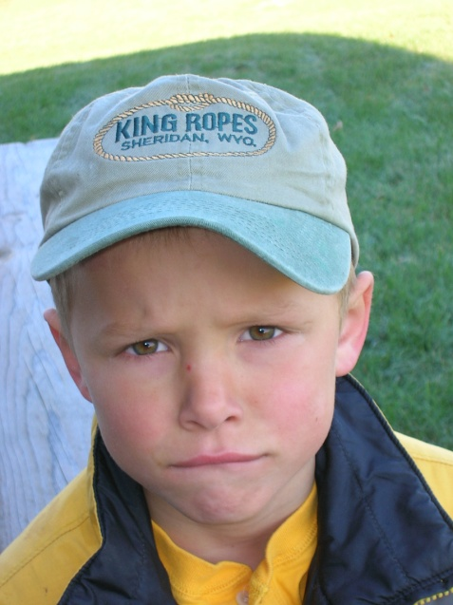
Emotional Literacy
Emotional literacy is the ability to identify, understand, and express emotions in a healthy way.
Notes:
Introduce the topic of emotional literacy by reading the definition of emotional literacy from this slide.
Emotional literacy refers to emotional communication or communication about emotion. Social emotional literacy in very young children develops as a result of having respectful, caring, supportive relationships with adults. Similarly, when working with children ages 3 to 5, emotional literacy refers to a child’s ability (with adult support) to understand their feelings and the feelings of others.

Slide 10
Emotional Literacy…
…. is the capacity to recognize, label, and understand feelings in self and others.
Adapted with permission, Cradling Literacy, 2007
Notes:
Emotional literacy is not just about language, language plays a large part in emotional literacy because language is so important in a social world. Language serves as a tool to communicate and much of what language communicates is our feelings about ourselves and our relationships with others. We use language to give common meaning to something, such as a feeling. Talking about shared experiences, acknowledging and labeling emotions, and letting children know that we see, hear, understand and accept their feelings many times a day are all major strategies that all caregivers can use to develop emotional literacy.
A child’s developmental level will determine what is said and what response the caregiver can expect from the child. In infants and toddlers, and some preschool-aged children, the words used to acknowledge and label an emotion may be well ahead of the child’s level of speech but the expectations for the child’s response must be in line with the child’s developmental capacity.

Slide 11
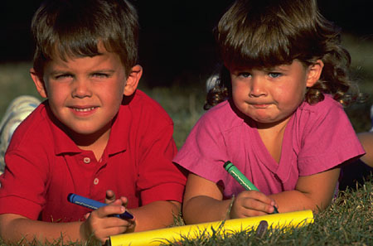
Children with a Strong Foundation in Emotional Literacy:
tolerate frustration better
get into fewer fights
engage in less destructive behavior
are healthier
are less lonely
are less impulsive
are more focused
have greater academic achievement
Notes:
Let’s discuss some of the things we know about children who have a strong foundation in emotional literacy. Children who don’t learn to use emotional language have a hard time labeling and understanding their own feelings as well as accurately identifying how others feel.

Slide 12
Four Strategies to Develop Emotional Literacy
Using the adult/child relationship to expand an individual child’s awareness of his emotions or feelings
Finding opportunities in the group setting to talk about feelings
Using enriching language tools
Modeling positive relationships
Notes:
There are many ideas to use when you focus on helping young children develop emotional literacy. This section is organized into these 4 topics. (read the list) These strategies are important for all young children; however, we are going to talk about several examples for children ages birth to three.

Slide 13
Strategies to Develop Emotional Literacy
Using the adult/child relationship to expand an
individual child’s awareness of his emotions or feelings:
  Verbally acknowledging and labeling emotions expressed by children in care
  Assisting children with regulating their emotions
  Talking about the fact that feelings can change
  Using questions about feelings to see if a child can respond
Notes:
Go through each strategy and provide an example. Ask for examples from the participants. Use the following examples if needed:
Using the adult/child relationship to expand an individual child’s awareness of his emotions or feelings:
Verbally acknowledging and labeling feelings expressed by children in care.
• The caregiver’s gentle, positive tone of voice is an important part of the message of understanding and acceptance of emotion for all young children.
A feeding situation with a 10-month-old fussing as he spits out food with a new texture: “Oh, Benji, you don’t like those beans, do you? Those beans make you angry. You want the apple sauce that tastes good right now. It will be all right. We’ll have apple sauce next and you will feel better.”
• Interrupting play to transition to a new activity: “Laura, let’s stop playing with the balls now so we can get ready for lunch. (Laura protests). I know you want to keep playing with the balls. Let’s put them in a special place so you can come back and play with them later today. Where should we put them? (Laura suggests the shelf). That’s a great idea!”
b. Assisting children with regulating their emotions.
• Calming a baby who bumped his head: “Oh Ethan, you bumped your head and it hurt. Let me hold you for a few minutes. Aw, it hurt, didn’t it, and made you mad. We will go away from that counter and find something else to play with. Are you feeling better?”
c. Talking about the fact that feelings can change.
• Letting a child know that another child who bit him is still his friend: “Benji bit you, didn’t he, Tyrone? You wanted to touch his pretty monkey and he bit your arm. Ouch! You like Benji but he bit you and you’re mad! “
d. Using questions about feelings and wishes to see if children can respond.
• Asking a child if he wishes he could play with more bubbles: “Juan, I know that it is hard to stop playing with the bubbles now. I can see that. Do you wish you could take those bubbles with you? Do you wish you could put them in your pocket? They pop don’t they?

Slide 14

Strategies to Develop Emotional Literacy
Finding opportunities in the group setting to talk about feelings:
    Taking advantage of teachable moments when children experience difficulties with peers and need adult support to resolve them
    Staying close to support children in difficult encounters with other children
Notes:
Finding opportunity in the group setting to talk about feelings
a. Taking advantage of teachable moments when children experience difficulties with peers and need adult support to resolve them
• Speaking for two children who want the same toy: “Juan wants the boat. Kiki wants the boat. Juan, I know you were playing with the boat and it makes you mad when Kiki takes it. Kiki, Juan was playing with the boat. You are sad you can’t have it. Let’s find another boat. Do you like red? Would you like playing with a red boat? ”
b. Staying close and supporting children in difficult encounters with other children.
Staying near two children who want to pet the same bunny: “Gentle with the bunny, Tim. Ethan likes the bunny, too. He wants to pick it up. Tim, look at Ethan petting the bunny, too. Two boys petting the bunny!”

Slide 15
Strategies to Develop Emotional Literacy
2. Finding opportunities in group settings to talk about feelings: (cont.):
    Showing positive feelings for both children in conflict
    Letting children know through your calm approach that conflict is to be expected and it can be resolved with help
    Helping children learn to put into words how they think others are feeling and to express empathy for those feelings
    Encouraging negotiating so that each child feels that she/he has been heard and that their feelings have been taken into consideration
    Clarifying rules
Notes:
a. Showing positive feelings for both children in conflict.
• Putting your arms around both children who want to sit on your lap while you read a story:
“Mia here is a place for you on this side and Kiki, here is a place on this side. Mia likes to read this book, Kiki. Kiki wants to have the book in her hands. Let me hug both of you and then we will read the story. Miss Peggy loves two girls on her lap.”
b. Letting children know through your calm approach that conflict is to be expected and that it can be resolved with help.
• Telling three children that it is hard to share:
“Children, we have lots of blocks for everyone to share. We can figure this out. We will find a place for everyone to play with the blocks and
trucks. Sometimes it is hard to share blocks and we get mad. One for you, one for you, and one for you. Everybody find a place to sit. We can all play with the blocks!”
c. Helping children learn to put into words how they think others are feeling and to express empathy for those feelings.
• Telling a child who is not crying why the child who is unhappy is crying and then telling her how to comfort the crying child: “Mia, Kiri is
crying because she wants her Mommy. Do you think she would feel better if she had her Binky? Are you worried? Can we find her Binky? You could give her the Binky and then she might not be so sad. Do you think she feels better? Do you feel better now that she’s not crying?”
d. Encouraging children to negotiate so that they feel that they have been heard and their feelings have been taken into consideration.
Telling both children you know they want to go on the rocking boat and that you will make sure each gets a turn: “Tyrone is riding in the boat. Do you want to ride, too, Teddy? Tyrone, Teddy wants to ride. Teddy, tell Tyrone you want to ride? Two more ups and downs, Tyrone, then it is Teddy’s turn for a ride. Tyrone, tell Teddy, two more ups and downs?”
e. Clarifying rules.
• Asking a child if she remembers that books are not to tear: “Cate, I know you like the Olivia story. Do you remember that we don’t tear books? Remember we take care of our books so that we will be able to read them again. Let’s put that book back on the table and let’s find another book for your grocery cart.”

Slide 16
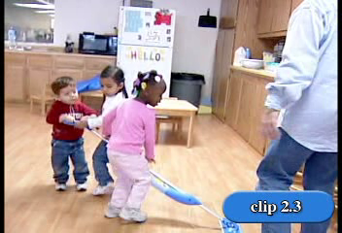
How is this teacher supporting emotional literacy?
I/T
Notes:
Let’s take a moment and watch a quick video.
To prep for the video, ask participants to look for examples of how this provider helps these children develop emotional literacy, given all of the strategies just discussed.
Show Video I/T 2.3
After watching the video ask for examples. You may choose to chart responses.
Some examples include: The provider stayed in close proximity, clarified rules, verbally acknowledged feelings, encouraged the children to talk about feelings, etc.

Slide 17
Strategies to Develop Emotional Literacy
3. Using enriching language tools:
    Choosing books, music, finger plays with a rich vocabulary of feeling words
    Using puppetry or felt board stories that retell common social experiences and that emphasize the feeling vocabulary and conflict resolution
    Reading stories about characters that children can identify with who express a range of feelings
    Encouraging toddlers to draw pictures of their difficult or scary emotions
Notes:
3. Using enriching language tools.
Choosing books, music and finger plays with a rich vocabulary of feeling words. Ask participants if they have favorite books, music, or finger plays that they use with children.
b. Using puppetry or felt board stories that retell common social experiences in the child care setting and that emphasize feeling vocabulary and stories about conflict resolution (e.g. having two puppets struggling over a favorite item or two puppets that have pretty hair that no one can touch).
c. Reading stories about characters that children can identify with who express a range of feelings (e.g. Baby Einstein for infants or See How I Feel stories like The Rainbow Fish).
d. Encouraging children to draw pictures of their difficult or scary emotions (e.g. if a child heard thunder and saw lightening, talking about it being frightening and offering an opportunity to draw, then asking about the drawing).

Slide 18
Strategies to Develop Emotional Literacy
4. Modeling Positive Relationships
    Between adults in the care setting
    With other children
The preceding strategies adapted with permission rom Im, Osborn, Sanchez, & Thorp,2007
Notes:
Between adults in the care setting.
• The emotional atmosphere among the adults in a care setting sends a powerful message to very young children. Speaking in kind voices to one another; saying hello to everyone and greeting parents with enthusiasm all carry messages about how we treat someone.
With children
• Saying only positive and constructive things to children; letting them know what you like rather than what you don’t like; laughing with children and letting them know that you like their personality or their antics also sends messages about how we treat people.

Slide 19
ACTIVITY:
“Table Talk”
With your table mates…
Think about preschool children …..write a list of feeling words that you would most want to teach the children you work with
Notes:
(Decide how you want to do this – table groups, groups of 2, whole group, etc., chart or not? )
We have been talking about 4 important strategies with a focus on children ages birth to 3. This section will focus on children ages 3 – 5. List feeling words that you want to teach preschoolers. We are going to record your “feeling words” on chart paper.
(Count the number of positive and negative feeling words. We want to stress the importance of teaching both positive and negative words.)
Now let’s look at the range of words you suggested. What is the importance of teaching preschoolers feeling words that go beyond the basics (happy, sad, mad)? An increased vocabulary allows children to make finer discriminations between feelings and to better communicate with others about their feelings. These skills help children to become better interpersonal communicators.

Slide 20
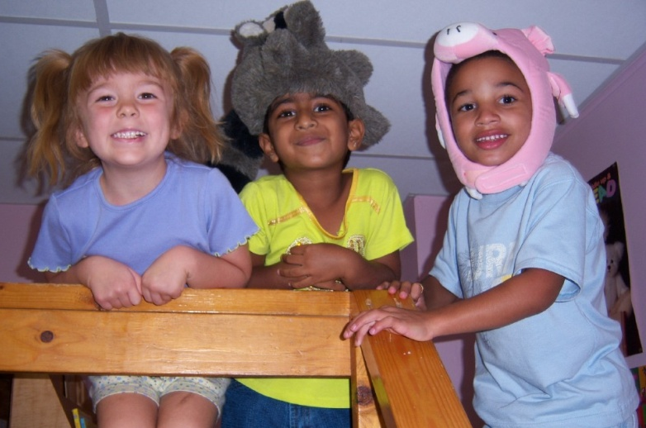
Enhancing Emotional Literacy for Preschool Children…
Direct Teaching
Indirect Teaching
Use of Songs and Games
Use of Children’s Literature
Notes:
This section of Module 2 will focus on ideas for children ages 3 – 5 and older. These are the 4 topics we will now be discussing.

Slide 21
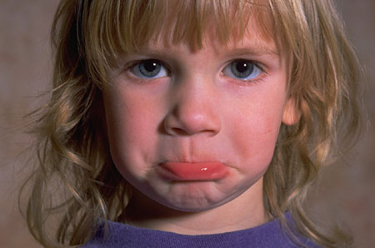

A. Direct Teaching of Feeling Vocabulary
Notes:
Direct teaching involves planning specific activities/opportunities for children to increase their emotional vocabulary as well as to start to discriminate what different facial expressions/emotions might look like.
This is an example of an activity you could use to teach feeling vocabulary. Use pictures of real children demonstrating a variety of emotions. Talk about what the child might be feeling and why.

Slide 22
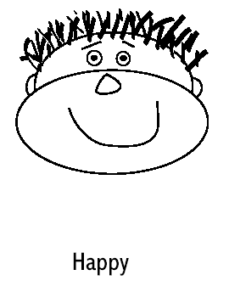
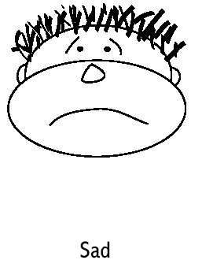
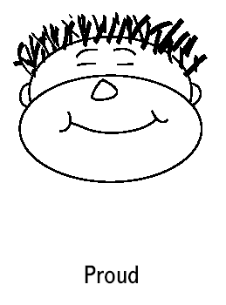
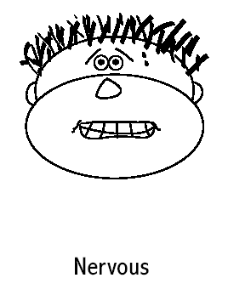
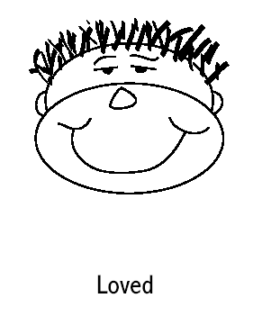
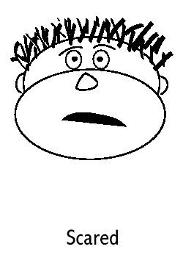
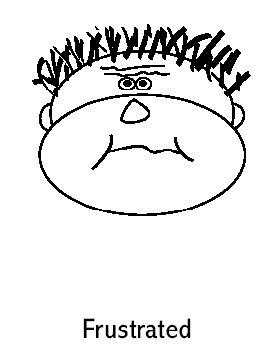
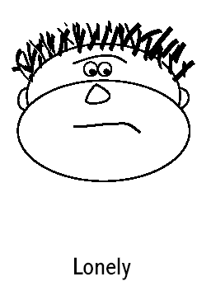
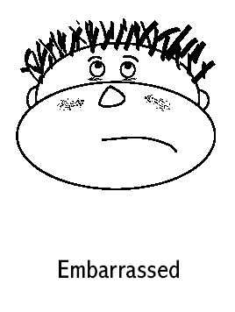
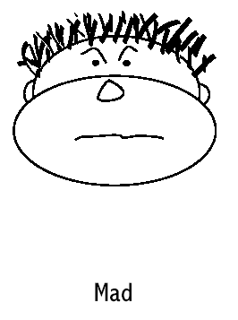
English/
Spanish
Notes:
Show Slide with examples of emotion faces that represent a range of emotions. Tell participants that they can download these “faces” from the CSEFEL website. They are available in English, Spanish or English/Spanish. Explain that you will be discussing many different ways to use the “faces” and they will probably come up with many more ideas! Ideas: matching, memory, bingo, etc.

Slide 23
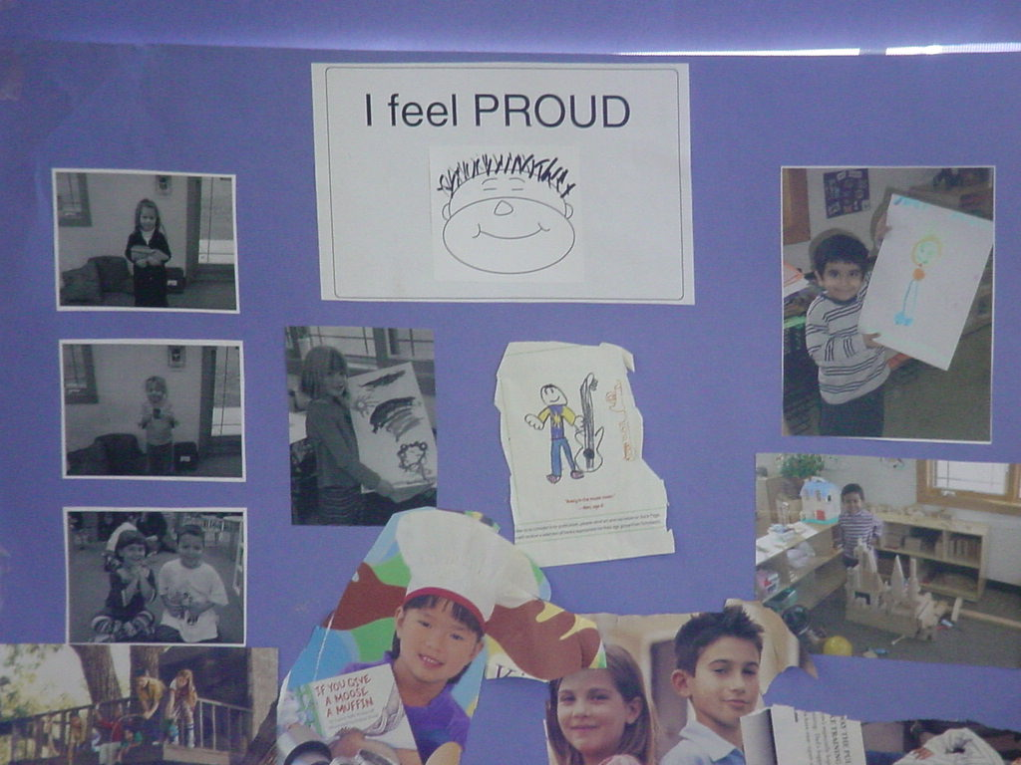
Example
Notes:
Another example of how a teacher used one of the feeling words (proud) for children created an opportunity to learn what “proud” means. They cut pictures out of magazines that showed people feeling proud. They also took pictures of children in the classroom who were feeling proud! They picked a different emotion each week and used the same process. This would be a great idea for home care settings.

Slide 24
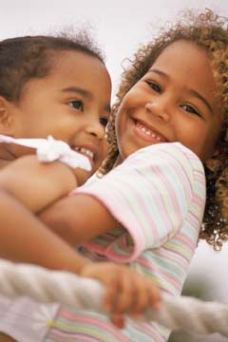
B. Indirect Teaching
Provide emotional labels as children experience various affective states - “Tamika and Tanya seem really happy to be playing together! They keep hugging each other!”
Notes:
This slide is an example of indirect teaching which would be when a teacher provides emotion labels – “you’re happy” or “you’re
frustrated” – as children experience various affective states. Use the example on the slide and note how the teacher describes what the two children are doing that helped her figure out how they were feeling.

Slide 25
C. Use of Songs and Games
Sample Song
If you are happy and you know it…add new verses to teach feelings
  If you’re sad and you know it, cry a tear, ”boo hoo”
  If you’re mad and you know it, use your words “I’m mad”
  If you’re scared and you know it, ask for help, “help me”
  If you’re happy and you know it, hug a friend
  If you’re tired and you know it, give a yawn
Notes:
An example of a favorite song (“if you’re happy and you know it…”) that has been changed to use feeling words. There are also many commercial CDs that have fun songs about emotions. An example would be Jim Gill’s “I’m so Mad I Could Growl” song.

Slide 26
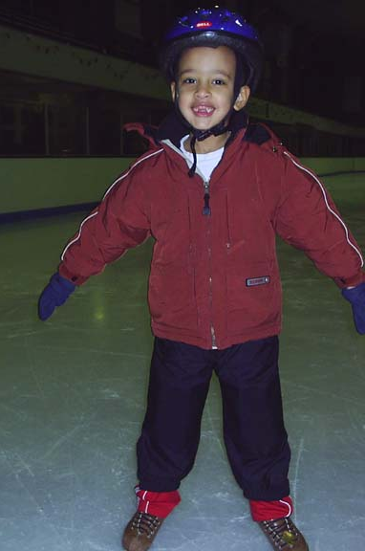
Sample Game
How does your face look when you feel proud?
What makes you feel proud?
Notes:
The next few slides are fun examples of emotion games. Note that two of the games use feeling faces from the CSEFEL web site. The Bingo game would be appropriate for a wide range of children. If each feeling face is done in a different color, children who might not be able to “read” the words could match the colors. Children might also be able to match the faces by the expressions.
Children who are starting to read can match the words as well as the faces. Be sure to choose words that you are teaching and talking about in class.

Slide 27
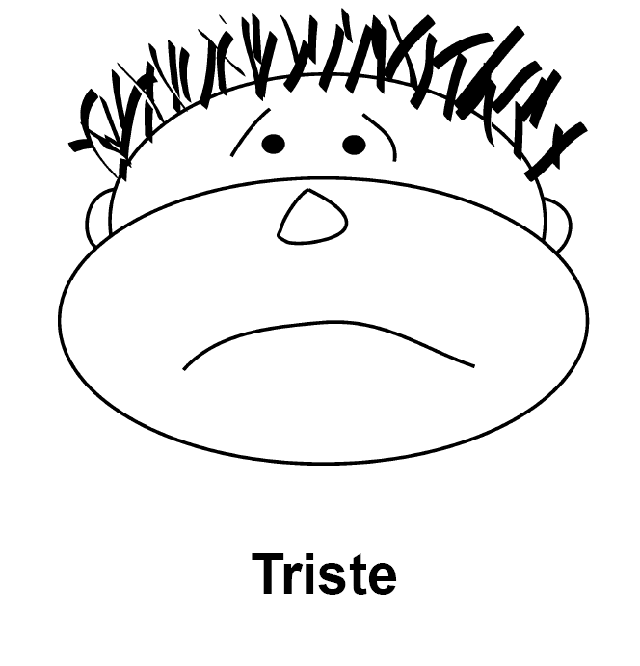
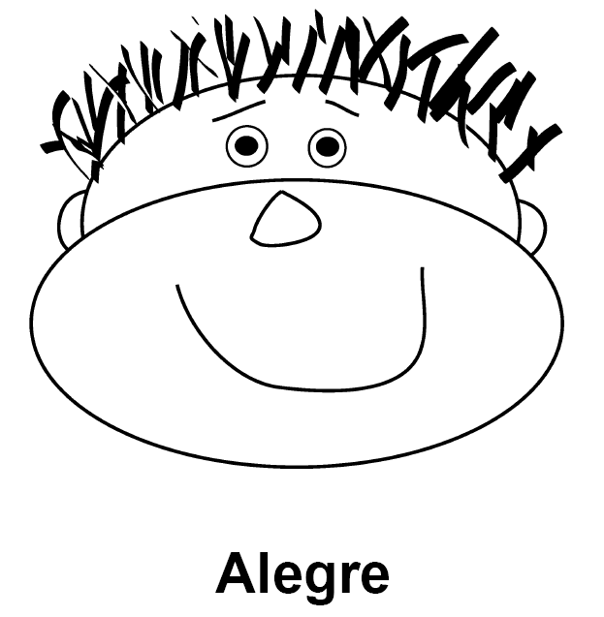
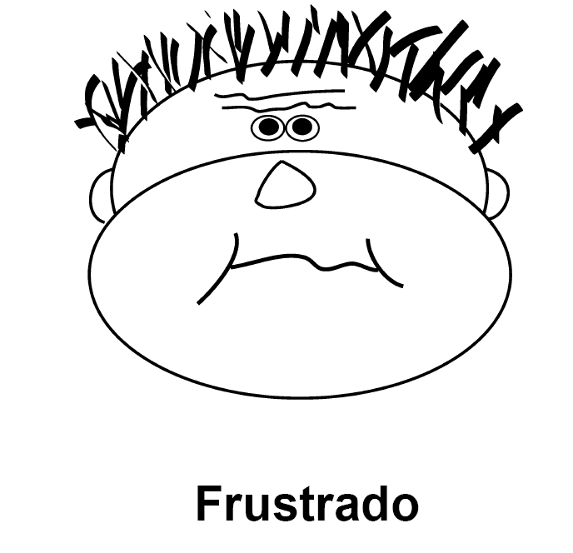
Sample Game
Make a _____ face.
Notes:
This could be a way for the children to share how they feel right now by having them mark the picture or it also teaches Spanish words to these feelings. What else might you do with this?

Slide 28
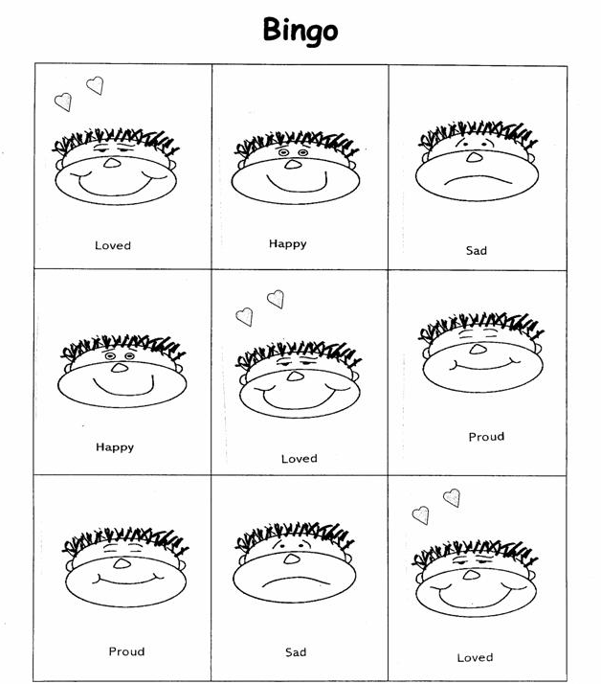
Sample Game
Notes:
How can you use this?

Slide 29
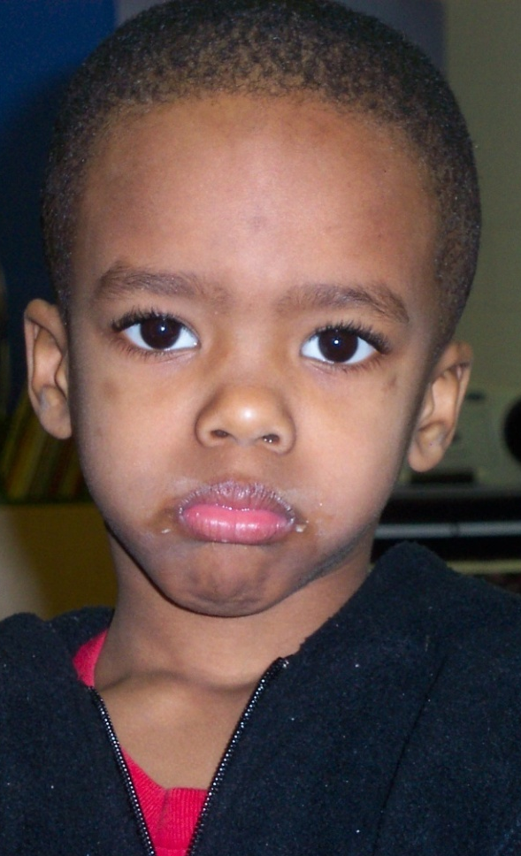
Play: How Would You Feel If?
Discuss typical situations that happen when children are together: “How would you feel if this happened to you?”
  Ex.: Jeremy wanted to play ball with Katie and Wu-ying today, but they wouldn’t let him. How do you think that made him feel? How do you think you would feel if that happened to you? What could Jeremy try next time?
Notes:
Play “How Would You Feel If?” – Have children role play typical situations that happen when they are together and then talk about “how would you feel if this happened to you?” Use the example on the slide.

Slide 30
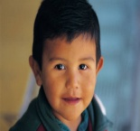


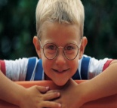

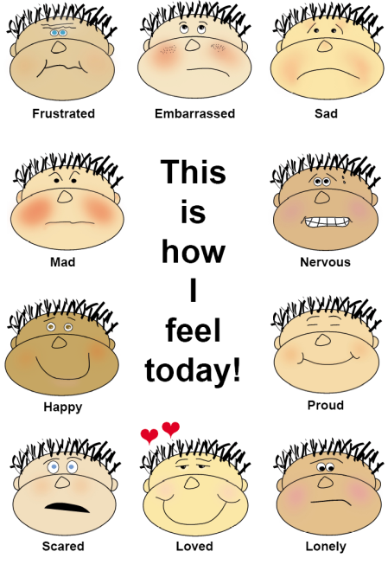

Checking In
How do you feel today?
Teachers and children can “check in” each morning by choosing a feeling face that best describes their affective state and putting it next to their name. Children can be encouraged to change their feeling faces throughout the day as their feelings change.
Notes:
Checking In –Children can “check in” each morning by putting their name by a feeling face picture that best depicts their affective state. Children can be encouraged to change their feeling faces throughout the day as their feelings change. Adults should also participate by putting their name by a feeling face and changing it throughout the day. They can talk about how their feelings change as they change their feeling face to help children understand that feelings can change many times during the day.

Slide 31
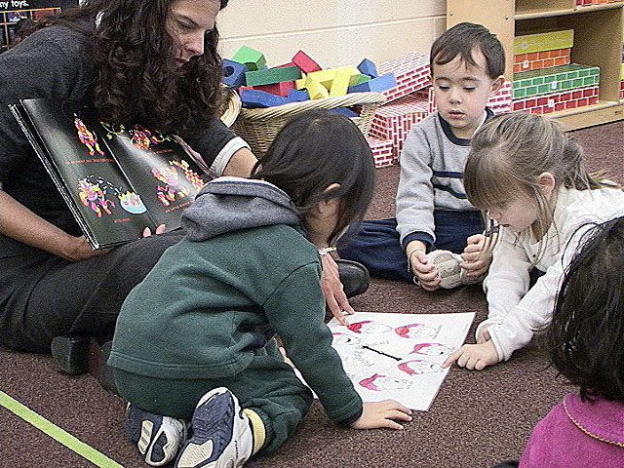
Feeling Dice/Feeling Wheel
Notes:
Feeling Dice and Feeling Wheel
Make a Feeling Wheel with a spinner that children can spin and then label the feeling face that the spinner lands on and talk
about a time they felt that way. Share with participants that the Feeling Wheel can be downloaded from the CSEFEL web site.
b. Make Feeling Dice by covering milk cartons with paper and drawing different feeling faces on each side. Children can toss dice; label the feeling face and describe a time they felt that way.

Slide 32
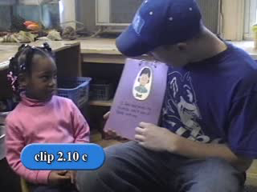
Emotional Literacy Activities
Notes:
Video Clip PS 2.10c shows an example of using a book to discuss emotions.

Slide 33
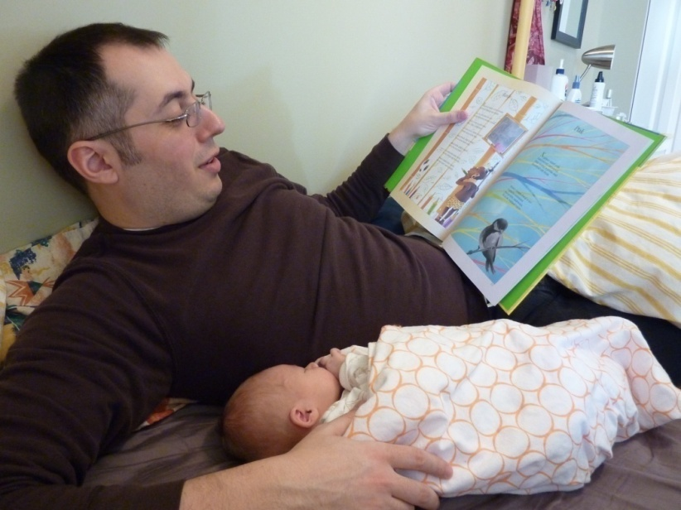
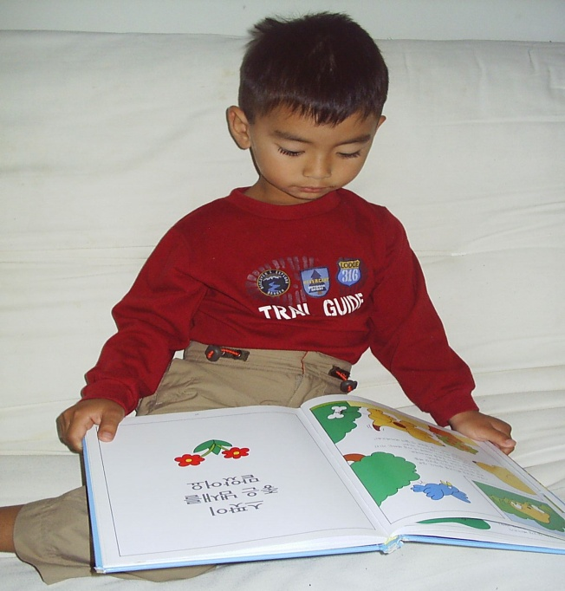
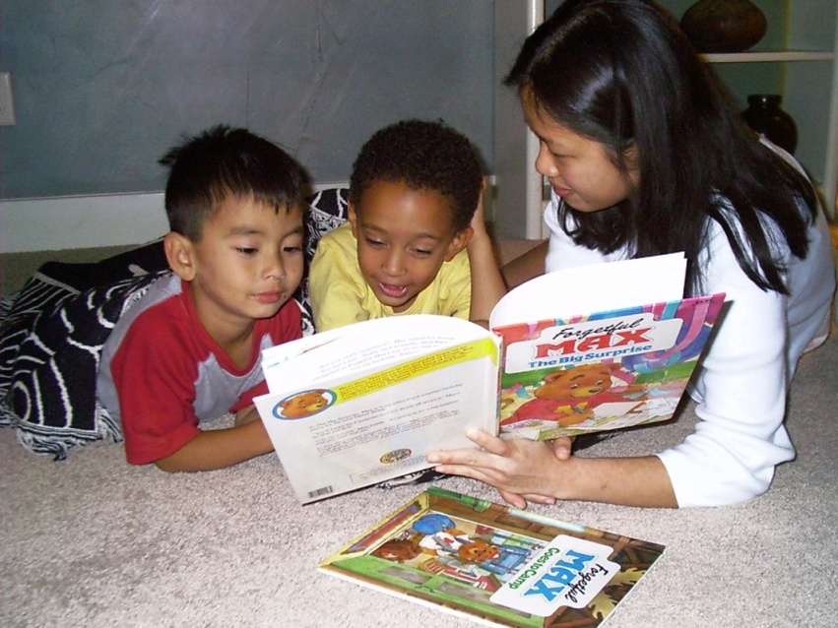
D. Use of Children’s Literature
Notes:
Books are a great and engaging way to teach about emotions. Many books are written explicitly about feelings and contain numerous feeling words. Most of us already have books in our settings – so this is an easy and fun way to be more “intentional” about supporting children’s social emotional development.

Slide 34
Book Example
On Monday When it Rained
by Cherryl Kachenmeister
Disappointed
Embarrassed
Proud
Scared
Angry
Excited
Lonely
Notes:
Read the book On Monday When it Rained by Cherryl Kachenmeister to participants as an example of a social emotional book. This book is about a little boy and the things that happen to him during the week. It is a good example of using literature to promote emotional literacy because of the little boy’s clear facial expressions as well as the range of feeling words (disappointed, embarrassed, proud, scared, angry, excited, lonely) presented in the book.
DEPENDING on the amount of time you have – you may want to just read a few pages of the book.

Slide 35
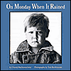
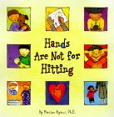
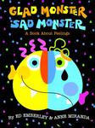
Book Nooks – Handout PS 2.4 http://www.csefel.uiuc.edu/practical-ideas.html
On Monday When
it Rained
Glad Monster
Sad Monster
Hands Are Not for Hitting
2.4
Notes:
Now introduce the Book Nooks example for On Monday When it Rained (Handout PS 2.4). The Book Nooks give examples of activities to expand on social emotional concepts while reading the book during story time. A different concept from the book, with related center activities, is focused on each day of the week. Point out that reading the same book for several days is a great way to support children’s social emotional development. Children learn the story, they can re-tell the story, and it becomes their story! They feel successful, confident and competent!
Give participants a few minutes to look at the Book Nook.

Slide 36
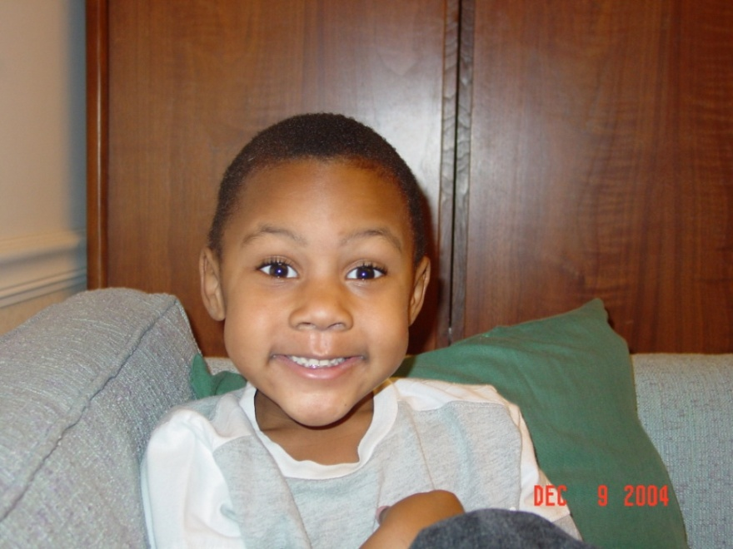
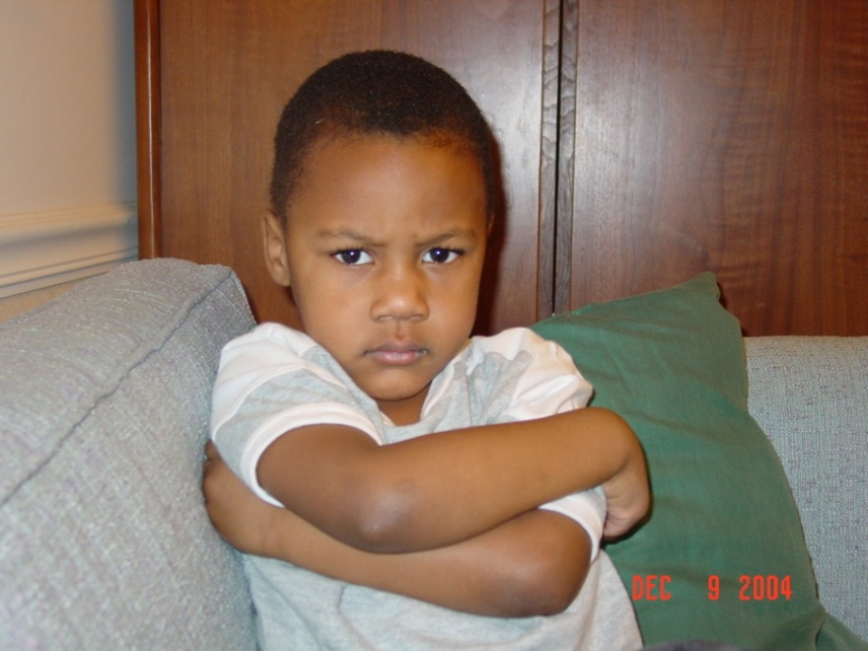
On Monday When It Rained
Book Nook Activity Example
“I feel excited when I get to go to my friend Coby’s house to play.”
“I feel upset when my mommy didn’t get me anything.”
36
Notes:
An example of one of the suggested activities listed on the Book Nook. The suggested activity is to take pictures of children in the classroom or home care setting that shows the children making feeling faces and then explaining a time when they felt that way.
More Book Nooks can be found on the CSEFEL web site.

Slide 37
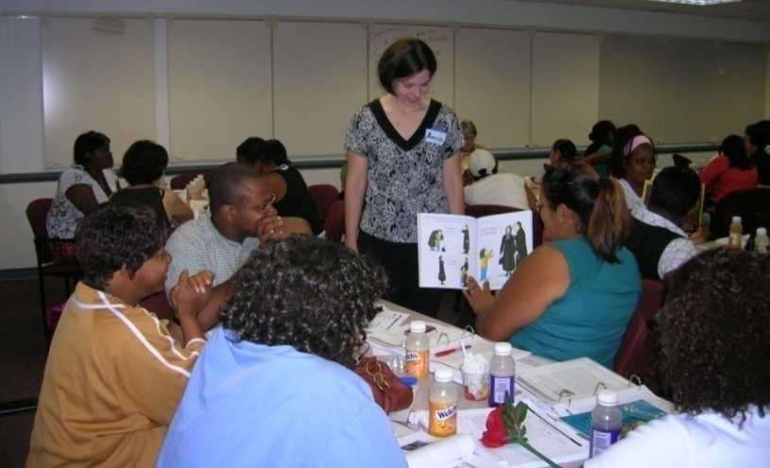
Discussion: Children’s Literature
1. Break into small groups
2. How would you use this book to
support social emotional development during large group/story time?
3. How would you plan for activities to support the skills presented in this story?
Notes:
BRING books for ages B – 5 for this activity. Tell participants that we are now going to practice using books to support social emotional development by doing a fun book activity. Have participants get into Small groups of 3 – 4 people. Give each group one book. One member will read the book to the group and then the group will answer the questions listed on the slide. Ask participants to choose a reporter to report back to the large group.
(Note to Trainer: If you do not have enough books for each group to have a different book – ask participants to bring a social emotional book with them to the training).
Tell participants that they can download a Book List of examples of books that support social emotional development on the CSEFEL web site.

Slide 38
        Characteristics That
        Foster Emotional Literacy
  Books about feelings are read and available in story center
  Photos of people with various emotional expressions are displayed
  Adults label their own feelings
  Adults notice and label children’s feelings
  Activities are planned to teach and reinforce emotional literacy
  Children are reinforced for using feeling words
  Efforts occur daily
Notes:
This slide lists several characteristics we see in a family group home or classroom when the adults purposefully promote emotional literacy.

Slide 39
Children with a Strong Foundation in Emotional Literacy:
Tolerate frustration better
Get into fewer fights
Engage in less destructive behavior
Are healthier
Are less lonely
Are less impulsive
Are more focused
Have greater academic achievement
Notes:
Let’s discuss some of the things we know about children who have a strong foundation in emotional literacy. Children who don’t learn to use emotional language have a hard time labeling and understanding their own feelings as well as accurately identifying how others feel.

Slide 40
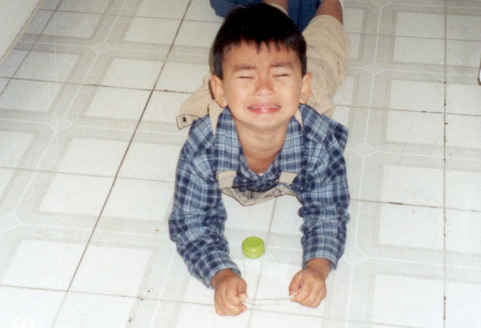
Emotion Regulation and Problem Solving for ages 2 ½ - 5
Notes:
Let’s move into another section on emotion regulation and problem solving.

Slide 41
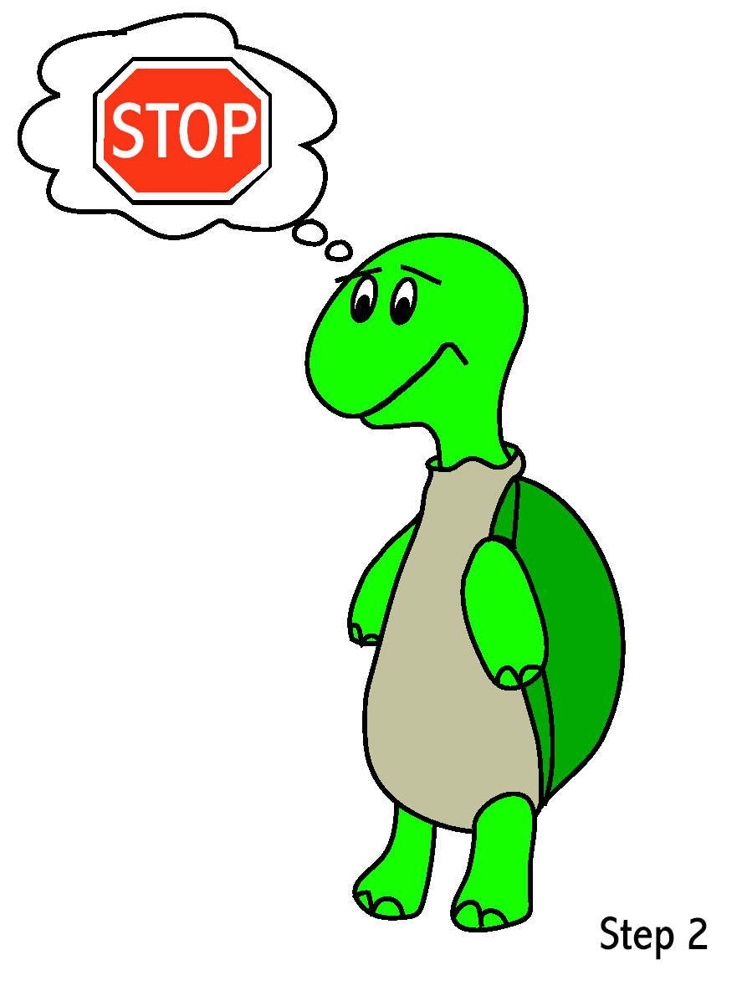
Managing Anger and Impulse
Recognizing that anger can interfere with problem solving
Learning how to recognize anger in oneself and others
Learning how to calm down
Understanding appropriate ways to express anger
41
Notes:
Describe how anger can interfere with thinking. Children need to learn how to recognize anger in themselves and others and understand appropriate ways to express anger. We just talked about several ways for children to learn to recognize anger (list ideas from above). We are now going to talk about some ways to teach children how to handle anger. It is important to teach young children effective ways to control their anger and impulse in conflict situations because:
a. Aggression and inadequate impulse control are perhaps the most potent obstacles to effective problem solving and successful relationships in childhood.
b. Aggressive children are more likely to experience peer rejection and continued social problems for years afterwards.
c. Evidence also suggests that aggressive children are more likely to misinterpret another peer’s or person’s intentions as hostile or threatening.

Slide 42
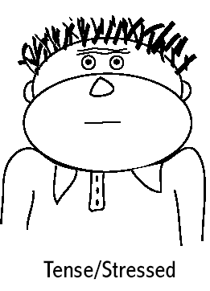
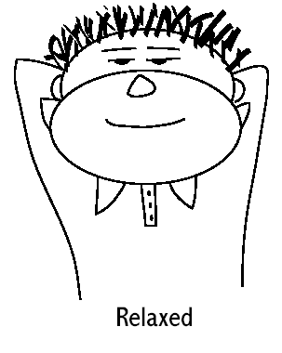
Emotion Regulation
Teach children how to “calm down”
3 deep breaths, blow out the candles
Webster-Stratton, 1990
Notes:
Present two feeling words that we don’t typically teach young children but that are very powerful. Those are “tense” or “stressed” and “calm” or “relaxed.”
1. Young children are often told to “calm down” but are not aware of what this means. First, they need to be taught the distinction between “tense” (like a tin man) and “calm” (relaxed – like a Raggedy Ann doll) (Webster- Stratton, 1990). Then describe how you get children from tense to relaxed. One way is by taking three deep breaths. Emphasize that these need to be very deep belly breaths (like you are blowing out birthday cake candles).

Slide 43
Relaxation Thermometer
Code words:
Chill out,
cool down
Code red,
hot engine
Take 3 deep breaths…1..2..3
Adapted from Incredible Years Dinosaur School
Notes:
The relaxation thermometer is used to teach children to calm down using the following steps:
a. Children can decorate their relaxation thermometer with pictures of feeling faces from “happy” and “relaxed” in the blue (or cool) section of the thermometer—all the way up to “angry” or “stressed out” in the red (or hot) section of the thermometer.
b. The adult can then ask children to describe a recent conflict and together with the child retrace the steps that led to the angry outburst. The adult writes down the child’s actions, thoughts, and words that indicated an escalating anger pattern (e.g., thinking “He always takes my toys,” yelling, kicking).
c. Then the adult discusses with the child the thoughts, words, and actions that the child can use to reduce his or her anger.
d. As adults retrace the steps of the angry outburst, they help the children identify the place where they were aware they were getting angry. This place is marked as the “Danger Point” on the thermometer. Once children have established their danger points, they give it their own name (e.g., chill out, cool down, code red, hot engine, etc.). This code word can be the adult and child’s signal that anger or stress has reached the threshold, which triggers the use of an agreed upon calming strategy, such as taking three deep breaths.

Slide 44
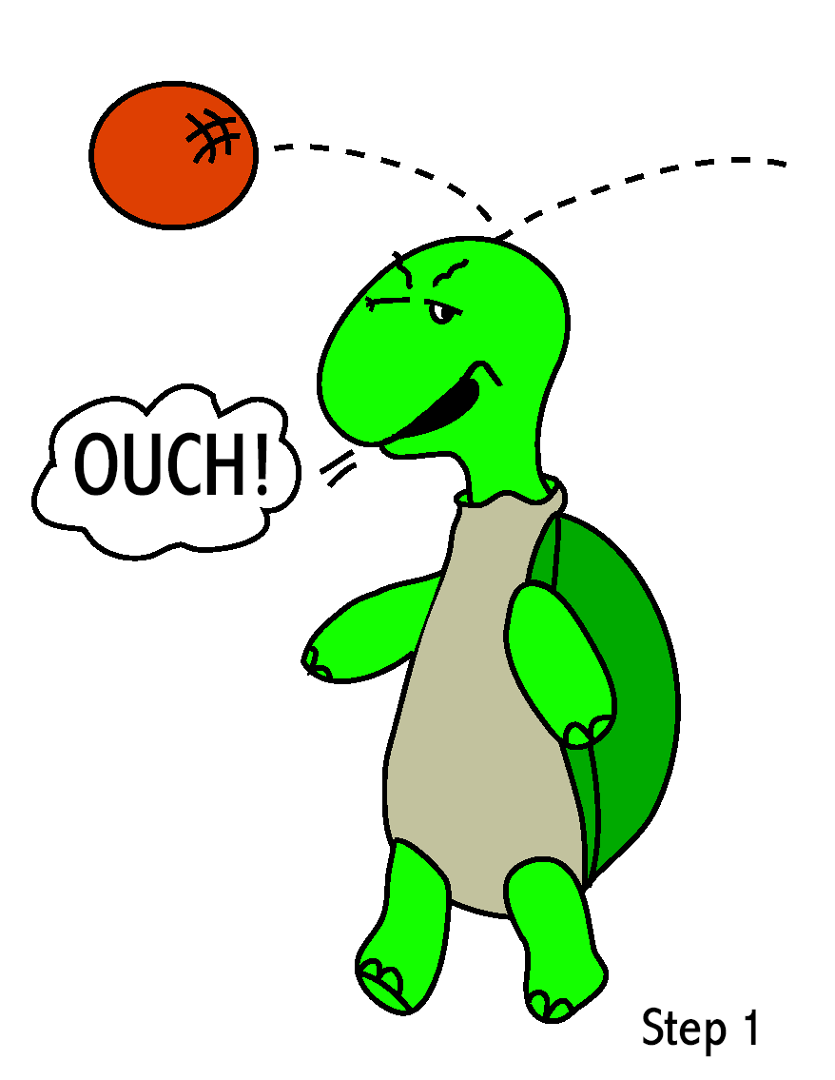
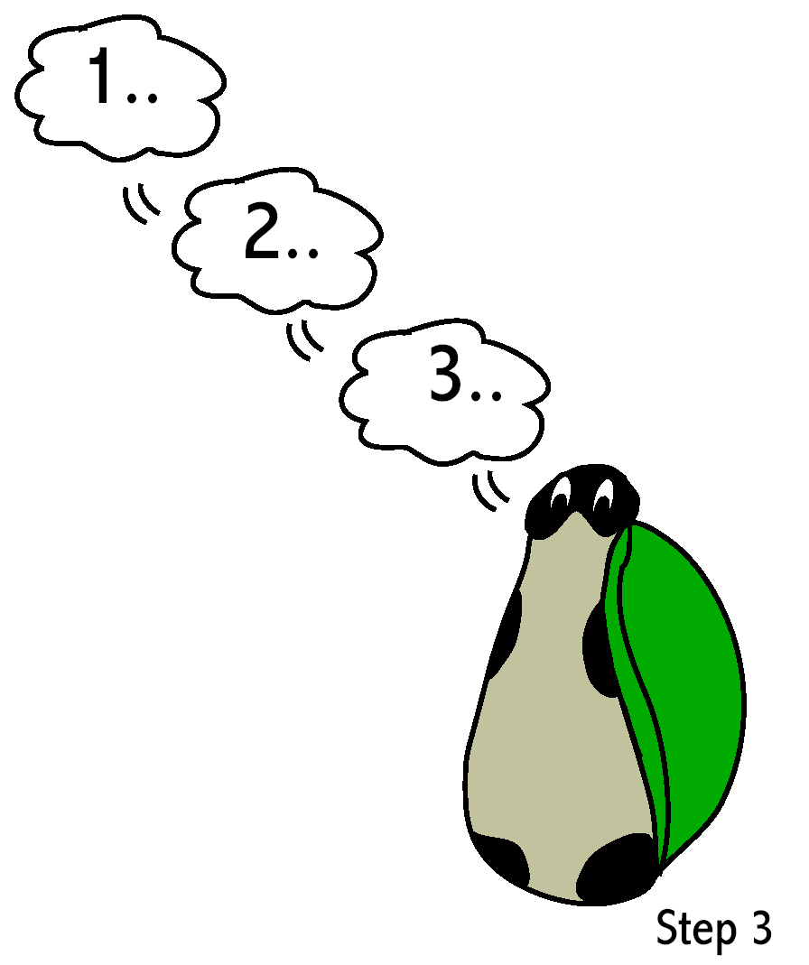

Turtle Technique
Recognize
that you
feel angry.
“Think”
Stop.
Go into shell. Take 3 deep breathes. And think calm, coping thoughts.
Come out of shell when calm and think of a solution.
Notes:
Describe how to teach children to recognize anger in themselves.
a. Ask participants how they feel physically when they are upset or angry.
b. Point out that children feel anger in different ways—just as we do.
2. Describe the “turtle technique.” The turtle technique was originally developed to teach adults anger management skills and later was successfully adapted for school-age children (Schneider, 1974). Since then, the turtle technique has been adapted and integrated into social skills programs for preschoolers (Kusche & Greenberg, 1994, Webster- Stratton, 1990). Let’s go through the basic steps of the turtle technique:
a. Recognize that you feel angry.
b. Think “stop.”
c. Go into your “shell,” taking three deep breaths, and thinking calming, coping thoughts: “It was an accident. I can calm down and think of good solutions. I am a good problem solver.”
d. Come out of your “shell” when calm and thinking of some solutions to the problem.
3. In essence, the turtle technique seeks to help children learn to replace aggressive acts with a more effective and efficient behavioral alternative.

Slide 45
Tucker Turtle Takes Time to Tuck and Think
A scripted story to assist with teaching the “Turtle Technique”
By Rochelle Lentini March 2005
Created using pictures from Microsoft Clipart® and Webster-Stratton, C. (1991). The teachers and children videotape series: Dina dinosaur school. Seattle, WA: The Incredible Years.
Notes:
This book can be printed out and given to participants. Or you can encourage them to go to the website and print it out. It is very helpful for participants when you have a copy of the book that you can show them.
4. Teaching the turtle technique to young children can happen at large and small group times. A turtle puppet is helpful and keeps children engaged during the lesson.
a. The teacher can begin by introducing the turtle to the class. After the children get a chance to say hello and perhaps give a gentle pet, the teacher shares the turtle’s special trick for calming down.
b. The turtle describes a time he got upset in preschool (selecting an incident familiar to the children is best). He demonstrates how he thinks to himself, “STOP,” then goes into his shell and takes three deep breaths; After he takes three deep breaths, he thinks to himself, “I can calm down and think of some solutions to solve my problem.” At this point in the process, the turtle technique is used to demonstrate that when he is calm, he comes out of his shell and is ready to problem solve peacefully.
c. To create a sufficient level of practice, the teacher can then invite the children to practice the turtle’s secret. For example, children can practice “going in their shells” as they go under a large sheet and take three deep breaths or an individual child can model the “turtle technique” in front of the class. Practice in small group activities can include making paper plate turtles with moveable heads and arms that “go in their shell.” Children can then rehearse the steps with the paper-plate turtle.
Tell participants that there is a turtle pattern on the CSEFEL web site that can be used to make paper plate turtles.

Slide 46
Tucker Turtle is a terrific turtle. He likes to play with his friends at Wet Lake School.

Slide 47
But sometimes things happen that can make Tucker really mad.

Slide 48
When Tucker got mad, he used to hit, kick, or yell at his friends. His friends would get mad or upset when he hit, kicked, or yelled at them.

Slide 49

Tucker now knows a new way to “think like a turtle” when he gets mad.

Slide 50

He can stop and keep his hands, body, and yelling to himself!
STOP

Slide 51

He can tuck inside his shell and take 3 deep breaths to calm down.

Slide 52

Tucker can then think of a solution or a way to make it better.

Slide 53
Tucker’s friends are happy when he plays nicely and keeps his body to himself. Friends also like it when Tucker uses nice words or has a teacher help him when he is upset.

Slide 54

Problem Solving
Preschool-age children can effectively be taught problem-solving skills
(Shure & Spivack, 1980, 1982;
Webster-Stratton & Hammond, 1997).
Notes:
1. When presented with interpersonal problem situations, some children, or all young children in some situations, find it difficult to think of alternative responses. We want children to learn problem solving steps, to be able to think of alternative solutions, and to learn that solutions have consequences.
2. Preschool-age children can effectively be taught problem-solving skills (Shure & Spivack, 1980, 1982; Webster-Stratton & Hammond, 1997).

Slide 55




Problem Solving Steps
Step 2
Would it be safe?
Would it be fair?
How would everyone feel?
Notes:
4. Present the problem-solving steps as an example of a problem solving process with fewer steps. There are four essential problem-solving steps for young children to learn and act on. Briefly review the steps and use the notes below to expand.
a. What is my problem? Children should be taught to pay attention to their feelings as a first step in problem solving. When children are experiencing a negative emotion (e.g., anger or frustration), this feeling is the cue that they have a problem.
This is why teaching young children an emotional vocabulary is an essential prerequisite skill to being an effective problem solver (see Joseph & Strain, 2003; Webster-Stratton, 1999).
b. After children recognize that they have a problem, they next need to describe the problem. Adults and/or puppets can model the problem for children. Children can practice by looking at cards depicting a problem and describing what the problem is. Initially, children will need guidance to reframe defining the problem as the other person’s problem (“They won’t let me play.”) to
their problem (“I want to play with them.”). This reframing, although subtle, will help children generate more appropriate solutions.

Slide 56
Help the Child Think of a Possible Solution:
Get a teacher
Ask nicely
Ignore
Play
Say, “Please stop.”
Say, “Please.”
Share
Trade toys/item
Wait and take turns
Notes:
This is a list of typical solutions for young children.

Slide 57


The Solution Kit
Notes:
This kit can be printed off of the CSEFEL website
Solution Kit. What are some solutions? Young children need help generating multiple alternative solutions to interpersonal problems. A lot of time should be spent directly teaching children alternative solutions to common problems and having
children generate solutions independently. At this point in the instructional process, the key is to teach children to generate as many solutions as they can think of rather than thinking of a solution that will work best. Describe how young children
need to spend time learning to generate alternative solutions.

Slide 58


Problem Solving
Learning problem solving steps
Thinking of alternative solutions
Learning that solutions have consequences
Learning to evaluate solutions - *Is it safe? *Is it fair? *Will it create good feelings?
5. What to do when a solution doesn’t work
TALKING
FEET
Notes:
1. What would happen next? After children have experienced generating multiple alternative solutions to problems, they can begin to evaluate consequences. This strategy can be communicated to children in terms of “What would happen next?” Three questions can guide a child’s decision to determine if the consequences would be good or bad: • Is the solution safe? • Is the solution fair?
• How would everyone feel?
2. Understanding consequences can best be taught to children through role-plays. Children can generate a solution to a problem and then act it out with a puppet. The teacher can then prompt the child to think: Did anyone get hurt? Was it fair? How did
you feel? How did the other person feel?
3. Give it a try! At this step, children are taught to act on the best solution that they generated. They are also taught what to do when a solution doesn’t work. When a prosocial solution doesn’t work, children can draw upon the other solutions they generated earlier that they believe will have positive consequences.

Slide 59
Problem-Solving Activities
Problematize everything
  “We have 6 kids at the snack table and only one apple. We have a problem. Does anyone have a solution?”
Play “What would you do if…?”
Children make their own “solution kits”
Children offer solutions to problems that occur in children’s stories
Notes:
1. Adults can “planfully sabotage” or “problematize” activities throughout the day and encourage children to generate solutions. For example, the teacher can bring one apple to the table for snack and say, “Oh my goodness! We have a problem.
There is only one apple and five kids—what can we do?” The teacher can then encourage the children to generate as many different solutions as possible.
2. Adults can play “What would you do” with children. To play, the teacher thinks of and writes down several problems on slips of paper. These slips are then put in a bag and passed around the circle until the music stops. The child who is holding the bag
when the music stops, selects a problem that an adult can read for the child. The child can then think of as many solutions as possible. He or she may even consult the “Solution Kit” if necessary.
3. Children can make their own solution kits by drawing different solutions to problems they have had. Some children may want to color pre-drawn solution cards.
4. Adults can select children’s books that feature characters who are having some kind of problem. The teacher can pause when reading and ask children to generate solutions to the problem. Then, as the teacher continues reading and the children learn how the character solved the problem, they can determine if it is a good or bad solution. Children can also create their own story (written by the teacher), where a character in the story has a problem and comes up with solutions to solve the problem.

Slide 60

Supporting Young Children with Problem-Solving in the Moment
Anticipate problems
Seek proximity
Support
Encourage
Promote
Notes:
Adult caregivers can keep in mind the following five steps as they assist young children in the problem-solving process:
1. Anticipate problems.
a. Expect problem situations to arise in your classroom. When over a dozen children are in a room with few adults and limited materials, it is natural for problems to occur.
b. There will also be certain situations when the teacher can predict that there will more likely be a problem. For example, there is a new dinosaur toy in the block corner, and the teacher anticipates many children will want to play with it. Or the teacher notices that a boy in her class has a scowl on his face when he gets off the bus—which last time meant a very troublesome day.
c. When teachers anticipate problems, they are available to support children when a problem occurs.
2. Seek proximity.
a. When a teacher is aware that a problem may ensue, seeking proximity is key.
b. This strategy is not necessarily to prevent the problem from occurring, but to ensure that the teacher is close enough to begin prompting a child through the problem-solving steps.
c. When the teacher notices a child getting agitated and upset, she can cue the child to “calm down” by remembering the Turtle Technique (see Joseph & Strain, 2003).
d. Once a child is calm and the teacher is in proximity to support, the child will be ready to problem solve.
3. Support.
a. Young children will need support from the teacher to remember the problem-solving steps and to stay in the situation.
b. Children who feel they are not skilled at problem solving will be prone to flee the situation.
c. So, sometimes support means keeping the child physically in proximity to the other child or children involved.
d. Support also means prompting the child through the problem-solving steps. This prompting can be done with the added support of visuals depicting the problem-solving steps. These visuals can be placed strategically around the room to remind children of the steps when an adult is not available.
4. Encourage.
a. It is almost a certainty that even good solutions don’t work all of the time. So, children need to be encouraged to keep trying at generating alternative solutions.
b. When children cannot think of any more solutions, they can be prompted to look through a “solution kit.” The solution kit provides children with picture cues of various solutions to interpersonal problems. Show examples of some solution cards. Cards are available on the CSEFEL Web site at csefel.uiuc.edu/practical-ideas.html.
c. Children will need support to remain in the situation and to keep trying in the face of adversity. After each try, it is essential that an adult acknowledge a child’s efforts (“Wow! You have thought of two really good solutions! I know you have some other ideas.”) and encourage them to go on (“Boy, this is a tough problem, and you have thought of so many good solutions. You are such an amazing problem solver. What else can you think of?”).
5. Promote.
a. The last task to supporting a child’s “in the moment” problem-solving efforts is to reinforce the child’s success. This kind of promotion can be done in informal and formal ways.
b. Informally, teachers can give children high-fives, thumbs-up, a wink, verbal acknowledgement of positive behavior, hugs, and so on.
c. Formally, teachers can plan mini-celebrations when a child has done a great job of problem solving. These mini-celebrations send a clear message to all of the children in the class that peaceful persistence at problem solving is valued.
d. It is not long after a teacher focuses on promoting problem solving before you see children supporting, encouraging, and promoting each other’s efforts.

Slide 61

Pulling it all Together!
Notes:
Pulling it all together
Now we have come to the conclusion of our face-to-face training together.
Let’s take a moment to reflect on a few key take home thoughts.

Slide 62
Major Messages to Take Home
Caregivers help children express emotion; develop emotional regulation; and form close, secure relationships
It is important to be intentional about supporting the social emotional competence of children
Notes:
Major Messages to Take Home:
Read each message and remind participants of the importance of their role in making this happen!
Caregivers help children express emotion; develop emotional regulation; and form close, secure relationships.
It is important to be intentional about supporting the social emotional competence of children.

Slide 63
Major Messages to Take Home
In order to support the social emotional wellness of young children, as well as their families, we need to be aware of our own emotional history.
Social emotional literacy is a prerequisite to the development of more advanced social skills and for the continued maturation of emotional self- regulation
Notes:
Major Messages to Take Home.
Review each message.
Ask participants if they have others to add.
In order to support the social emotional wellness of young children, as well as their families, we need to be aware of our own emotional history.
It is important to be intentional about supporting the social emotional competence of children
Social emotional literacy is a prerequisite to the development of more advanced social skills and for the continued maturation of emotional self- regulation.

Slide 64

    If there is anything that we wish to change in the child, we should first examine it and see whether it is not something that could better be changed in ourselves.
    Carl Jung – psychiatrist
Notes:
It is often easier to change our behavior or our environments than it is to change the child.

Slide 65



Be the change you wish to see in the world.
Mahatma Ghandi
Review your Personal Action Plan
Notes:
Action Planning Activity.
Have participants complete their Action Plan Form, filling in the grid with ideas of changes they want to make in their early childhood settings as a result of today’s session, as well as methods for evaluating their progress in making these changes.
Ask if anyone is willing to share some ideas that they hope to implement “back home.” Encourage a few participants to share ideas gleaned from today’s session.

Slide 66
Resources
Childcare and Youth Training and Technical Assistance project: http://www.extension.unl.edu/web/child/cyttap
Better Kid Care: http://betterkidcare.psu.edu/
CSEFEL : http://csefel.vanderbilt.edu/
Notes:
Review each of the resources and if time permits visit the corresponding website.
Be sure to point out the following key characteristics of each resource:
CYTTAP website: Visit website, click on Rock Solid Foundations Link. Additional training resources available as well as information on the project.
BKC: visit website to show how to sign up for the newsletter as well as how to access the online learning modules and resources that have been developed.
CSEFEL: Again explain how this training selected pieces of the more comprehensive program of CSEFEL. Therefore if they would like additional resources, materials, information and strategies they can visit the CSEFEL website.

Slide 67
Evaluation
Notes:
Evaluation: Thank participants again for their time and ask them to complete the evaluation form. However there is an option to complete the evaluation online. Link will be provided. Details about the evaluation procedures will be outlined and can be accessed on the CYTTAP website under instructor resources/Rock Solid Foundations. (If credits or certificates are available do not provide until evaluation is submitted. Same applies for the “incentive” item we provide).

Slide 68

¡Gracias!
Thanks
beaucoup
شكرا
Notes:
Express your gratitude in having the opportunity to share with them the CSEFEL resources and strategies.
Remind participants as stated at the beginning of the presentation that this training is the beginning of ongoing support and resources.
Explain that the CYTTAP team will be offering trainings for the next two years and look out for future training opportunities.

