Slide 1



Click 2 Science http://click2sciencepd.org/
Notes:
Quick Introduction (5-10 min)
Click2Science is an interactive, professional development site for trainers, coaches, site directors and frontline staff/volunteers working in out-of-school time interested in STEM programs, serving children and youth. Today, we’re going to learn about the Click 2 Science professional development resources, the 20 skills that makes STEM click and do some activities that teach about STEM and demonstrate what Click2Science is all about.
We will introduce you to Click2SciencePD. We will be covering 4 of the 20 areas – Embracing Active STEM Learning, Encouraging Collaborative STEM Work, Reflecting and Processing STEM Experiences, and Making Connections to STEM Careers
Purpose: Afterschool staff and volunteers will be able to identify skills needed for Active STEM learning and their role in developing an active learning environment.

Slide 2
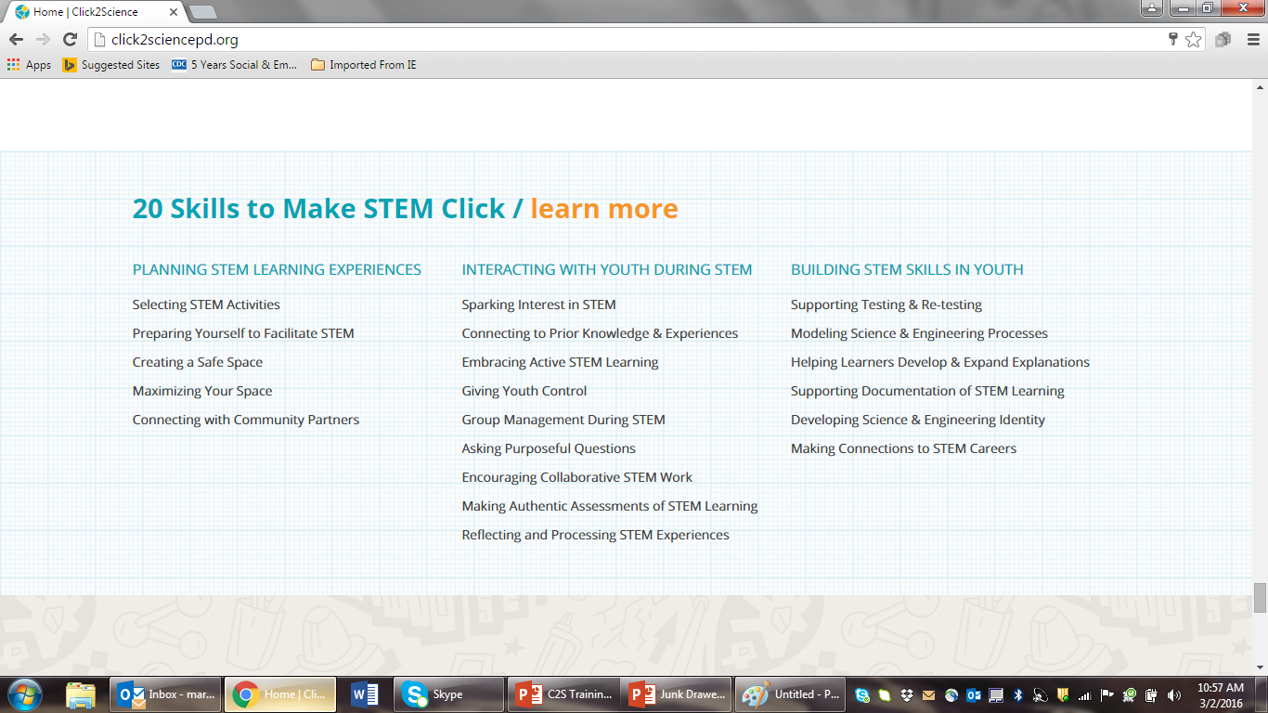
Notes:
These are the three categories of skills. What we will be teaching will fall under these skills – interacting with youth and building STEM skills.
*Handout - 20 Skills to Make STEM Click

Slide 3
Agenda
Embracing Active STEM Learning
  Developing an Active STEM Learning
  Environment - 1
Encouraging Collaborative STEM Work
  Teaming Up for Success
Reflecting and Processing STEM Experiences
  Discovering Skills - 2
Making Connections to STEM Careers
  STEM Careers Rock
Notes:
Review the slide.

Slide 4
Purpose: To foster curiosity and create active STEM Learning experiences.
Outcomes for Staff:
  Recognize expressions of curiosity and sense making and utilize them to enhance STEM learning experiences
  Facilitate inquiry learning experiences that allow youth to be creative and curious as they explore phenomena in meaningful ways
  Facilitate individual and group discussions that result in learners connecting ideas and generating their own understanding
Notes:
Purpose: To foster curiosity and create active STEM Learning experiences that engage youth.
Outcome: Staff will learn to:
Recognize expressions of curiosity and sense making and utilize them to enhance STEM learning experiences
Facilitate inquiry learning experiences that allow youth to be creative and curious as they explore phenomena in meaningful ways
Facilitate individual and group discussions that result in learners connecting ideas and generating their own understanding

Slide 5
Activity
Complete
Embracing Active STEM Learning Self-Reflection
Notes:
*Handout – Embracing Active STEM Learning Self-reflection
Complete this handout and keep handy to use after each mini-session.

Slide 6
On your Index Card, write …
What Active STEM Learning means to you
One thing you would like to learn today
One question you have about Active STEM Learning
Notes:
To introduce ourselves we are going to do two things
On the index card that is on your table, write:
What Active STEM Learning means to you
One thing you would like to learn today
One question you have about Active STEM Learning.
Save your index card to use in the next activity and at the end of today’s session.

Slide 7
Developing An Active STEM Learning Environment-1
Notes:
What is STEM??
For a few minutes now, I want you to think of yourself as frontline staff at a staff meeting. We are going to model incorporating Click2Science PD into a regular meeting. And we’re going to work on improving how well we embrace active STEM learning.
In order for youth to feel comfortable using their creativity, curiosity and imagination, we must endeavor to create an active STEM learning environment. Staff and volunteers can do this by focusing on the skills necessary to engage learners.

Slide 8
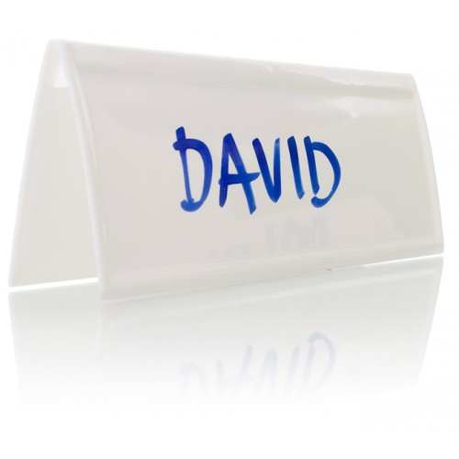
Your Name
A favorite childhood activity with an important adult
Notes:
Fold a piece of paper into 3 sections to make a “ name tent”—please write your name on one side and on the other write about a favorite activity you did with an important adult in your life as a child—what did you do and who did you do it with?
Share your name and favorite childhood activity with others at your table.

Slide 9
Childhood Activity
Why do you think this memory was special to you?
What was it about the activity you liked so much?
What did the adult do that made this memory special to you?
Notes:
Ask questions from the slide.
Thank you all for sharing these important childhood memories. It’s important for us to realize how adults in our lives supported our curiosity and learning and how we can do the same for the children in our care each day.
Today we are going to explore more about Active STEM Learning and how as adults in children’s lives you can help create memories for them – just like the ones you shared here – and in the process also promote learning!

Slide 10
Know
What I know about this topic
What
What I want to know
Learn
What I have learned
Next Steps
What my next steps will be
Notes:
*Handouts – KWLN Active Learning Chart, KWLN Active Learning Blank Chart
Review the KWLN Active Learning Chart. We are now going to create our own KWLN chart that may help you think about Active STEM Learning and the skills adults use to promote active learning with children.
This activity is commonly used to help organize children’s ideas around topics to explore in the classroom.
Using what you put on your index card earlier about What Active STEM Learning means to you, fill in something you KNOW about Active STEM learning under the “K” on each of your individual KWLN charts and then share with everyone at your table.

Slide 11
Questions
What types of materials are used for Active STEM Learning?
What considerations should be made in regard to time and space?
What do children’s expressions and questions tell the adult about whether or not they are interested in the materials?
How might adults support children’s inquiry and/or creativity, imagination and curiosity?
Notes:
Use the following questions to guide the discussion about Active STEM Learning (K):
What types of materials are used for Active STEM Learning?
What considerations should be made in regard to time and space?
What do children’s expressions and questions tell the adult about whether or not they are interested in the materials?
How might adults support children’s inquiry and/or creativity, imagination and curiosity?

Slide 12
Know
What I know about this topic
What
What I want to know
Learn
What I have learned
Next Steps
What my next steps will be
Notes:
Now that you’ve had time to discuss the “K” column at your table, we’ll make a Whole Group KWLN chart to share different perspectives about Active STEM Learning. We’ll also use this to develop questions and to create individual goals at the end of the session.
Following the same process used to develop the “K” column, we’ll begin the “W” – or WHAT – column individually. Think of at least one question you have regarding Active STEM Learning, something you wonder about Active STEM Learning, or something you want to learn about Active STEM Learning.
Maybe this was a question you put on your index card earlier or another question you’ve thought of as we listed what we “Know” about Active STEM Learning.
(To further prompt—if needed) Also, consider the following:
What is the purpose of Active STEM Learning for children? For adults?
What does the classroom “need” for Active STEM Learning to take place?
What does Active STEM Learning look like?
What might the adult need to know/do for Active STEM learning to take place?

Slide 13
Seeing the Skill in Action
What strategies did the adults use to encourage active learning?
What are the children are saying or doing that indicates they are learning?
What does the space look like? How is this similar or different from the space you use?
What materials are used?
Notes:
Considering what you have put in the K and W columns as individuals and at your table, we will now view a short video of Active Stem Learning in action. We can always view the video more than one time, but if at any point in the video you would like me to pause it or have questions, please let me know.
The video will show adults working with youth to use simple machines to design a grape smasher. The focus of the design challenge is to explore and apply simple machines to solve a problem. Imagine that the adult and children have already filled in the K and W columns on their KWLN charts prior to the experience we are about to see. They would have probably added some predictions in their “W” column to explore as they experiment with simple machines.
The questions on this slide are for you to think about as the video is playing.
Please take notes on things that you notice—
What strategies did the adults use to encourage active learning?
What are the children are saying or doing that indicates they are learning?
What does the space look like? How is this similar or different from the space you use?
What materials are used?

Slide 14
Know
What I know about this topic
What
What I want to know
Learn
What I have learned
Next Steps
What my next steps will be
Notes:
Now that we’ve seen Active STEM Learning in action, please write one thing under the “L” of your individual chart to note what you LEARNED. Share this with your table and then we will share as a Whole Group.

Slide 15
Know
What I know about this topic
What
What I want to know
Learn
What I have learned
Next Steps
What my next steps will be
Notes:
To conclude this section of the agenda, we will review the Active STEM Learning skills we have discussed. This would be the “N” – for NEXT STEP – on the KWLN chart. In a classroom setting, we would gather the students together and review all parts of the chart and then decide what to put in the “N” column.
Keep this KWLN chart handy. We will use it again at the end of each mini session!
Please take out your Active Learning Self- Reflection. All the statements on the Self- Reflection relate to skills needed for Active STEM Learning. Review your reflection. For any items on which you circled a 1, 2, or 3, consider developing 1-3 goals and write them on the Active Learning Goal Setting Action Plan. Focus on this plan throughout the next few weeks.

Slide 16
Break
Take a ______ Minute break
Before we get into Encouraging Collaborative STEM Work

Slide 17
Teaming Up for Success
Notes:
Encouraging Collaborative STEM Work and interaction among peers is necessary in science and engineering learning experiences. Learn how to facilitate and support youth interaction as they engage in these experiences.

Slide 18
Purpose: To effectively collaborate and interact during STEM learning experiences.
Outcome: Staff will learn to:
  Describe the value of collaborative efforts in terms youth can understand and provide real world examples
  Portray science as a collaborative effort that involves groups of people working together to solve problems and build explanations of the natural world
  Facilitate STEM activities in which youth develop the skills to collaborate and cooperate effectively
Notes:
As a result of ongoing, consistent professional development efforts, frontline staff and volunteers will be able to:
Describe the value of collaborative efforts in terms youth can understand, and provide real world examples.
Portray science as a collaborative effort that involves groups of people working together to solve problems and build explanations of the natural world.
Facilitate STEM activities in which youth develop the skills to collaborate and cooperate effectively.
Review Slide

Slide 19
What does the word “collaboration” mean to you?
Tell about a time of positive collaboration you've experienced.
Notes:
What does the word collaboration mean to you? Cooperation is working with two or more people or organizations to realize shared goals.
Share experiences when you have had a positive collaboration.

Slide 20
DANGER IN THE OKEFENOKEE
Your team is stranded in the Okefenokee Swamp where a new species of people-eating alligator lives. You know that the gators will attack after dark (in 20 minutes) and that your team will only be safe if the entire team is 6 inches above the swamp floor. There are no trees or other structures to climb; you are surrounded by grass. The only supplies you have with you are 5 newspapers and several rolls of masking tape (go figure…).
The task: Build a structure that will support your entire team 6 inches off the ground for 10seconds (the time it takes the gators to get bored and walk away).
Notes:
READ the slide: You know that the gators will attack after dark (in 20 minutes) and that your team will only be safe if the entire team is 6 inches above the swamp floor. There are no trees or other structures to climb; you are surrounded by grass. The only supplies you have with you are 5 newspapers and several rolls of masking tape (go figure…).
Please count off by 4’s so that we can arrange ourselves into small groups of engineers.
Let’s spread out so that we have room to work.
Here’s the challenge for today! Would someone please read the instructions?
This challenge requires that you work together to build a device that will hold your whole team 6 inches off the ground for 10 seconds using only the newspapers you have and masking tape.
Here’s a hint for success: Everyone has to collaborate to be successful!
At the end of 20 minutes, each group will demonstrate their device. We’ll confirm that each group’s device is 6 inches off the ground by measuring, and we’ll count to 10 to make sure each device is off the ground for 10 seconds.
You have 20 minutes to engineer a device that will save you from the alligators. Let’s get started!

Slide 21
Share Back
Sharing your success
  Why was collaboration so important in this activity?
  What were some of the elements of collaboration?
Notes:
Let’s come back together and test the devices. We will go around the room and ask each group to demonstrate their success. Why was collaboration so important in this activity?
What were some of the elements of collaboration?

Slide 22
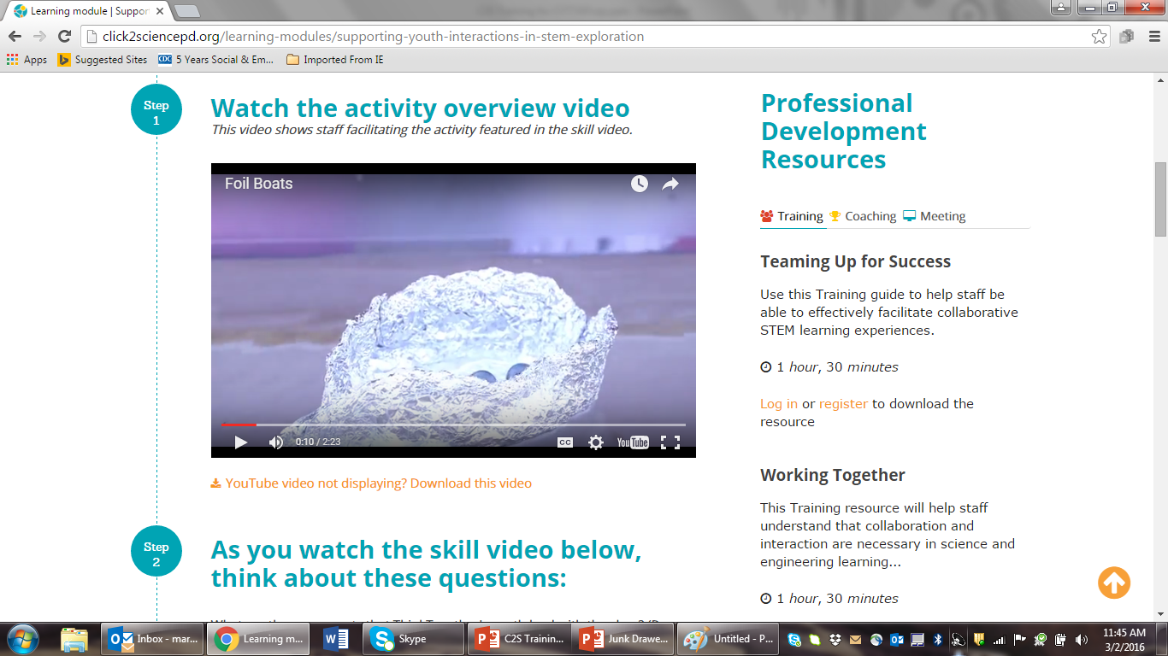
How does this set the stage for STEM activity?
What does Jason say that allows youth to feel comfortable collaborating and prepares youth to engage in STEM?
How does Jason encourage youth to voice ideas?
What strategy does the facilitator use to encourage cooperation?
How could you encourage collaboration differently?
What strategies to encourage collaboration could you use from the video?
Seeing the Skill in Action
Notes:
In real-world STEM, the stereotype of the mad scientist working alone in a lab just doesn’t exist. Real-world STEM requires real-world skills—like collaboration.
The ability to collaborate—to share and improve on each other’s ideas, to work together to solve problems, to create a shared vision, and to make the team’s goal central is essential.
It would have been very difficult, if it was possible at all, to get all of the team members off the ground without collaborating. By working together and by putting the team’s goal first, you were either successful or on your way to success.
When we go back to our sites and work with youth, what are strategies we can use that encourage collaboration in youth.
Look at the questions and be ready to discuss.

Slide 23
Know
What I know about this topic
What
What I want to know
Learn
What I have learned
Next
What are my next steps
Notes:
Using your KWLN Blank chart please complete each section as it relates teamwork and collaboration.
If time permits, share.

Slide 24
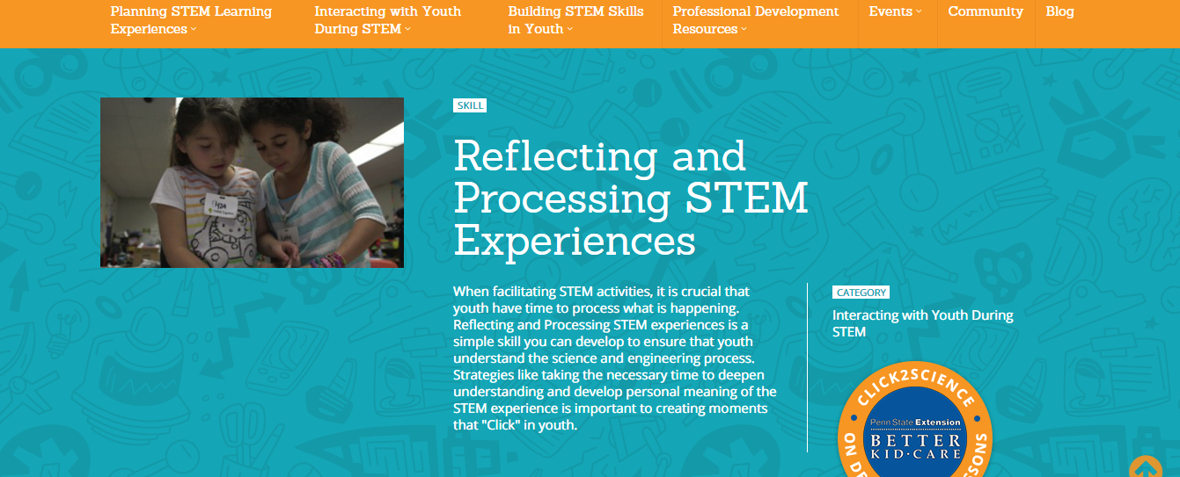
Discovering Skills 1 and 2
Notes:
Frontline staff and volunteers will deepen understanding and personal meaning for youth by facilitating opportunities for reflecting on and processing of STEM learning experiences.

Slide 25
Purpose: To deepen understanding for youth by encouraging reflection and processing of STEM learning experiences
Outcome: Staff will learn to:
  Develop strategies and questions that encourage youth to reflect on what they have learned and develop a personal understanding of STEM concepts
  Guide discussions that help youth make sense of what is happening during STEM activities and understand the science and engineering process skills being developed
Notes:
Purpose: To deepen understanding for youth by encouraging reflection and processing of STEM learning experiences.
Outcome: Staff will learn to
Outcome: Staff will learn to
Develop strategies and questions that encourage youth to reflect on what they have learned and develop a personal understanding of STEM concepts
Guide discussions that help youth make sense of what is happening during STEM activities and understand the science and engineering process skills being developed

Slide 26
REFLECTION
  What is reflection?
    Do you reflect in your setting (alone; with other colleagues; with children)?
    If you do reflect, what is one strategy you use to reflect? If you do not reflect, why?
Notes:
*Handout - Reflecting and Processing STEM Self-Reflection
Please take a few minutes to complete this activity Self-Reflection for Reflecting and Processing STEM experiences. We will be using this later in our session. Now let’s take a few minutes to discuss these questions.
I’d like to use the Chart Paper to take some notes on a few of the responses from the whole group. During this time, we’ll use the Chart Paper as a way to organize ourselves; to take note of how people are reflecting and to take note of problems people may be facing trying to reflect in their setting.
Throughout the training today, we’ll pause and review the chart to see if any of the experiences we have can help us identify solutions to issues or create ideas for new ways to incorporate reflection into our settings.

Slide 27

Notes:
What do you see in the image?
Did everyone see the same thing? If so, is there anything else you can find in the image?
An important aspect of reflecting and processing includes listening and understanding other people’s viewpoints. Often times, we have a better picture or deeper understanding of a situation when we hear what other people saw and how they interpreted the information.
If not, what did the other person see?

Slide 28
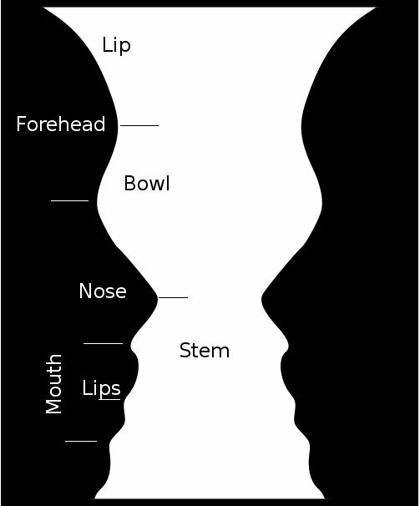
Notes:
An important aspect of reflecting and processing includes listening and understanding other people’s viewpoints. Often times, we have a better picture or deeper understanding of a situation when we hear what other people saw and how they interpreted the information.
Did you see any variations in the pictures? (Such as faces vs. vase)
Can I see a show of hands to see how many saw the faces? How about the vase?
Did anyone write more or less information than what is shown in this 2nd image?
What does this activity show us about the importance of reflecting (sharing information) with others?
(This activity is designed to show that each person’s perspective can bring something of value to the discussion.)

Slide 29
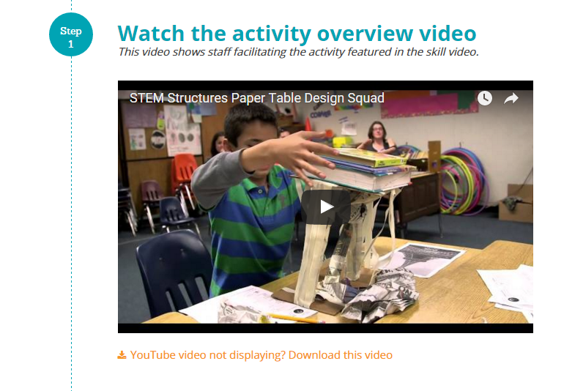
How the space is organized?
How the Chart is being used to lead discussion around questions?
What the children say/do?
What the adult says/does?
Could you see something like this happening in your setting?
Seeing the Skill in Action
Notes:
Next, we will view a video of the Skill in Action to better understand how Reflecting and Processing looks in the classroom setting. Later, we will simulate an activity to practice using the Reflective Process during an experience.
At any time, please ask questions as we move through the various activities.
We’ve talked about reflection, its purposes, how some of us are using it in our setting and how others aren’t and why. Let’s see what it looks like with actual children in a real setting during an activity.
In the video you will see an adult facilitating a hands-on experience of children using newspaper to build a structure and then testing the strength of the structure with various materials. As you watch the video take note of:
Share with your ‘elbow partner’ 1 thing you saw in the video you could incorporate into your setting.

Slide 30
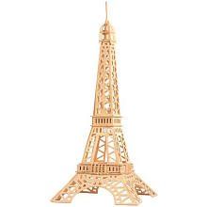


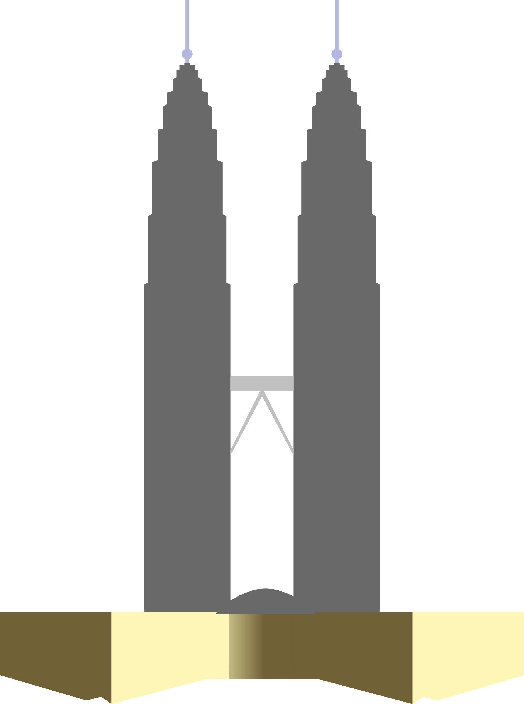
Notes:
We are now going to practice the skill of Reflecting and Processing STEM with one another by simulating an activity you might do with children in your setting.
There are several scientific concepts that could be explored with these materials and the focus; however, for the purposes of the training, the goal is to focus on how to reflect and process information during the experience.
OPTIONAL
Divide participants into groups of 4 at the most. (More than 4 will make it more difficult to have each participant share their perspectives about the experiment.)
Distribute materials to each group for the Paper Structures Activity, 1 piece of Chart Paper and a marker; 1 copy of the Reflective Process During an Experience; and 1 copy of the Reflective Process).
Ask participants to identify 1 person to be the ‘adult’ for the simulation and the other 3 to be the ‘children’ in the simulation. (It is not necessary for them to ‘role play’ as children and adults, but the differing roles are to allow for the understanding of what the adult can do during an activity/experience and what children can do to enable them to reflect and process information about materials and experiences.
MATERIALS NEEDED:
We are going to use newspapers and masking tape to build a table. We will test the ‘strength’ of the table using various objects (books, paper, etc.). Photos of famous structures (Eiffel Tower, St. Louis Arch, etc.) can be examined to gain ideas or inspiration about building the table. Groups will formulate questions about the experiment (How should we build it? What should we pay attention to? How much weight will it hold? etc.). The adult should use the Chart Paper like we did at the beginning of our session to record our ideas about reflection to record any of the questions, theories/ideas the group has prior to beginning to explore or build.

Slide 31
Reflective Process
1. What happened?
2. Why do you think it happened?
3. Was this different than what you thought would happen? Why or why not?
4. What questions do you still have?
5. What could we do next? (materials, time, space, etc.)
Notes:
*Handouts - The Reflective Process, The Reflective Process During an Experience
Once the adult has reviewed the handouts and has an understanding of the Test-Reflect- Re-Test process and some questions or strategies to use, we will spend approximately 10 minutes exploring materials. The ‘adult’ in the group should initiate the Reflective Process using the handout to guide the discussion. We will spend about 5-10 minutes in the reflective process and then Re-Test for approximately 5-10 minutes and then Reflect/Debrief for about 5-10 minutes. For the adult, be sure as part of the Reflective Process to refer back to the Chart paper to see if any question, theories/ideas were correct or not. You may add new questions, theories/ideas to the Chart paper as you go.

Slide 32
Reflecting & Processing
What could you use as the adult in your setting to reflect with children during an experience?
How could you encourage children in your setting to write about their STEM experiences?
Notes:
The steps we took during this process: question, predict, explore/test materials, make observations, questions, reflect, re-test, debrief, etc. are all part of the scientific process. The more we practice and incorporate these steps into our routines with children, the more natural they become to our interactions in our settings.
Share with an elbow partner:
1 question/statement you could use as the ‘adult’ in your setting to reflect with children during an experience
1 way you could encourage children in your setting to write about their STEM experiences

Slide 33
Know
What I know about this topic
What
What I want to know
Learn
What I have learned
Next
What are my next steps
Notes:
Complete the KWLN Chart as it refers to reflecting and processing.

Slide 34
STEM Careers Rock
Notes:
Purpose: Afterschool staff members and volunteers will be able to identify job/career titles and work opportunities in STEM careers that will apply to activities with youth.

Slide 35
Purpose: To present STEM career pathways and the practical application of basic STEM skills that professionals use on a day-to-day basis.
Outcome: Staff will learn to
  Connect STEM learning to career pathways for youth
  Identify options that youth have as part of the future STEM workforce
  Introduce positive STEM role models that youth can relate to in the real world
  Connect real-world STEM skills to activities they are facilitating
Notes:
As a result of this training, frontline staff and volunteers will be able to:
Identify the options youth have as part of the future STEM workforce.
Introduce STEM role models that relate to the real world of the youth, including gender, race, class and ethnicity.
Connect real-world STEM careers to activities they are facilitating.
We are going to focus on ways to help youth learn about careers and work possibilities that use STEM skills. How do we get youth to see the need to learn and develop STEM skills and connect them to their daily lives?
Purpose: To present STEM career pathways and the practical application of basic STEM skills that professionals use on a day-to-day basis.
Outcome: Staff will learn to
Connect STEM learning to career pathways for youth.
​Identify options that youth have as part of the future STEM workforce.
Introduce positive STEM role models that youth can relate to in the real world.
Connect real-world STEM skills to activities they are facilitating.

Slide 36
Activity | Describe the activity. | What was the educational goal or focus? | Were any STEM careers highlighted? | Could youth interact with STEM role models?
Your last field trip
Guest Speaker 1
Guest Speaker 2
Guest Speaker 3
Activity 1
Activity 2
Activity 3
Notes:
(5-10 min)
Please complete this chart. You can use some of the activities we did today to get started (Making Connections to STEM Career Choices).
How many of the activities on your chart included a STEM career connection?
Think about one of the STEM careers you introduced or could have introduced to youth. How did you decide to share this career with youth? How did this career area complement the other activities you were leading with youth at the time?
Now think about one of the activities that did not include a career connection. As a group, brainstorm some career connections that could be a part of this activity the next time.
It is not only important for youth to see possible careers out there, it is important for them to identify a person who has a similar career. It is also important for youth to see people like them in STEM careers. How do you introduce STEM role models to youth in your program? Did any of the activities on your checklist include a STEM role model? How did you identify that person?

Slide 37
STEM Connections to Careers
List as many careers as possible that are connected to STEM
STEM Careers
Notes:
With a show of hands, how many had career connections in each of the activities listed on their checklist? Four? Three?
Share your career lists by posting them on the wall.
What observations do you make about these lists?
The youth who participate in our programs are career bound. In our work, we can introduce them to career possibilities and help them see pathways to those careers.
Today we are going to focus on strategies you can use to incorporate STEM careers into your daily work with youth.

Slide 38
Seeing the Skill in Action
How did the girls respond to their career- based roles?
What do you think about using careers to define tasks for group activities?
How did Katie support the youth in their career roles?
How might you facilitate this activity differently?
What is an activity you use that could be led this way?
Notes:
In the video we will see one strategy for introducing career roles as a part of the activity structure. You will have an opportunity to explore this strategy as well as other strategies for making career connections. Strategies can be used in any activity and should be applied to all career possibilities.

Slide 39
Know
What I know about this topic
What
What I want to know
Learn
What I have learned
Next
What are my next steps
Notes:
Using the KWLN Chart complete each column as it relates to STEM Careers.

Slide 40
A visit to the site
Click2Science Website

Slide 41
Questions and answers

Slide 42




Thank You!
Connect with Click2Science
click2sciencepd.org
click2sciencepd@unl.edu

