Slide 1
Essential Elements of Youth Development Programs Key Ingredients for Program Success
Notes:
This train the trainer session is an overview of a curriculum that was designed to help youth development professionals understand the importance of positive development in youth and to become competent, contributing adults.
Within youth development education there are various frameworks and lists of elements that researchers have identified and utilized to define and guide the design and structure of youth development programs.

Slide 2
Curriculum Authors
Curriculum Design Team
Jill Martz, PhD
Texas A&M
Claudia Mincemoyer, PhD
Penn State University
Niki Nestor McNeely, PhD (retired)
The Ohio State University
Contributing Authors
Lori Purcell Bledsoe, EdD University of Georgia
P. Craig Dart, Utah State University
Elaine Johannes , PhD, Kansas State University
Angie Arnould, Louisiana State University
Kim Gressley, MEd, University of Arizona
Kenneth Jones, PhD, University of Kentucky
Jacqueline V. Lerner, PhD, Boston College
Debbie McDonald, PhD, West Virginia University
Kyle Worthington, MS, Oklahoma State University
Notes:
This is a 4-H curriculum. This has been developed and adopted by the 4-H program nationally based upon the findings of the 4-H Study of Positive Youth Development in 2005 (Lerner, etal) and the National 4-H Assessment Project.
The 4-H program has been available to youth for a very long time and has a positive effect on youth. Youth professionals can use 4-H has a model to create environments and attributes that optimize youth development.

Slide 3
Training Outline
CYTTAP
Train the Trainer
Overview of Curriculum
Let’s Get Acquainted!!
Notes:
CYTAPP – Can use the one page flyer. Please mention that is training is sponsored by this project
Explain that this is a ‘train the trainer – this is professional development for youth workers
Overview of Curriculum – The curriculum was designed to help youth development professionals understand the importance of PYD by presenting the 8 Essential Elements as central to helping young people become competent, contributing adults
Let’s Get Acquainted – Pg. 14 – Vanity License Plate

Slide 4
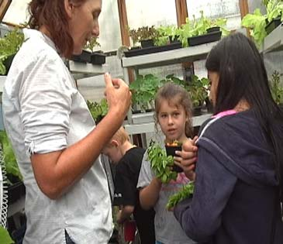
Positive Youth Development
Positive Youth Development programs set the stage for youth to acquire skills and abilities to succeed:
Independence
Belonging
Generosity
Mastery
Notes:
These four concepts set that stage:
1. Independence - Youth need to know that they are able to influence people and events through decision-making and action. By exercising independence through leadership opportunities, youth mature in self-discipline and responsibility, learn to better understand themselves and become independent thinkers.
2. Belonging - Youth need to know they are cared about by others and feel a sense of connection to others in the group. This “fellowship” has always been an important part of an experience. Programs gives youth the opportunity to feel physically and emotionally safe while actively participating in a group.
Current research emphasizes the importance for youth to have opportunities for long-term consistent relationships with adults other than parents. This research suggests that a sense of belonging may be the single most powerful positive ingredient we can add into the lives of children and youth.
3. Generosity - Youth need to feel their lives have meaning and purpose. By participating in community service and citizenship activities, youth can connect to communities and learn to give back to others. It’s clear that these experiences provide the foundation that helps us understand the "big picture" of life and find purpose and meaning.
4. Mastery - In order to develop self-confidence, youth need to feel and believe they are capable and they must experience success at solving problems and meeting challenges.
By exploring projects and activities, youth master skills to make positive career and life choices.
Additionally, youth need to have a safe environment for making mistakes and getting feedback, not just through competition but also as an ongoing element of participation.
Finally, youth need the breadth and depth of topics that allow them to pursue their own interests.

Slide 5
4 Concepts: 8 Essential Elements
Mastery
Independence
Generosity
Belonging
Positive relationship with a caring adult
An inclusive environment
A safe environment
Engagement in learning
Opportunity for mastery
Opportunity to see oneself as an active participant in the future
Opportunity for self-determination
Opportunity to value and practice service to others
Source: Kress, C. (2004) Essential Elements of 4-H Youth Development. National 4-H Headquarters, CSREES UDSA,
Notes:
These four concepts are broken into the eight essential elements. Review the slide.

Slide 6
If Youth Needs are Met in Positive Ways:
Youth develop characteristics most of us relate to healthy, successful adults...
Notes:
Review slide. Then ask participants to share some thoughts as you look at this list of characteristics as they relate to healthy, successful adults.

Slide 7
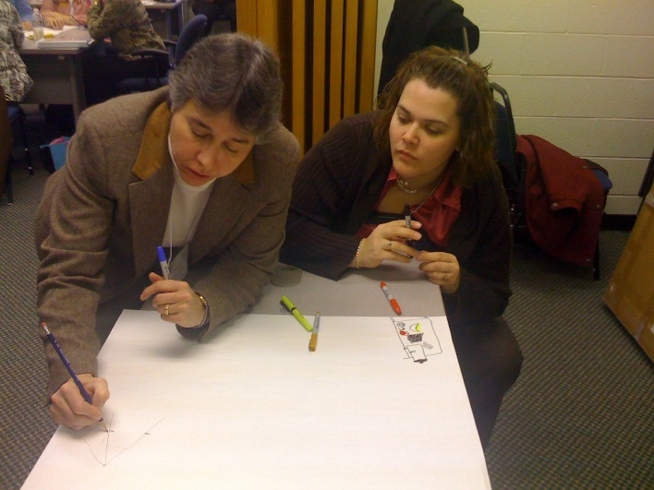
Essential Elements Curriculum
Professional development for youth-serving professionals and volunteers to:
identify the key components of a positive youth development program and potential outcomes for youth
identify what each element looks like “in practice”
assess current youth programs for
success in incorporating the 8
Essential Elements
Notes:
Review slide.
-There is a section in the curriculum manual – pgs. 6-7 - that focuses on working with adult learners. While we won't go over this now, you might take an opportunity to review when planning your training events for these adult youth professionals.

Slide 8
Essential Elements Curriculum
INTENTIONAL
Notes:
The 8 essential elements must be intentionally included in all positive youth development programs.

Slide 9
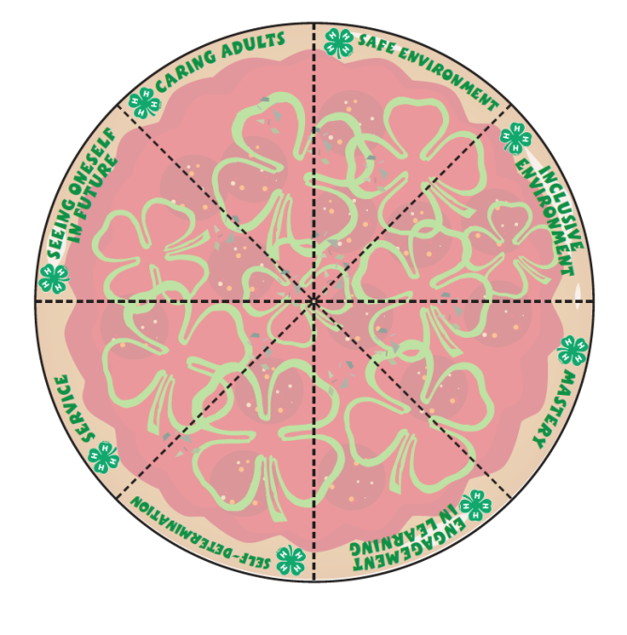
Ten Curriculum Sessions
The Key Ingredients: An Overview
A Positive Relationship with a Caring Adult
A Safe Emotional and Physical Environment
An Inclusive Environment
Engagement in Learning
Opportunity for Mastery
Opportunity to See Oneself as an Active Participant in the Future
Opportunity for Self-Determination
Opportunity to Value and Practice Service to Others
Pizza Supreme! Putting It All Together & Applying It to My Program
Notes:
The Essential Elements curriculum is comprised of 10 modules. Listed on this slide are the 10 modules.
Each session of the Essential Elements curriculum includes a description of key concepts, best practices, resources and activities that have been tested successfully.
They include practical application of knowledge or “learning by doing” to develop skills and acquire a sense of responsibility, initiative and self-worth.

Slide 10
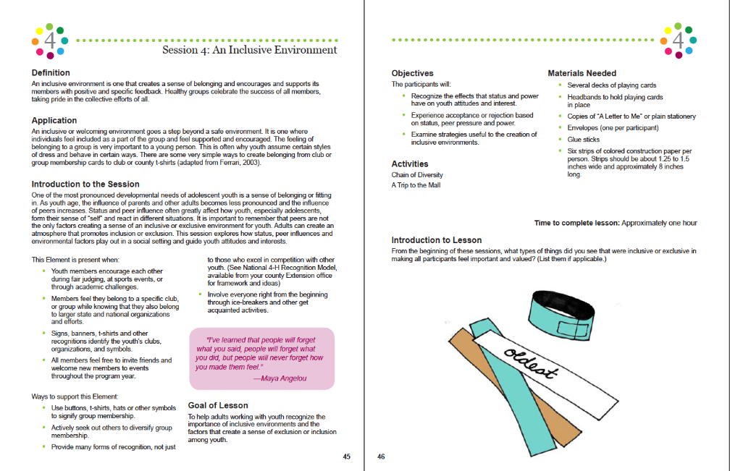
Session Contents
Definition of the element
Application in programming
Introduction to the session
Goal of the session
Session objectives
Materials needed
Time to complete
Activity instructions
Prompts for processing, generalizing and applying learning
Notes:
Review this slide

Slide 11
Curriculum Implementation
Each module is approximately 1 hour
First module is overview of 8 Essential Elements
Last module is a summary of 8 Essential Elements
Total time to implement
entire curriculum: approx. 10 hrs.
Notes:
Review this slide. You are free to do this is any amount of time but must use at least one module. Our suggestion is to cover several modules at one time.

Slide 12
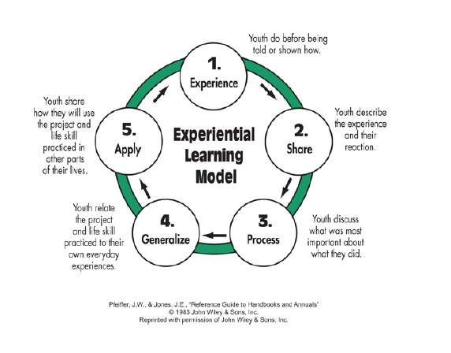
Experiential Activities
2+ hands-on activities for each Essential Element
Do, share, process, generalize, apply
Digging deeper activities
Notes:
Each module will have 2 hands-on activities, as well as Digging Deeper activities to further explore that element.

Slide 13
Essential Elements Training Kit
Notes:
This will be training kit that you will receive after this TOT. You will receive the Curriculum manual, and a big Pizza template.

Slide 14
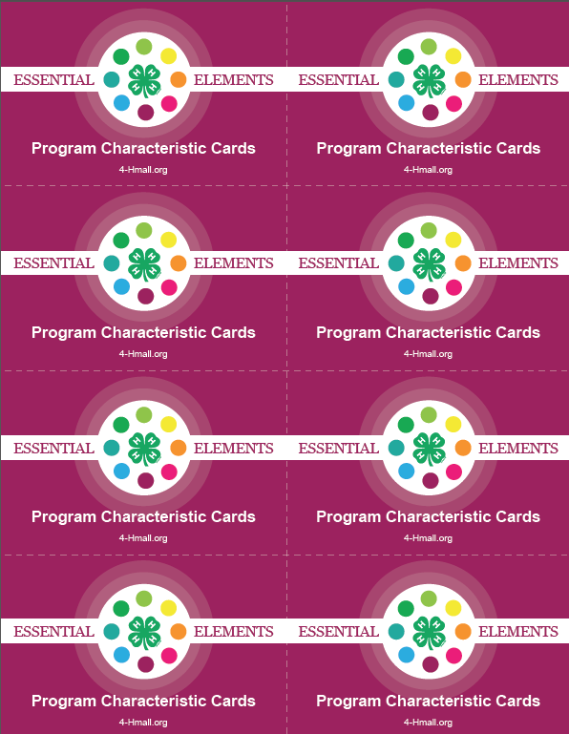
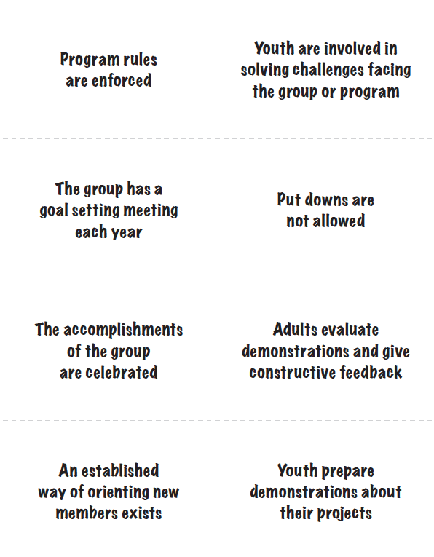
Program Characteristic Card Sort
Essential Elements
Overview
Notes:
…..and 7 sets of Program Characteristics Cards. All of these materials will be used in your trainings. We will discuss other supplies at the end of the training".

Slide 15
Let’s Play Essential Elements
Notes:
We have already done an activity for the Session 1 – The Key Ingredients – Overview earlier in this presentation (Vanity Plate). That is a good introduction/icebreaker/set the stage (pg. 14)
Now, lets try some activities that highlight the concepts and elements that are in the curriculum modules. We will begin with another activity in Session 1. Then, as we mentioned before, each ‘element’ has 2 activities to try. We will go through each Concept and Element and then do 1 activity per Concept.

Slide 16
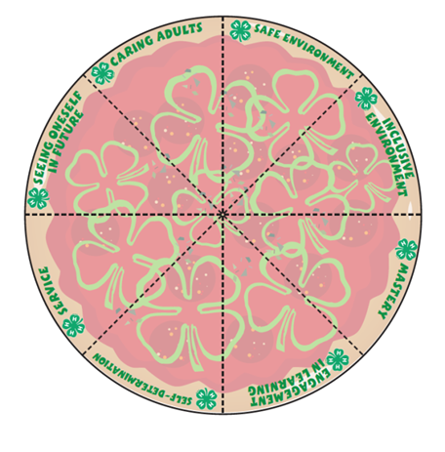
Session 1 – Key Ingredients
Learn definition of the 8 essential elements and relate to your own experiences as a youth worker.
Notes:
Complete the activity – Sorting the Toppings – pg. 14. This is an analogy of pizza ingredients and youth development.

Slide 17
4 Concepts Belonging
Elements
Positive Relationship with a Caring Adult
A Safe Emotional and Physical Environment
An Inclusive Environment
Notes:
The first concept of the 8 Essential Elements is Belonging. There are three Elements under this concept. Each element is a session and will have the 2 activities to go with the lesson.
We chose to do Chain of Diversity, pg. 47 – in the Inclusive Environment session.

Slide 18
Chain of Diversity
Notes:
Instructions of pg. 47. Please refer to the manual

Slide 19
4 Concepts Mastery
Elements
Engaged in Learning
Opportunity for Mastery
Notes:
The second concept is Mastery. The elements that make up this concept are these that are listed. Lets do the activity for Opportunity for Mastery – Putting It All Together - pg. 63.

Slide 20
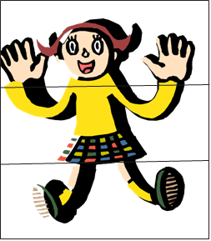
Putting It All Together
Photo of page
Notes:
This activity is for the element of Opportunity for Mastery. Please follow the instructions on page. 63.

Slide 21
4 Concepts Independence
Elements
Opportunity to See Oneself as an Active Participant in the Future
Opportunity for Self-Determination
Notes:
The 3rd concept is Independence, with the elements listed above.

Slide 22
Examining Teen/Adult Partnerships
Notes:
The activity we will do is Examining Teen/Adult Partnerships under the Opportunity of Self-Determination element – pg 75

Slide 23
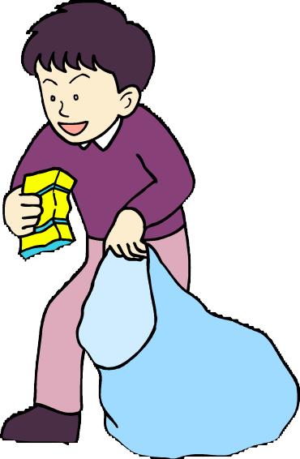
4 Concepts Generosity
Element
Opportunity to Value and Practice Service to Others
Notes:
The 4th concept is Generosity. This means finding yourself begins with losing yourself in the service of others. Service is a way for youth to gain exposure to the larger community, indeed, the world itself. Service is more than a product; it is a process that provides developmental opportunities for youth.

Slide 24
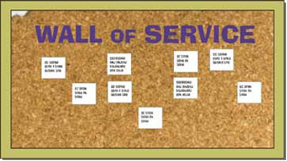
Wall of Service
Notes:
The activity – Wall of Service is on pg. 90. Since the concept Generosity is made up of 1 element – this relates to Opportunity to Value and
Practice Service to Others.

Slide 25
Session 10 Applying to My Program
Be intentional
Promote the Essential Element
Identify strategies to incorporate into programming
Develop a plan
Notes:
Let’s begin to reflect how we might use the knowledge gained in our own youth development programming.
On pg. 97 – Pizza Supreme – follow instructions.

Slide 26
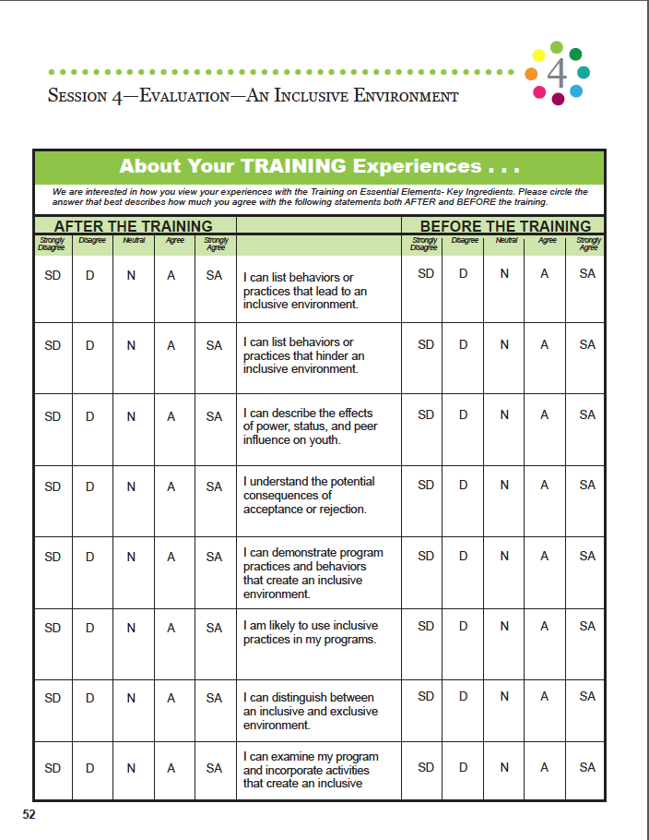
Session Evaluation: Retrospective
Notes:
After each modules, there is an evaluation if you need it.

Slide 27
Curriculum Appendix
Ice Breakers
Essential Elements Program Checklist
Ages and Stages
Certificate of Recognition
Web Appendix - Essential Elements
Notes:
The Appendix begins on pg. 99. It includes – Ice Breakers, Program Checklist, Ages and Stages chart, and a certificate of Recognition template. The Web Appendix can be found at www.4H.org/resources/essentialelements (found in the Table of Contents – Page 1, of the Curriculum and Training Guide. This page does require a log in.

Slide 28
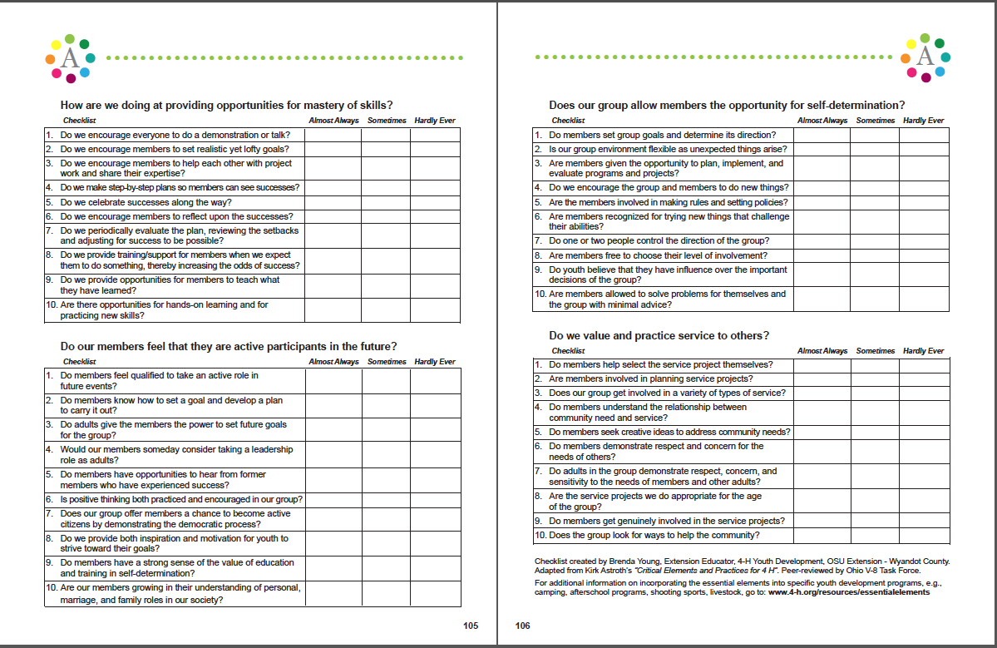
My Checklist
Notes:
In the Appendix – Use this checklist to review your success in incorporating the Elements

Slide 29
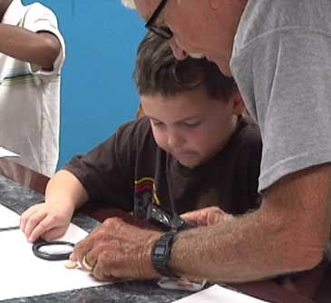
Potential Training Opportunities
Out of School programs
Volunteers-all program types
Teen Volunteers
Camp Counselors
Other Youth-Serving Agency
Staff and Volunteers
Advisory Boards and Councils
Others?

Slide 30
Questions and Discussion

