Slide 1

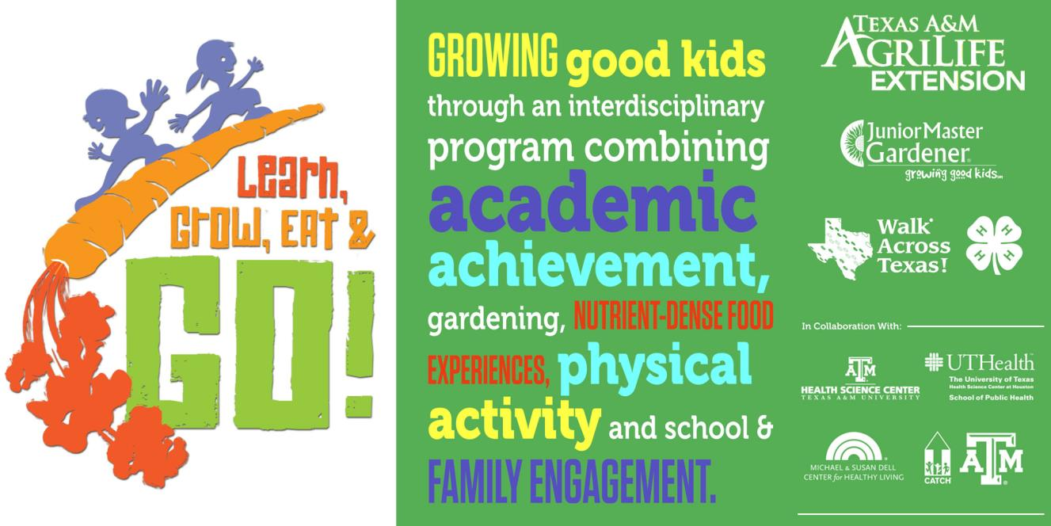

http://jmgkids.us/lgeg/
http://jmgkids.us/lgeg/
Notes:
Welcome to Learn, Grow, Eat and Go! This curriculum, LGEG for short, is a 10-week unit of study that is hands-on, multifaceted, and academically rich. LGEG was developed for a research project in which Texas A& M Agrilife Extension contributed and is a part of the International Junior Master Gardener Curriculum. This research project helped to support a significant body of research showing the relationship between improving school performance, attendance, attachment and commitment, and the development of pro-social skills and leadership capacity related to increased physical activity and improved opportunities for project-based, hands-on or real life learning. LGEG is focused on getting children to participate in activities where they can learn important science, math and language arts concepts and at the same time be more physically active, improve healthy eating habits and have fun. LGEG activities promote leadership and responsibility in children and, according to teacher surveys, have improved classroom participation. It is comprised of 20 lessons which also feature food exposures, gardening, and physical activities.
LGEG is a part of the Junior Master Gardener Program (JMG). JMG is an innovative 4-H gardening program developed by Texas A&M Agrilife Extension
We think using LGEG in after school programming is a great way to utilize this curriculum.
Optional –
National On-line Survey for Leaders Conducted by Texas A&M University Department of Agricultural Education and National JMG Program Office
Over 85% of respondents stated that
JMG has increased youth interest in science
Over 83% of respondents stated JMG has
contributed to higher academic standards
Over 85% of respondents said JMG youths were
more enthusiastic about learning

Slide 2
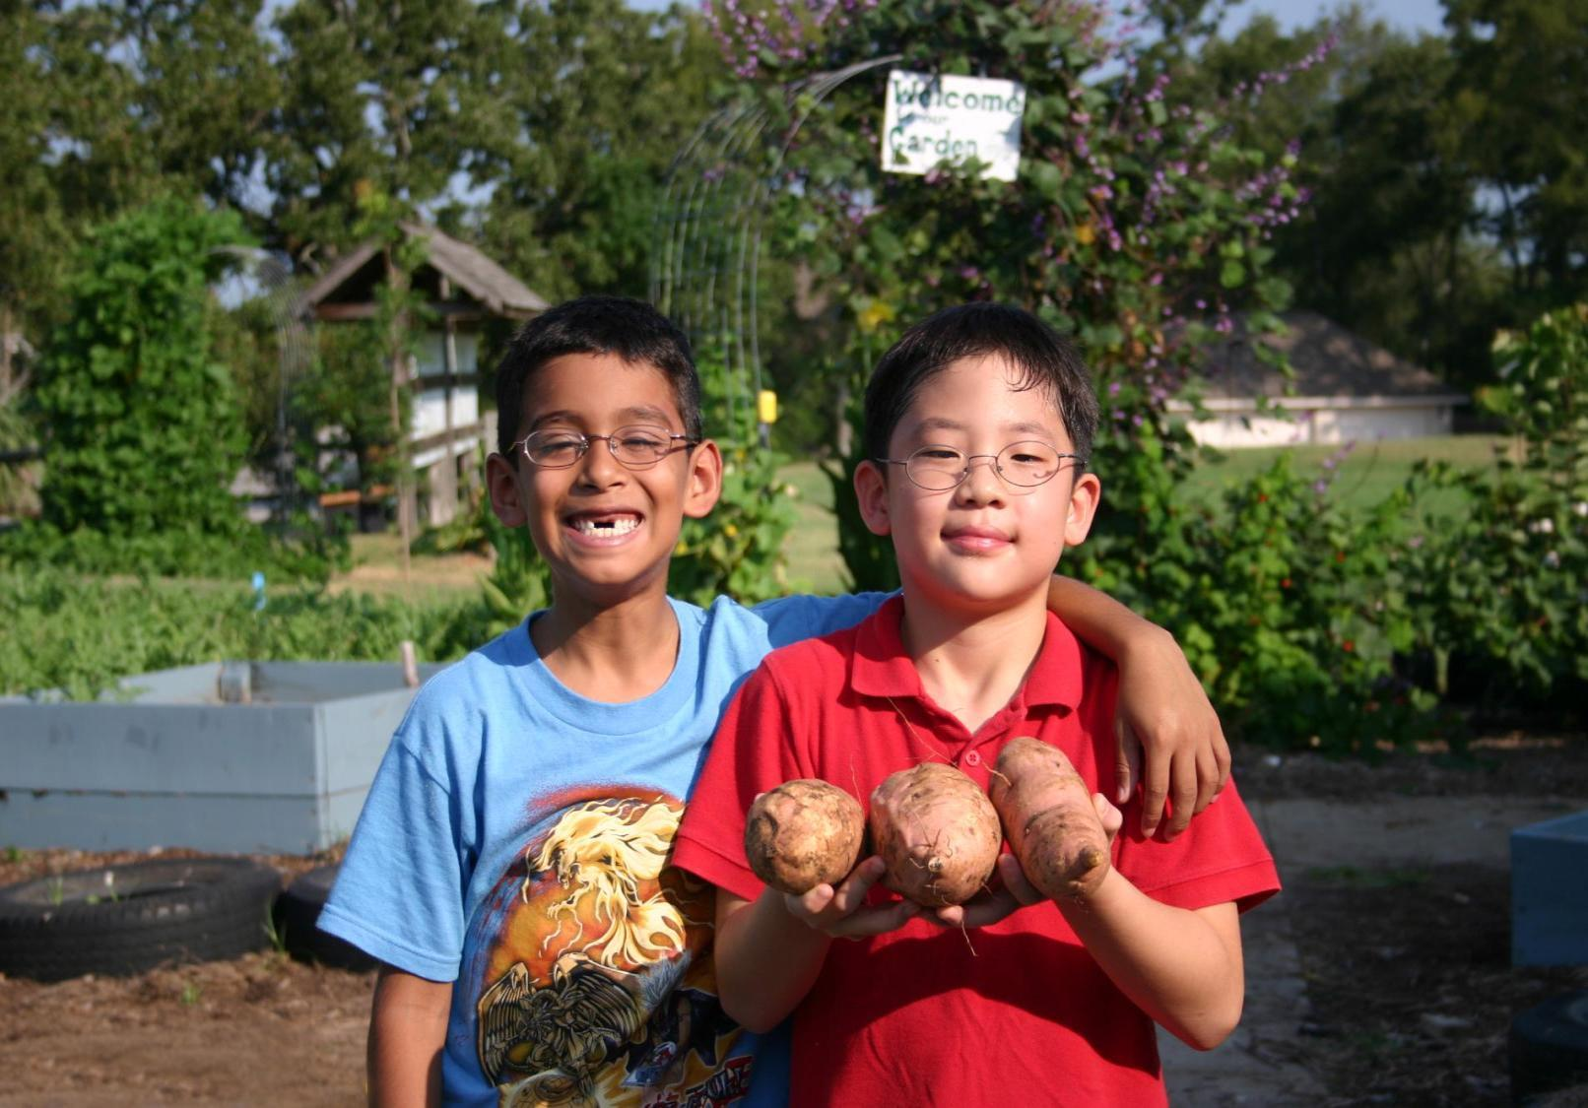
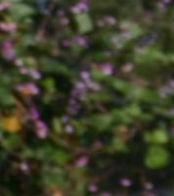








Research Project: Texas Grow! Eat! Go!
Expansion/Implementation/Research
Study Project
Notes:
This is the research project that started it all.

Slide 3
LGEG Evidence Based Outcomes
Significant Improvements in:
MVPA
Total Physical Activity
Vegetables Consumption
Vegetable Preferences
Healthy Beverage Preferences
Self-Efficacy & Knowledge
Parent/child cooking, physical activity and gardening
Reaches into the home to support positive family health practices
BMI Significantly Reduced for CATCH + JMG and CATCH + WAT
Preliminary Conclusion: Family-focused garden, nutrition and physical activity
programs significantly improve health behaviors in children.
Notes:
Through the course of this research, we saw
child vegetable preference, and nutrition and plant science knowledge increased significantly
child physical activity with parents increased, while screen time decreased.
Parents encouraged eating vegetables and increased gardening with their children.
Teachers reported that students were more attentive and had high participation in LGEG learning activities.
41% of Parents learned about “Go, slow and whoa” foods
81% of parents learned about the school gardens
60% of parents read the recipes sent home and 30% tried the recipes
27% of parents walked with their child to earn “Bonus Miles” for their child’s class.

Slide 4
Can Gardening Positively impact?
Child Health
Childhood Obesity Rates
Family health
Family mealtimes
Reach into the home
Notes:
4
LGEG lessons were then designed to bring food and nutrition education to the classroom and to impact these aspects of health.

Slide 5
Why Health Matters
Healthy kids are in school & in class.
Healthy kids are ready to learn.
Healthy teachers are at school with energy.
Healthy administrators and staff are engaged.
Healthy parents are at work or home –involved.
Healthy people have a higher quality of life.
Healthy people need fewer health resources.
Healthy communities are desirable places to live and work.
Notes:
5
Why does health matter? LGEG lesson are meant to help grow healthy kids through the gardening experiences and food experiences.

Slide 6
Notes:
Establishing healthy habits early in life is essential for life long health and well being.

Slide 7
Relevance
High prevalence of childhood obesity is cause for concern because it is linked to negative health consequences for children and their families.
Vegetable exposure plus school gardening has been shown to improve consumption of fruits and vegetables.
Adding more frequent and more vigorous physical activities during school has been shown to improve student fitness and weight.
The greater the frequency of vegetable consumption and physical activity by parents, the greater the consumption of these foods and exercise by their children.
With child obesity rates among low-income children in Texas ranging from 10% to over 20%, engaging schools and families in prevention efforts is critical.
Notes:
7
NOTE: The green bulleted items,
This study was done in Texas, but Nebraska statistics also show cause for concern.
LGEG lessons allow for exposure to fruits and vegetables and opportunities to try new foods. Research also shows that it can take up to 7 times of exposure to a food before a child will accept it.

Slide 8


LGEG Curriculum
& Program
Notes:
There is a significant body of research showing the relationship between improving school performance, attendance, attachment and commitment, and the development of pro-social skills and leadership capacity related to increased physical activity and improved opportunities for project-based, hands-on or real life learning. LGEG is focused on getting children to participate in school activities where they can learn important science, math and language arts concepts and at the same time be more physically active, improve healthy eating habits and have fun. LGEG activities promote leadership and responsibility in children and, according to teacher surveys, have improved classroom participation.

Slide 9

LGEG Evidence-Based Facts
Encourages daily physical activity
Increases exposure to vegetables
Encourages adoption of healthy beverages
Expands knowledge in plant science and nutrition
Reaches into the home to support positive family health practices
Notes:
Through the course of this research, LGEG was developed to –
-Learn – about plants, nutrition, and activity
-Grow – grow vegetables
-Eat – encourage healthy eating habits
-Go- encourage daily physical activity
If we go back to Slide 3 – the research actually showed -
child vegetable preference, and nutrition and plant science knowledge increased significantly
child physical activity with parents increased, while screen time decreased.
Sugar sweetened beverage consumption decreased.
Parents encouraged eating vegetables and increased gardening with their children.
Teachers reported that students were more attentive and had high participation in learning activities.
41% of Parents learned about “Go, slow and whoa” foods
81% of parents learned about the school gardens
60% of parents read the recipes sent home and 30% tried the recipes
27% of parents walked with their child to earn “Bonus Miles” for their child’s class.

Slide 10
School District, Community Partners & Extension Collaboration
School/District Nutrition Services
County Extension Staff & Volunteers
District Wellness/SHAC
School/District Facilities and Maintenance
School & Community Organizations
Teachers and PE Coaches
Principal/AP
Notes:
We show this information because the full extent of the Junior Master Gardener and LGEG can be reached with collaboration among
-schools and school personnel (administrators, teachers, food service, etc)
-parents and parent groups
-community organizations
-Extension - staff and volunteers
The research did show that schools with healthy environments are most successful when they start with a campus team! School Health Advisory Councils or SHAC’s, administrators, nutrition/food service, teachers, parent groups , coaches/PE teachers, and school maintenance crews can all have an impact on a healthy school climate. Support from local organizations, community leaders, and elected officials can then help enhance the school health team’s efforts for a greater impact.

Slide 11
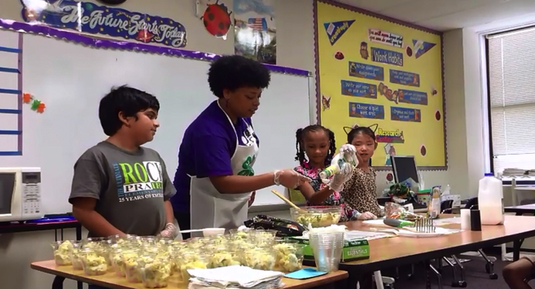
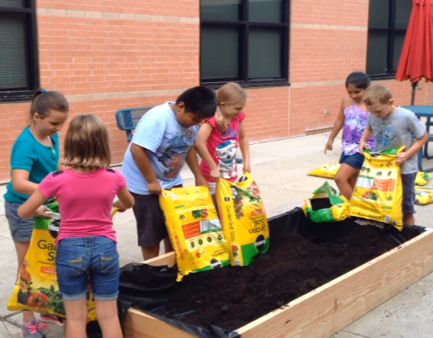
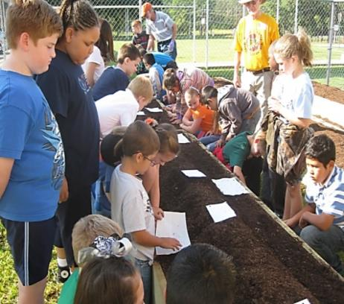
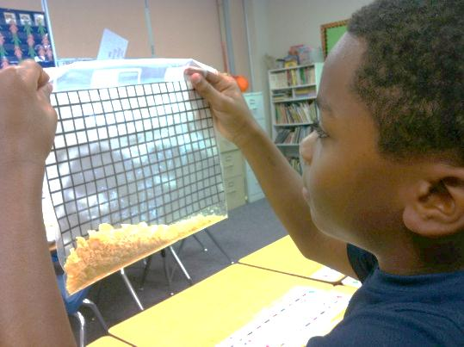
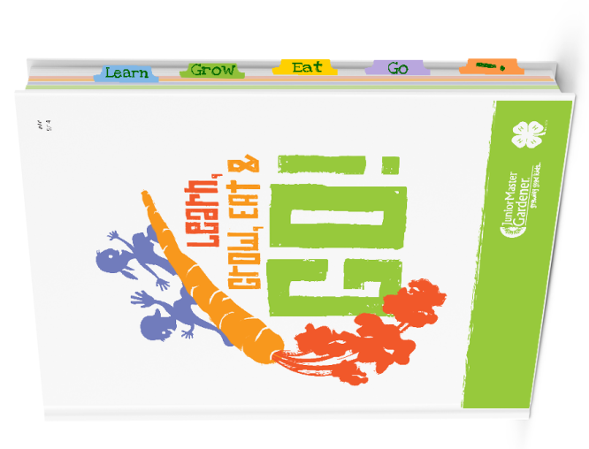
LGEG Components
Notes:
The components are Learn, Grow, Eat, and Go as depicted

Slide 12
Review of Lessons
Learn lesson(s)
Grow activity
Eat exposure
Go activity
Notes:
So let’s begin to explore the curriculum! These components make up the curriculum. You can use your book as we go.

Slide 13

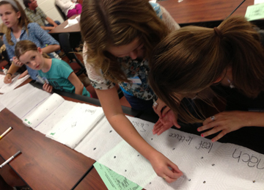
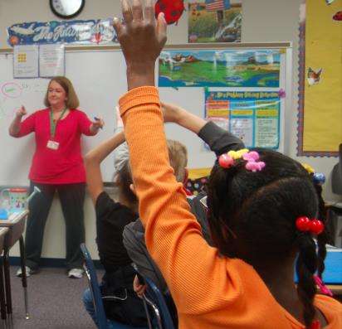



CLASSROOM INSTRUCTION
10 week – lessons aligned to TEKS, STAAR readiness and supporting standards
Student garden journals
Math within Garden Kitchen recipes
Family engagement resources online
WAT Teacher lesson plans online
Service-learning opportunity
JMG certification opportunity
Notes:
LEARN – This overview gives you a good idea on how the lessons for the 10 weeks are organized. We will go through the lessons a little later in the training.

Slide 14

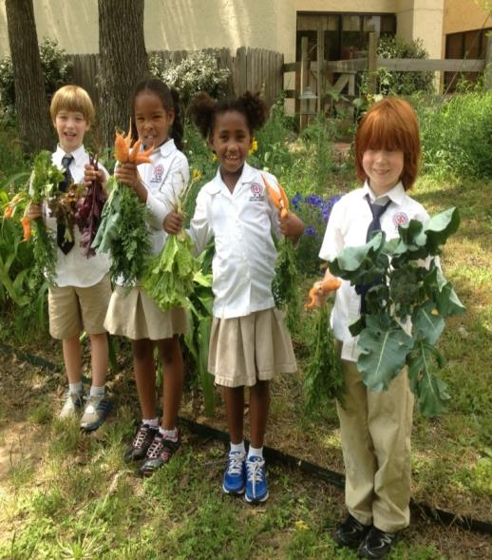
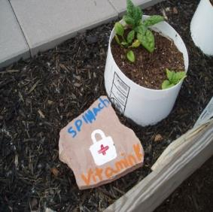
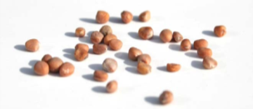
GARDENS - raised beds or container gardens
Grow featured nutrient-dense vegetables
Carrot
Red leaf/loose leaf lettuce
Broccoli
Potatoes
Swiss chard
Bell pepper
Cauliflower
Spinach
Oriental cabbage – Bok Choy
Cherry tomatoes
Sugar snap peas
Squash
Notes:
The next component is GROW. Let’s take a look at it.

Slide 15


Starting
School Gardens
Notes:
This could be any kind of garden – both indoor and outdoors.

Slide 16
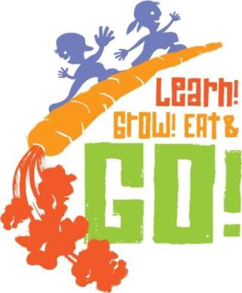
Primary constraints &
stressors of trainers and teachers
Time & testing
Many others… funding, societal/family
issues, training, etc.
Notes:
Obviously, there are things to consider to start gardening – growing season, time of year, etc. The primary constraints are Time and Testing.

Slide 17
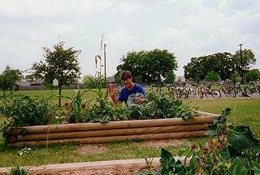
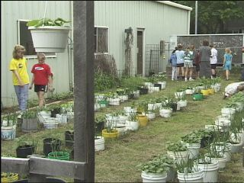
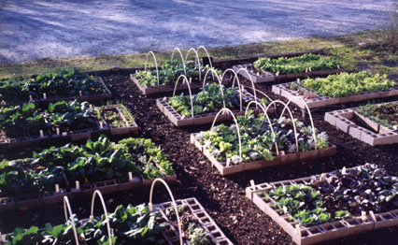
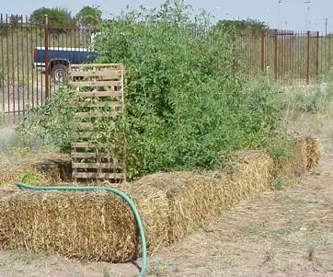
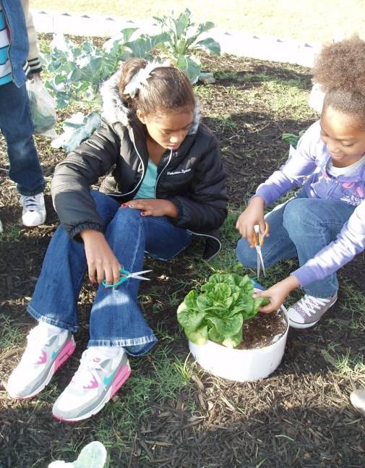
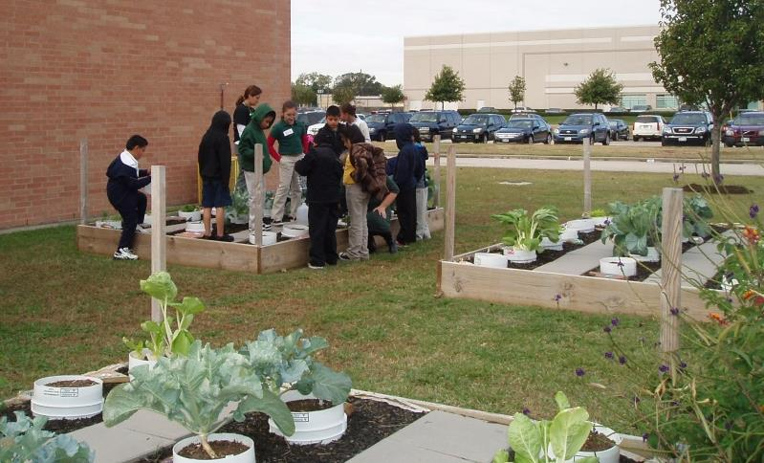
Lots of Options!
Notes:
But there are lots of options! Here are some photos of outdoor gardening – from gardening beds to container gardening.

Slide 18
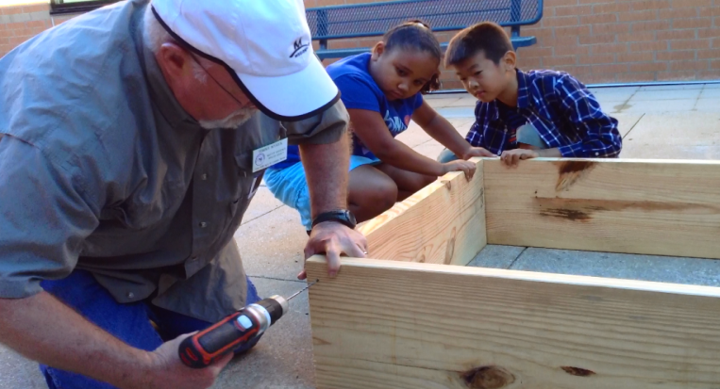
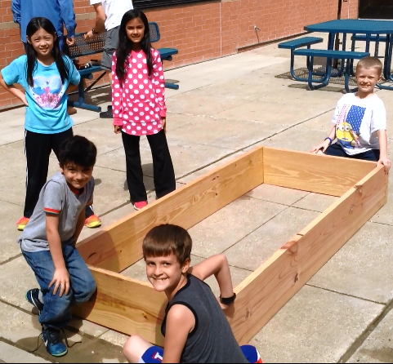
Quick & Easy Garden Kit
Getting Materials
Building the Garden
Planting It
Provides
teachers
with
steps on:
with the help of one volunteer with a drill!
Notes:
*Handout – Quick and Easy Garden Kit. If teachers or youth workers want to start a garden (this is great for a summer project), this can provide instructions and guidelines to start. Let’s take a look --

Slide 19
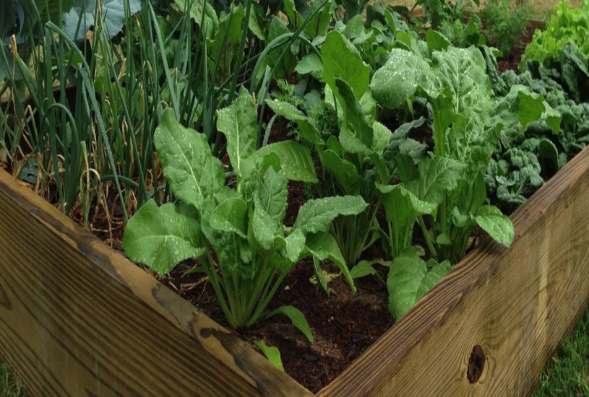
The LGEG school garden project specifically designed to be:
Simple
Easy
Quick
Inexpensive
Notes:
Its meant to be – simple, easy, quick, and inexpensive.

Slide 20
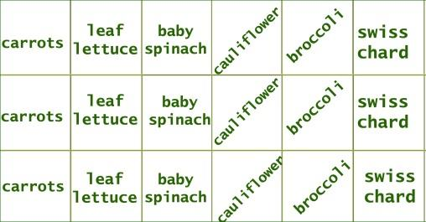
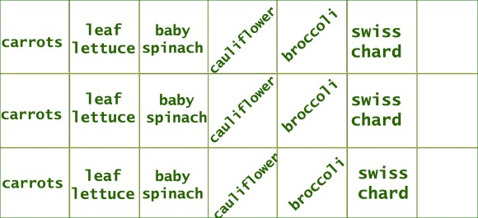
Quick & Easy Garden Kit
Getting Materials: What are we growing?
- growing 6 seasonal crops
- 3 square ft. plantings of each
- extra space for kids to choice plantings
- simplicity of steps/supplies
Sample cool season 3x7 raised bed:
kids’
choice
kids’
choice
kids’
choice
Notes:
There are instructions for layout and planting -

Slide 21
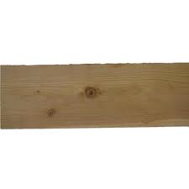
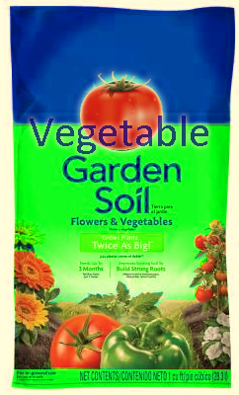
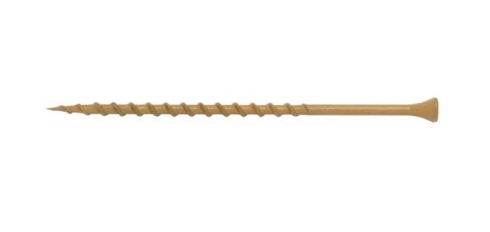
Quick & Easy Garden Kit
- simplicity of steps/supplies
2
10’ boards
21
cubic
feet soil
Boards can be cut at building store
12
4” Screws
Notes:
Steps for making a raised garden bed --

Slide 22
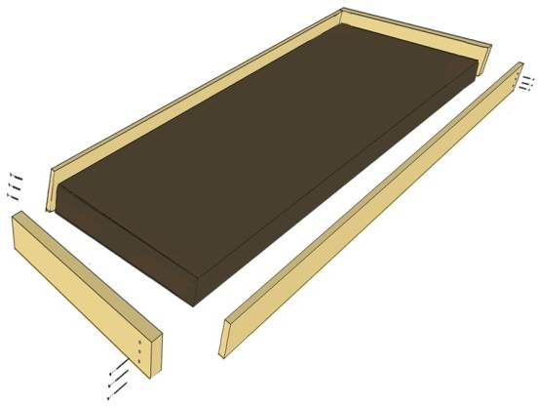
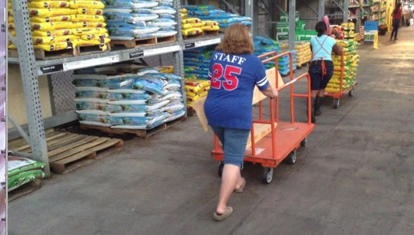
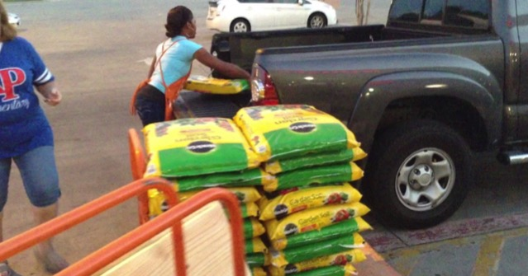
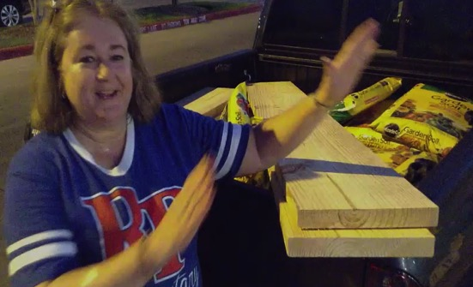
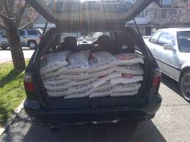
Quick & Easy Garden Kit
How to get materials to school?
- can be loaded for you at building store
- whole garden fits in back of van or small truck
(borrowed vehicle, potential volunteer task?)
Notes:
Instructions on how to get materials to where your garden is --

Slide 23
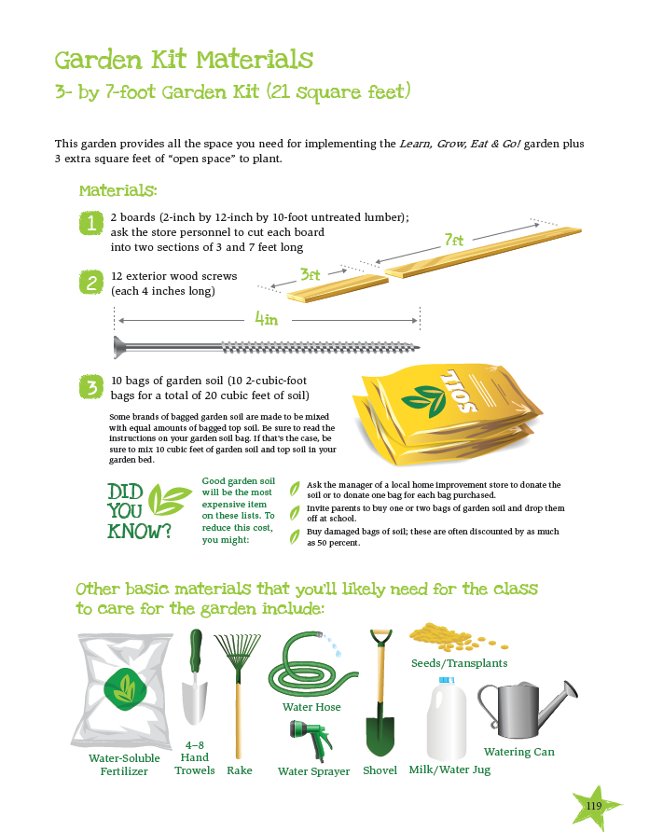
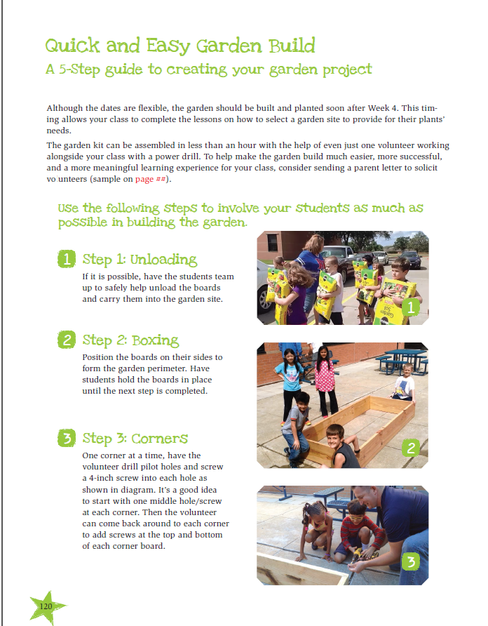
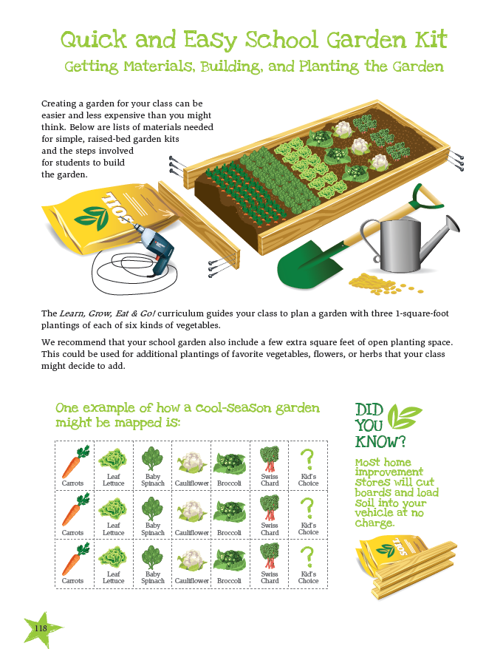
Grow:
Quick & Easy Garden Kit Pages include in curriculum
Notes:
Here is a sample of what is in the handout.

Slide 24
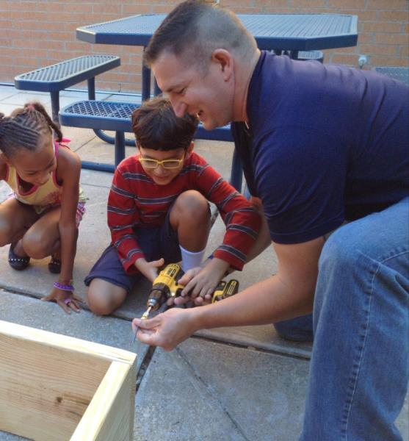
Tips for Starting a Children’s Garden
Funding & Starting Small
Solicit Involvement of Others
  – kid – parent
  – PTA – business
“Our Garden”
Establish a Plan
  – what –site – materials
  – build –plant –maintain
  –off season – next season
Notes:
These are some additional tips to get started on the GROW part of this curriculum.

Slide 25
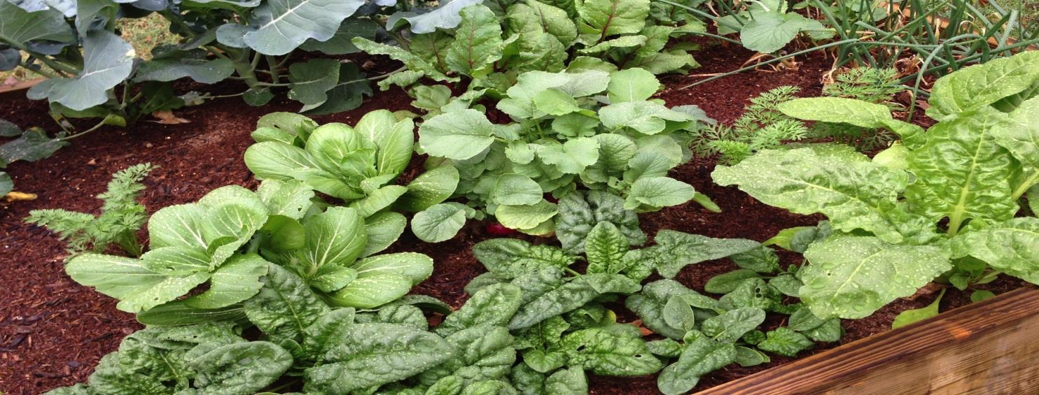

Garden success!
Notes:
And this is what Garden Success looks like!

Slide 26

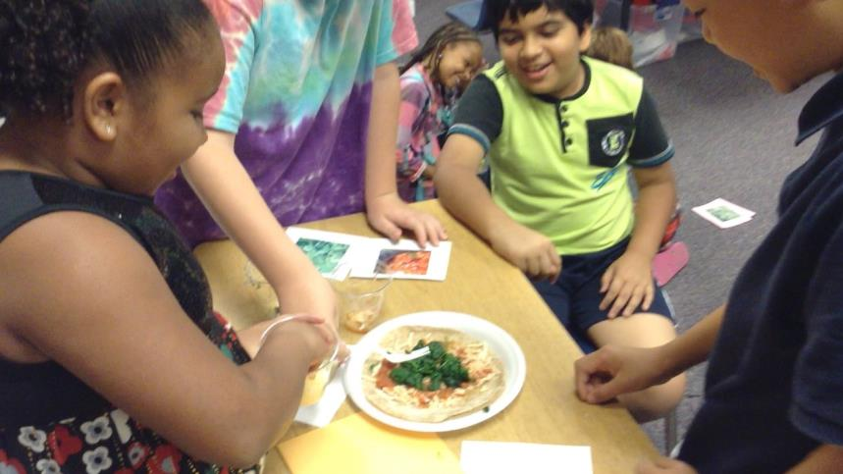
Goals
  Exposure to new foods preparations thru food demonstrations will engage and excite children.
  Children will share those food experiences in the
  home environment by encouraging care
  providers to prepare
  foods from the garden.
Notes:
On to the Eat portion of the LGEG curriculum. The Goals are -

Slide 27

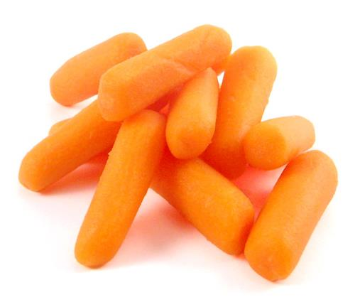
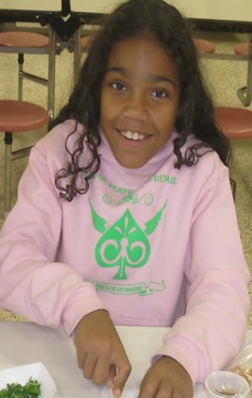
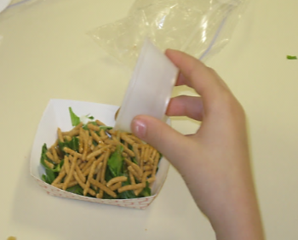
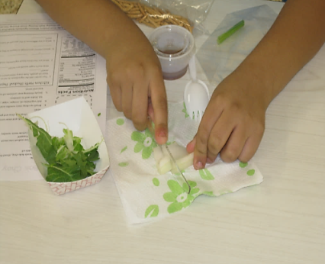
Food Exposure
1st exposure: Evaluation
of fresh vegetable sample in classroom
2nd Exposure: Garden Kitchen recipe demonstrations in classroom with featured vegetables
Notes:
With this, we want youth to –
1. Have exposure to fresh vegetables (and to the veggies that they have grown).
2. Make a recipe for eating with the featured vegetable.

Slide 28
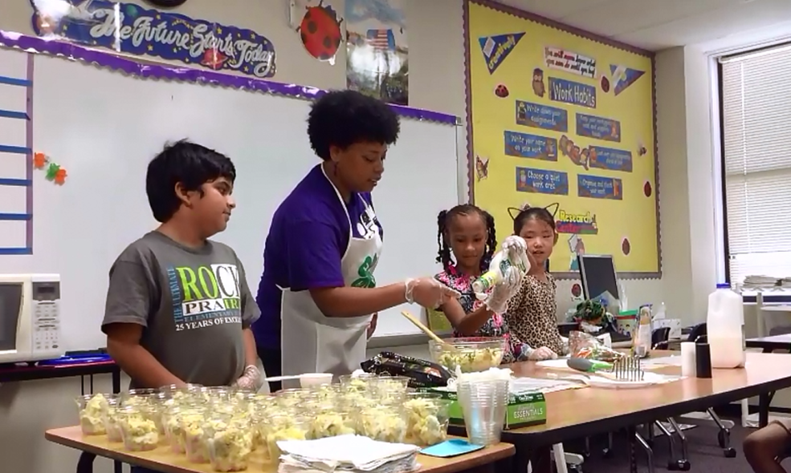
Food Exposure
Notes:
Eat! is all about Food Exposure. Here is a sample of what might take place

Slide 29
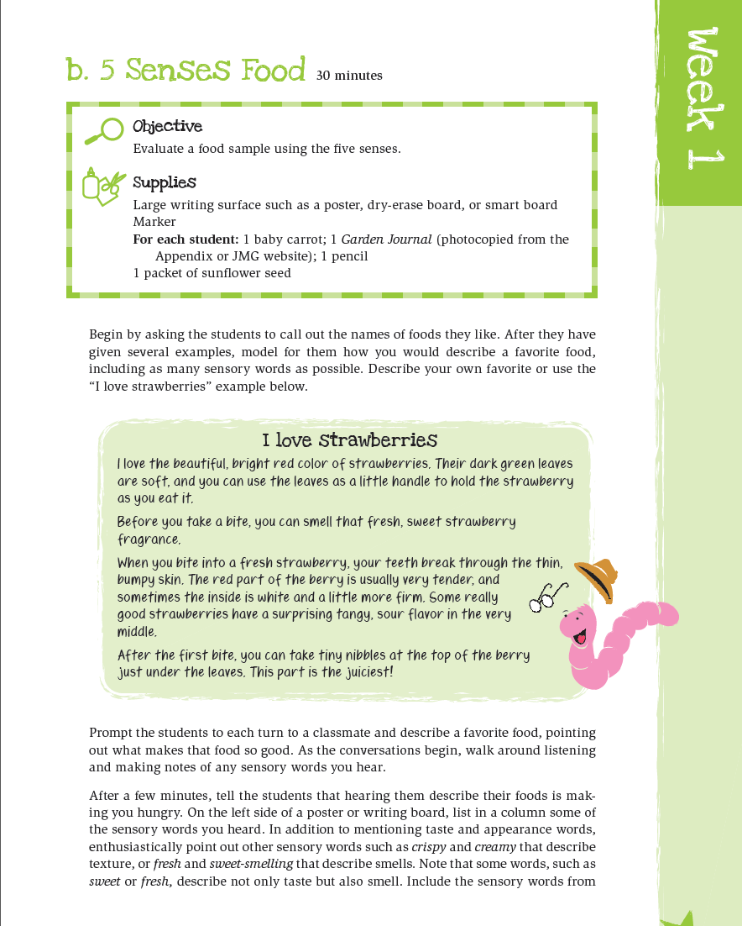


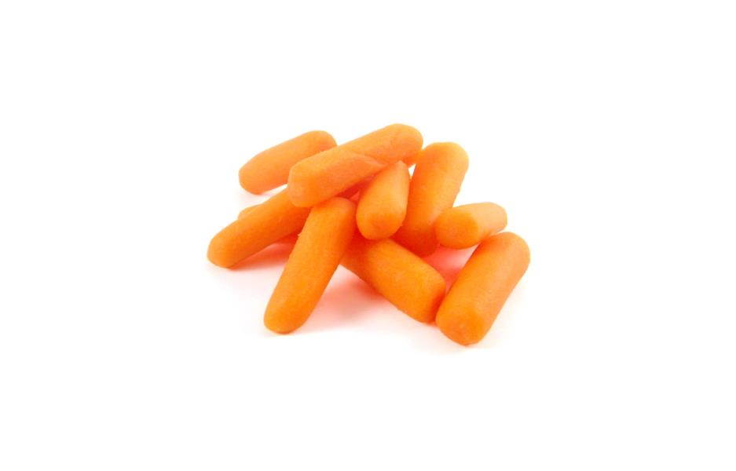
Notes:
So, with exposure to different foods, we want youth to think about that food. In the lessons, they will have an ‘evaluation’ of that food – grading it on sight, smell, feel, sound, taste. So they will need to do a ‘food tasting’.
LGEG Manual – pgs. 5-8

Slide 30
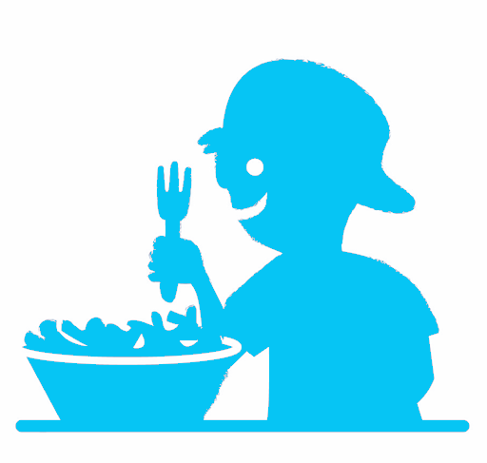
Selecting Recipes for
In-School Food Demonstrations
Identify viable recipes
  Limited set-up space, cooking equipment, and time
  Cost and availability
  Cooking skills
  Kid friendly
  Model healthful food choices
  & safe kitchen practices
Notes:
Then, we have an opportunity to experiment with the food and recipes for it. Keep these things in mind when discussing with school age workers if they would do food demos with kids

Slide 31
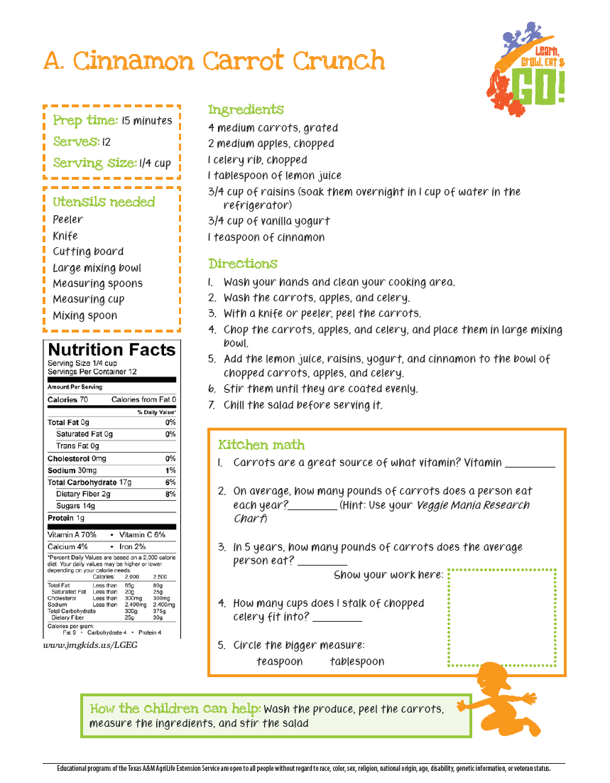
Garden
Kitchen
recipe
demos
http://jmgkids.us/garden-kitchen-recipe-demos/
Notes:
Here is an example of a recipe using the food the youth tested - This video shows –
LGEG Manual – EAT Section - 138 and beyond

Slide 32
Notes:
This is a way to see how much they learn –
LGEG Manual – pg. 139

Slide 33
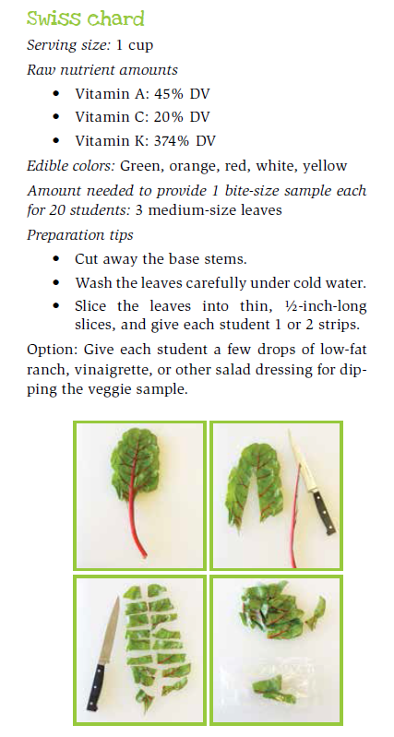
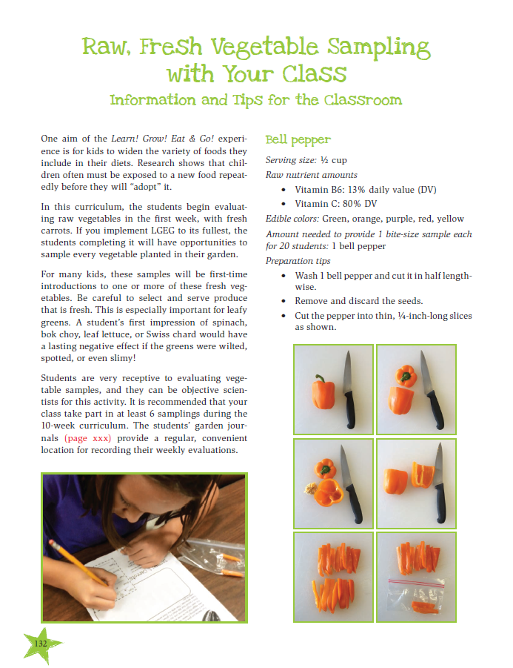

Notes:
In the EAT portion of the curriculum, there is information regarding how to do demos with youth (LGEG Manual, pg. 132); and much nutritive information about vegetables ( LGEG Manual – EAT Section, pgs. 133-137)

Slide 34



Notes:
An another example of the EAT Section – there are both English and Spanish instructions.
LGEG Manual, EAT, pg.143-144

Slide 35


Go Strong - Physical activities for school, classroom, and school age child care
Promotion of gardening physical activity components
State walking programs
Notes:
The benefits of physical activity are many and LGEG recognizes the importance of physical activity. Youth workers have noticed that brief physical activity , such as taking a quick walk or dancing to fun music, can yield such benefits as:
-settling a fidgety child or group of kids
-help youth to re-focus
-promote creativity
-re-energize
So, the curriculum has a GO section. It’s focus is on –
-physical activities
-promoting gardening and the physical activity components of gardening
-State walking programs
Let’s take a look -

Slide 36



GO Activities
Notes:
The weekly Go Strong activities are part of the Go Section of LGEG.

Slide 37


Go!
Notes:
Here are a couple of examples of Go Strong activities. In LGEG, we promote incorporating physical activity in this curriculum to support the high correlation between forming healthy habits and the amount of time spent being physically active. In addition, this tends to lead to increased academic performance, in the classroom and beyond.
Also, be sure to look for the research notes at the top of each page that highlight the benefits of physical activity.
LGEG Manual – pg. 161

Slide 38

Walk Across Nebraska
Notes:
One of the activities that Extension has promoted across the country is the “Walk Across…” programs. This is a good way to promote physical activity and can be easily adapted to the LGEG program.

Slide 39



Walk Across……
Program Goal: “Helping people of all ages establish the habit of regular physical activity since 1996”
Fun, motivating way to become active and get moving!
All it takes is people willing to get physically active!
Goal: Each team, individual, or classroom will walk(log miles) across Texas= 833 MILES!
Notes:
Texas, a huge partner is this endeavor, also has a walking program. You might check to see if your State Extension is involved with a “Walk Across…” program your state.

Slide 40
CURRICULUM DESIGN
10 weeks,
2 lessons/week
Sequence, integration,
pace, & flexibility
Notes:
We have just reviewed the components of this curriculum – Learn, Grow, Eat, and Go. Let’s return to the Learn portion to take a more in-depth look and review the lessons and activities. These lessons were developed to be –
-Sequential – build upon the information and activities of each lesson
-Integrated – with science, math, health, language arts, and social studies
-Paced and Flexible – for your use, your needs, and the youth

Slide 41

Start WAT!
Notes:
This is the base curriculum for 10 weeks. As you can see, there are 2 lessons

Slide 42

Notes:
*Handout – Also relates to Pg. vii – Base Curriculum in LGEG Manual. Shows the Grow, Eat, and Go activities with an added 8 week walking program.

Slide 43
Weeks 1-10
Lesson
Overview

Slide 44




Know & Show Sombrero 45 mins
5 Senses Food 30 mins
Notes:
Here are the 2 lessons for Week 1. Know and Show Sombrero is the first lesson.
5 Senses Food is the other lesson in Week 1. Using the 5 senses, describe a strawberry (or other favorite food).

Slide 45



Plants need P.L.A.N.T.S.
P
L
A
N
T
S
lace
ight
ir
utrients
hirsty
oil
Notes:
LGEG Manual – pg. 24
Do know and show sombrero with participants. This is a lesson on what is needed for a plant to stay alive. The activity is in the Leader’s Guide.
Tell participants that there is an easy way to recall what a plants need to stay alive – P.L.A.N.T.
Newspaper
Tape
Craft materials
Note to trainer – you might do the activity, but if not enough time, then explain the activity. Have a sombrero example.

Slide 46




Notes:
Week 2 – The 2 lessons are Plant Parts We Eat and Nutrients to Grow. Let’s discuss Plant Parts We Eat – LGEG Manual, pg 10-14.
Read book Tops and Bottoms (included in your training kit) and discuss questions.

Slide 47

Notes:
This table shows the food and plant parts that are edible. The Plant Parts Web activity goes along with this and helps youth understand the parts of plants.

Slide 48



Notes:
Week 3 – goes along with the GROW section of the LGEG curriculum. This lessons help youth to understand how to plan a garden. The first activity, Don’t Crowd Me uses units of measure to plan the use of garden space. LGEG provides support for growing any 6 crops of the list (pg. 20) of 12 veggies.

Slide 49


Notes:
Paper Toweling Gardening is the 2nd lesson. In this activity, planting templates are created into provide adequate space for plants to grow.

Slide 50


How close together do we
plant seeds?
Notes:
The activity uses carrot seeds.

Slide 51





Notes:
In the template, there is 1 seed per square with glue. When dry, you can lay these on the ground in a garden area.

Slide 52



Local
Extension
support
provide
info on
your local
planting
dates
Notes:
On LGEG Manual pg. 27, there is a garden planning chart to provide the information for all crops.

Slide 53


Notes:
Week 4 focuses on what is a good garden site, and to introduce the nutrition and food classification guide MyPlate.
Home Sweet Home (pg. 28-31) is an activity that begins with reading the book, A Place to Grow (included in the training kit

Slide 54


Notes:
). Proceed to evaluate aspects of a good garden site and home from seeds and plants.
Taking It Further is a feature of all lessons.

Slide 55

Soon after students evaluate & select the location in the Home Sweet Home lesson, the garden can be built.
Notes:
With the garden site emphasis of this lesson, this is a great time to segway to the GROW section of LGEG. You can begin to see how all of these work together.

Slide 56






Notes:
The next lesson of Week 4 is Balloon Hot Potato (pg. 33-37) and focuses on what they would grow in a garden as crops and how to classify them. This introduces MyPlate. The activity with the Great MyPlate Debate Cards is used with this.

Slide 57


Notes:
Week 5 allows classrooms to brainstorm garden rules to make it a safer place for plants and people as well as a schedule for the classroom team as to who is responsible for what in the garden. This maintenance schedule is very important to the garden. Some of the duties on the schedule include watering, weeding and fertilizing. Students will be active in scheduling this care on a shared calendar. The calendar can serve as a visual reminder of what needs to be done and by whom.
The objectives are -
1.Recognized and solve problems by planning and assigning garden responsibilities.
2. Establish routines and rules for safety
Teachers and youth workers can guide students in discussions to problem solve; Will the garden need daily care? How often will the garden need to be watered? How can you tell a plan needs water? Show students how to water plants slowly at the base of the stem. Show students how to pull weeds by the base to remove the root and the weed. Talk about following label directions for fertilizing/feeding plants, as too much is not always a good thing.
This is a good time to discuss the source for water for your garden.

Slide 58


Notes:
Lesson 5 also teaches the importance of meeting our plant’s needs in our gardens, and emphasizes the need to plan our meals to ensure our nutrition needs are being met. This simple Choose My Plate activity reinforces the importance of incorporating foods from each category of My Plate, and in the right amounts. The lesson also touches on the benefits we get from the different food groups. To extend the activity, students can collect data from their school lunches to determine if the meals served are meeting all the My Plate components each day.
Activity: designing my plate
MATERIALS:
1 large paper plate per student
1 small paper plate per student
Crayons or markers

Slide 59


Notes:
Week 6 lessons focus on learning nutritional benefits of vegetables and the idea of Go, Slow, and Whoa foods.

Slide 60



nutrient stone:
Class makes 3 different stones for each crop growing:
label stone:
benefit stone:
Notes:
In this 1st lesson of Week 6 (LGEG Manual, pg 46-48), art is used to be in the garden to depict the importance and value of vegetables. These are stones that can be put in the garden.

Slide 61

nutrient stone:
a Quick & Easy
option to stones/paint:
Use stir sticks and
permanent markers
Class makes 3 different stones for each crop growing:
label stone:
benefit stone:
Notes:
Or…you could use stir sticks and markers.
After pg. 48, there is a chart of Veggie Research Data that provides all kinds of important information about vegetables!

Slide 62

Evaluate foods and classify based on amounts of:
unhealthy fats, added sugars, and salt
Whoa foods – contain the most
Go foods – contain the least
Notes:
LGEG Manual – pg. 54 helps youth to understand the classifying of foods, but also to evaluate on amounts of fasts, sugars, and salt.
Go foods would contain the least, and Whoa foods contain the most.

Slide 63

Classification charts included to illustrate
how foods are classified
Notes:
This shows what might be Go, Slow, and Whoa foods in the food groups. This also give an example of a meal (Big, Cheesy Kids Meal – pg. 57) that has all the food groups, but could be healhier.

Slide 64



Notes:
Week 7’s focus is to plan healthy meals. Both activities for this week are comprised of discussion about healthy foods and meals

Slide 65



Notes:
. This activity gives them the opportunity to draw up a shopping list of fruits and vegetables they would like to eat for a whole week. This planning worksheet can be used.

Slide 66



GO = 0
Notes:
The 2nd activity, 1-Week Dinner Tracker provides the opportunity to the youth to learn about menu planning – instructions on LGEG Manual pg.63-66)

Slide 67




Notes:
Week 8’s Objectives are:
-Predict the produce that will be the most desirable based on appearance, and correlate the findings with blind taste tests.
-Develop an appreciation for unfamiliar foods
The activity, Fruity Beauty and Blind Taste Test
Supplies:
-Large board for writing and a marker
-3 varieties of apples for judging by appearance
-Same 3 varieties of apples Peeled, and cut into bite size pieces for tasting
-Toothpicks
-6 plates
-3 index cards numbered 1,2 & 3
-3 index cards labeled A, B, & C
-1 copy for each student : Fruity Beauty and Blind Taste Test graph (page 73) , notebook paper and crayons

Slide 68





Notes:
This literature connection activity will guide discussion about what leads people to try different or unfamiliar foods. The guided questions are there to encourage youth to use passages from the book to support their answers.
Teachers will encourage youth to try new foods and to celebrate their adventurous taste buds.
The Tasty Unknown Food Chain will help them see how many new foods the class will sample as well as serve as a special record of what they all try. Youth can be encouraged to set goals as a group as to how many new foods they think they could try as a whole.

Slide 69




Notes:
Week 9 begins the journey to understand where food comes from and to observe both positive and negative effects of food choices. In this activity, the book Two Old Potatoes (in your training kit) starts the discussion on potatoes – where they originated, can old, wrinkled potatoes be planted and grow, and their history. Students can be explorers and learn about potato geography.

Slide 70



Notes:
This activity, goes on to explore both positive and negative effects of food choices, again using the potato and comparing the different ways to make a potato to be eaten.

Slide 71






meat/protein =3 ounces
grains = ½ cup
vegetables = ½ cup
fruits ½ cup
dairy = 1 cup
Notes:
Week 10 features learning about portion size and menu makeover (with a picky eater in mind)
This activity, Kitchen Cotton Quantity Conversion shows youth, using items such a deck of cards, a small paperback book, and eraser, to illustrate portion sizes of food. You can also use the cotton ball conversion (pg 94-96). Lastly, do the Perfect Portion Scavenger Hunt (pg.97).

Slide 72






Notes:
Start by reading the book, I Will Not Ever Never Eat a Tomato, then ask questions about trying new foods (pg. 98-101). Youth can then break down into small groups to create posters to ‘advertise’ a certain vegetable (Use the Veggie Research Data chart – pg. 50-53) to create the ad.

Slide 73

The LGEG Curriculum:
Youth Leaders
Empower implementers to make the LGEG curriculum their own
  Remember….. 10 overarching teaching Concepts
  2 hands-on lessons per Concept
  GO Strong class exercise activities per Concept
  Concepts are implemented in sequence
  Some may prefer to spread lessons over a week or even a
  month (if its used in a Club setting), others may choose to
  do them all at once
  There is no right or wrong way to implement
Notes:
Now, we will transition into what you need to start training, and what we need from you for the CYTTAP project.

Slide 74
Next Steps

Slide 75
Resources for Youth Worker

Slide 76
CYTTAP Training Kit
Instructor Resources Website
CYTTAP Registration Website
  Class registration
  Roster
  Instructor agreement
Notes:
Welcome to Learn, Grow, Eat and Go! This curriculum, LGEG for short, is a 10-week unit of study that is hands-on, multifaceted, and academically rich. LGEG was developed for a research project in which Texas A& M Agrilife Extension contributed and is a part of the International Junior Master Gardener Curriculum. This research project helped to support a significant body of research showing the relationship between improving school performance, attendance, attachment and commitment, and the development of pro-social skills and leadership capacity related to increased physical activity and improved opportunities for project-based, hands-on or real life learning. LGEG is focused on getting children to participate in activities where they can learn important science, math and language arts concepts and at the same time be more physically active, improve healthy eating habits and have fun. LGEG activities promote leadership and responsibility in children and, according to teacher surveys, have improved classroom participation. It is comprised of 20 lessons which also feature food exposures, gardening, and physical activities.
LGEG is a part of the Junior Master Gardener Program (JMG). JMG is an innovative 4-H gardening program developed by Texas A&M Agrilife Extension
We think using LGEG in after school programming is a great way to utilize this curriculum.
Optional –
National On-line Survey for Leaders Conducted by Texas A&M University Department of Agricultural Education and National JMG Program Office
Over 85% of respondents stated that
JMG has increased youth interest in science
Over 83% of respondents stated JMG has
contributed to higher academic standards
Over 85% of respondents said JMG youths were
more enthusiastic about learning

Slide 77
CYTTAP Training Kit
Notes:
First, we have provided to you a LGEG Trainer’s Package. As we have gone through the lesson, we have utilized most of the parts. But let’s take a look at it again

Slide 78
Instructor Resources Website
http://child.unl.edu/instructor-resources
CYTTAP Registration Website
http://extension.psu.edu/youth/cyttap
Notes:
Welcome to Learn, Grow, Eat and Go! This curriculum, LGEG for short, is a 10-week unit of study that is hands-on, multifaceted, and academically rich. LGEG was developed for a research project in which Texas A& M Agrilife Extension contributed and is a part of the International Junior Master Gardener Curriculum. This research project helped to support a significant body of research showing the relationship between improving school performance, attendance, attachment and commitment, and the development of pro-social skills and leadership capacity related to increased physical activity and improved opportunities for project-based, hands-on or real life learning. LGEG is focused on getting children to participate in activities where they can learn important science, math and language arts concepts and at the same time be more physically active, improve healthy eating habits and have fun. LGEG activities promote leadership and responsibility in children and, according to teacher surveys, have improved classroom participation. It is comprised of 20 lessons which also feature food exposures, gardening, and physical activities.
LGEG is a part of the Junior Master Gardener Program (JMG). JMG is an innovative 4-H gardening program developed by Texas A&M Agrilife Extension
We think using LGEG in after school programming is a great way to utilize this curriculum.
Optional –
National On-line Survey for Leaders Conducted by Texas A&M University Department of Agricultural Education and National JMG Program Office
Over 85% of respondents stated that
JMG has increased youth interest in science
Over 83% of respondents stated JMG has
contributed to higher academic standards
Over 85% of respondents said JMG youths were
more enthusiastic about learning

Slide 79

Train youth workers with these provided resources
Notes:
Will include – LGEG Manual, children’s books, 15 garden journals, 15 kitchen recipe books.

Slide 80
Website Support
  Videos:
  Vegetable harvest and lifecycle
  Shopping for and preparing vegetables
  How to build raised beds and container gardens
  What’s For Snack
  Recipe demonstrations (linked to Dinner Tonight)
  Publications:
  Easy Gardening Series
  Vegetable Varieties and Planting Timelines
  Recipes
  Nutrient Information
  Child Activities
http://jmgkids.us/LGEG
Notes:
Web Support from Junior Master Gardener website

Slide 81









Marketing
Tools
LGEG Marketing Folders
LGEG Banner
TEKS/ STAAR Correlations
TGEG Infographic
LGEG
Website

Slide 82


Notes:
Pre-test

Slide 83


Notes:
Post - test

Slide 84

Register your class for free!

Slide 85


Slide 86
Questions?
Thank you!

